Slide 1
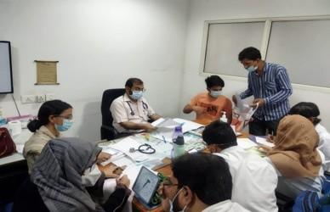
JAMIA HAMDARD
(Deemed to be University)
Hamdard Nagar, New Delhi-110062
GeoTag Pictures
7.3.1:Unani hospital
Latitude: 28.305636
Longitude: 77.153899
UNANI HOSPITAL
JAMIA HAMDARD

Slide 2
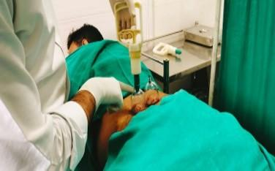
JAMIA HAMDARD
(Deemed to be University)
Hamdard Nagar, New Delhi-110062
7.3.1: cupping therapy in Unani Hospital
Latitude: 28.304978
Longitude: 77.153640
Cupping therapy in Unani Hospital
JAMIA HAMDARD

Slide 3
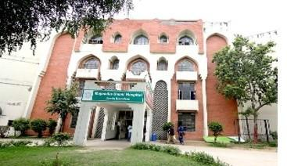
JAMIA HAMDARD
(Deemed to be University)
Hamdard Nagar, New Delhi-110062
7.3.1: Hamdard Unani Hospital
Hamdard Unani hospital
JAMIA HAMDARD

Slide 4
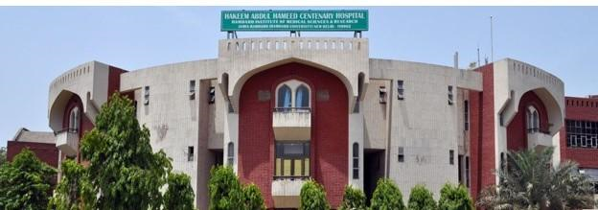
JAMIA HAMDARD
(Deemed to be University)
Hamdard Nagar, New Delhi-110062
7.3.1 HAHC Hospital
Latitude: 28.305436
Longitude: 77.158159
HAHC Hospital
JAMIA HAMDARD

Slide 5
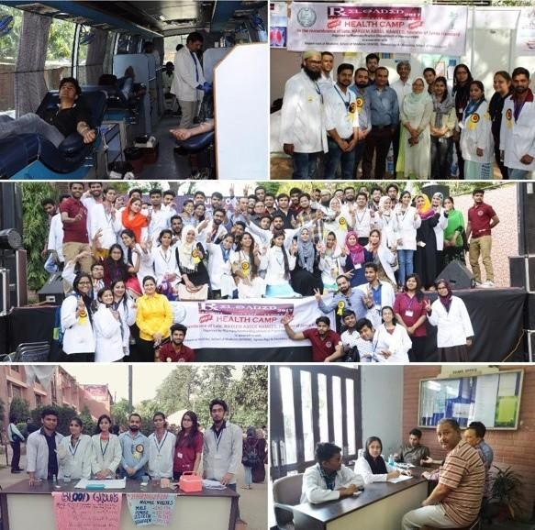
JAMIA HAMDARD
(Deemed to be University)
Hamdard Nagar, New Delhi-110062
7.3.1: HEALTH CAMP SPER
Latitude: 28.304819
Longitude: 77.145499
HEALTH CAMP SPER
JAMIA HAMDARD

Slide 6
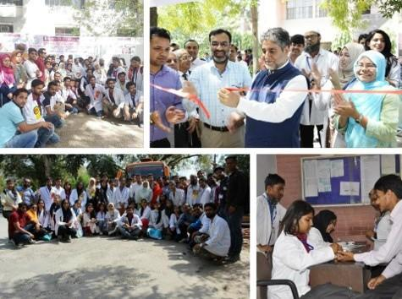
JAMIA HAMDARD
(Deemed to be University)
Hamdard Nagar, New Delhi-110062
7.3.1: Photo gallery of SPER
Latitude: 28.305175
Longitude: 77.151679
PHOTO GALLERY OF SPER
JAMIA HAMDARD

Slide 7
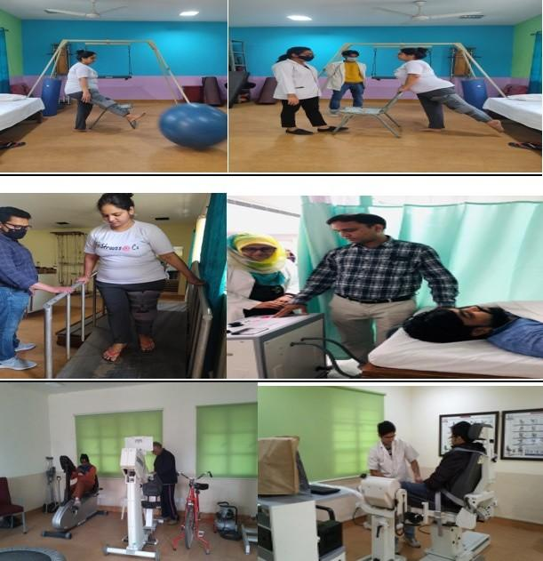
JAMIA HAMDARD
(Deemed to be University)
Hamdard Nagar, New Delhi-110062
7.3.1:Rehabilitation Department
Latitude: 28.305469
Longitude: 77.145954
Rehabilitation Department
JAMIA HAMDARD

Slide 8
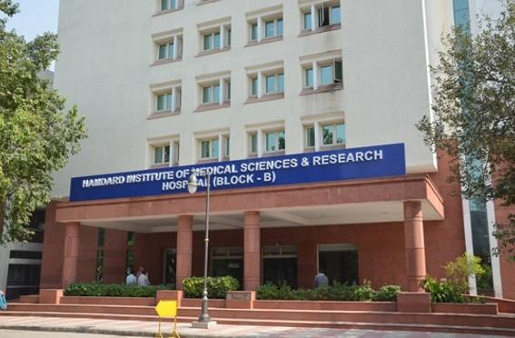
JAMIA HAMDARD
(Deemed to be University)
Hamdard Nagar, New Delhi-110062
7.3.1: Hamdard Institute of Medical Sciences
Latitude: 28.304983
Longitude: 77.151016
Hamdard institute of Medical Sciences(HIMSR)
JAMIA HAMDARD

Slide 9
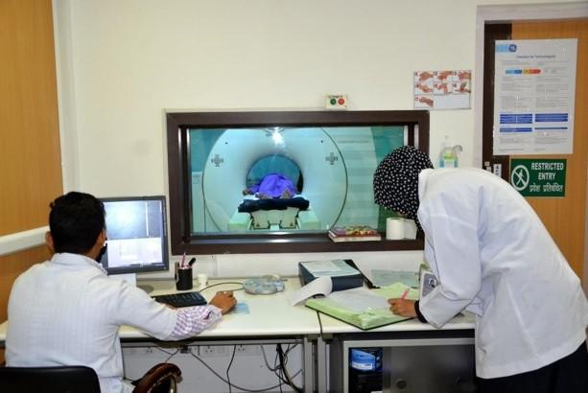
JAMIA HAMDARD
(Deemed to be University)
Hamdard Nagar, New Delhi-110062
7.3.1: Hamdard imaging center
Latitude: 28.3051750
Longitude: 77.151679
HIMSR IMAGING CENTER
JAMIA HAMDARD

