Slide 1
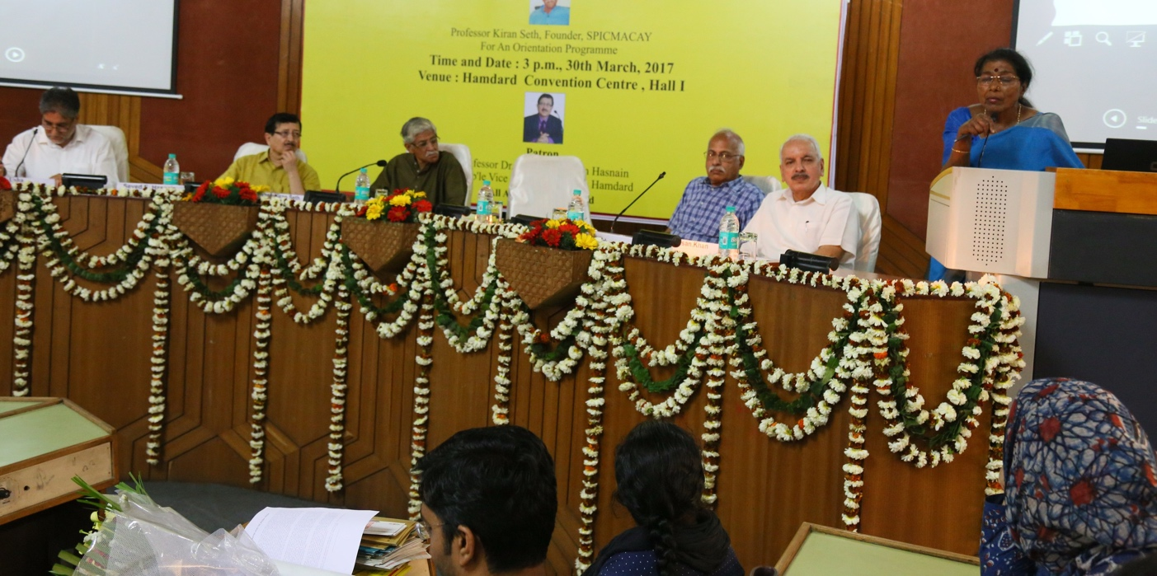
JAMIA HAMDARD
(Deemed to be University)
Hamdard Nagar, New Delhi-110062
7.1.8. Institutional efforts/initiatives in providing an inclusive environment
GeoTag Pictures
Latitude: 28.30590
Longitude: 77.15821
30TH MARCH 2017: JAMIA HAMDARD INITIATED SPIC MACAY CHAPTER AT HAMDARD CONVENTION CENTRE

Slide 2
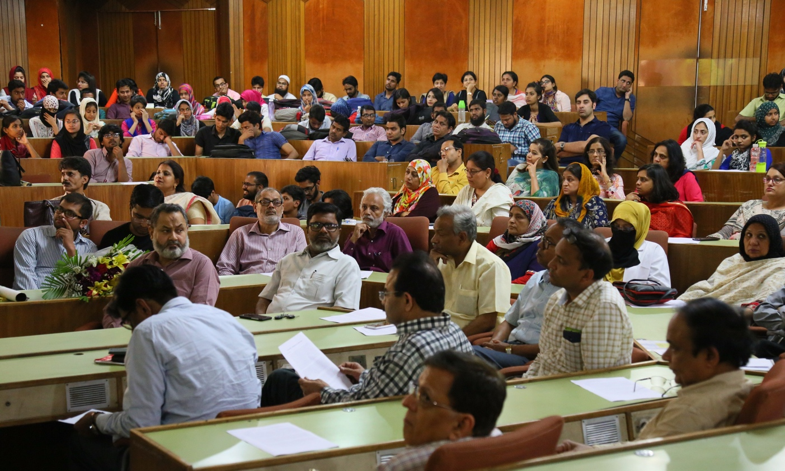
JAMIA HAMDARD
(Deemed to be University)
Hamdard Nagar, New Delhi-110062
7.1.8. Institutional efforts/initiatives in providing an inclusive environment
Latitude: 28.30590
Longitude: 77.15821
30TH MARCH 2017: JAMIA HAMDARD INITIATED SPIC MACAY CHAPTER AT HAMDARD CONVENTION

Slide 3
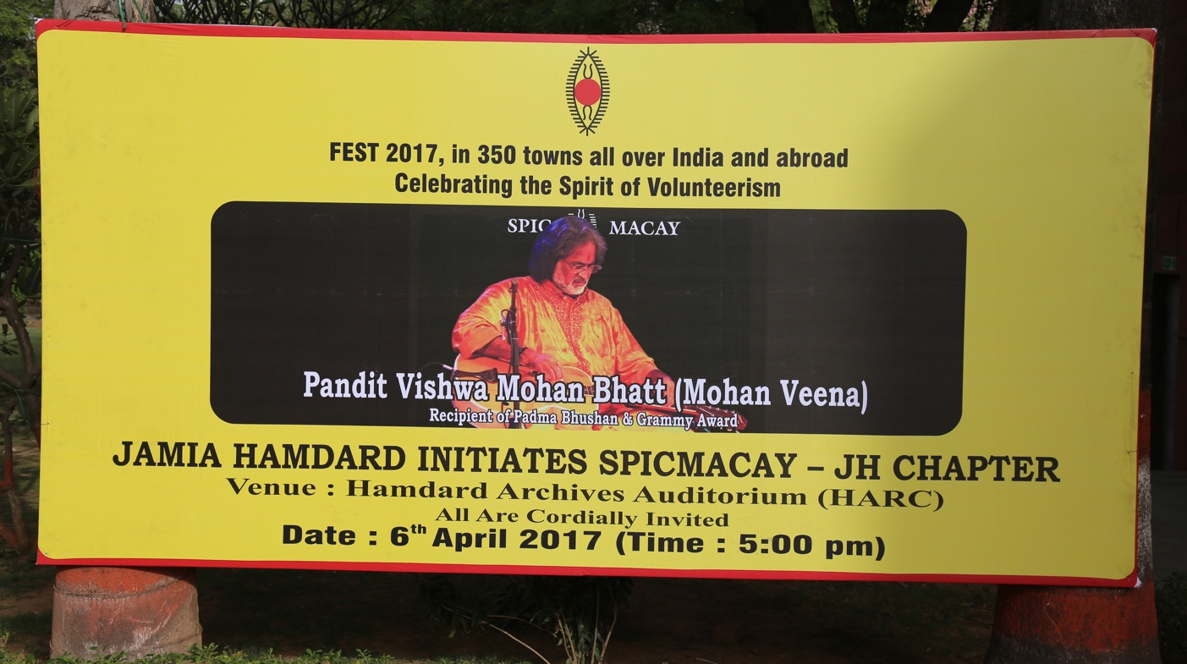
JAMIA HAMDARD
(Deemed to be University)
Hamdard Nagar, New Delhi-110062
7.1.8. Institutional efforts/initiatives in providing an inclusive environment
Latitude:28.31461
Longitude:77.15464
APRIL 6, 2017: CULTURAL EVENING WITH PANDIT VISHWA MOHAN BHATT AT HAMDARD ARCHIVES AUDITORIUM (HARC)

Slide 4
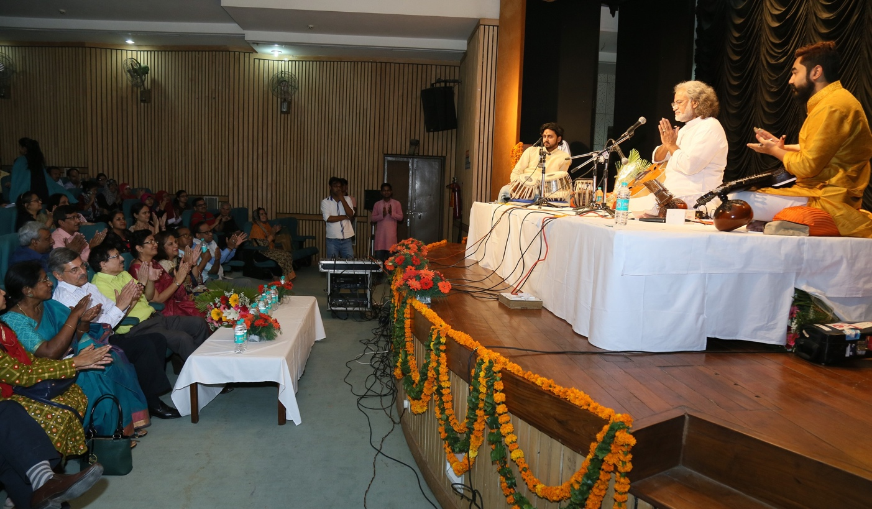
JAMIA HAMDARD
(Deemed to be University)
Hamdard Nagar, New Delhi-110062
7.1.8. Institutional efforts/initiatives in providing an inclusive environment
Latitude: 28.31461
Longitude: 77.15464
APRIL 6, 2017: CULTURAL EVENING WITH PANDIT VISHWA MOHAN BHATT AT HAMDARD ARCHIVES AUDITORIUM (HARC)

Slide 5
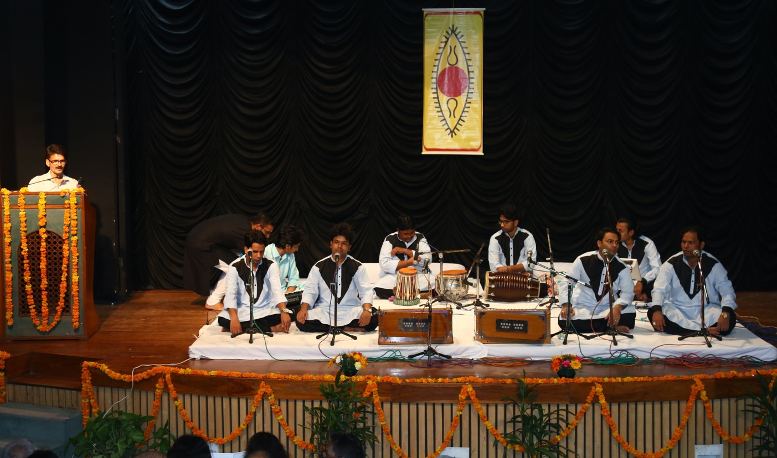
JAMIA HAMDARD
(Deemed to be University)
Hamdard Nagar, New Delhi-110062
7.1.8. Institutional efforts/initiatives in providing an inclusive environment
Latitude 28.31461
Longitude: 77.15464
CULTURAL EVENING WITH NIZAMI BROTHERS VENUE: HAMDARD ARCHIVES AUDITORIUM

Slide 6
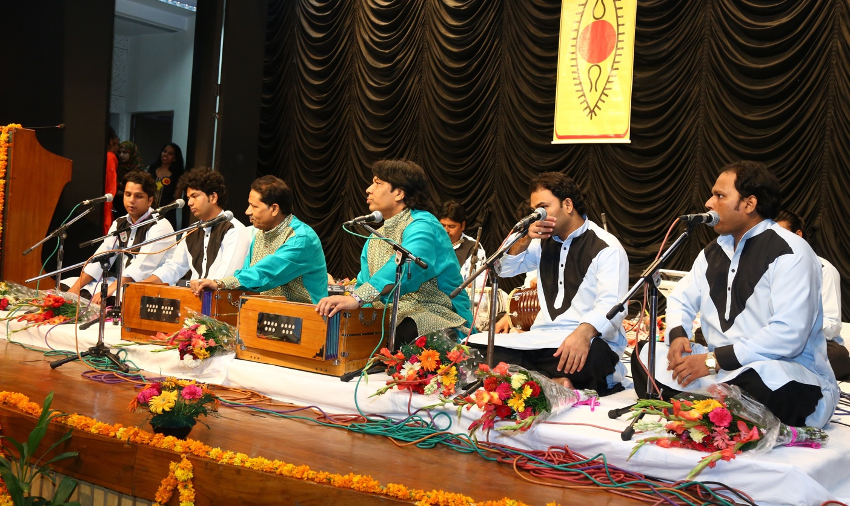
JAMIA HAMDARD
(Deemed to be University)
Hamdard Nagar, New Delhi-110062
7.1.8. Institutional efforts/initiatives in providing an inclusive environment
Latitude: 28.31461
Longitude: 77.15464
CULTURAL EVENING WITH NIZAMI BROTHERS VENUE: HAMDARD ARCHIVES AUDITORIUM

Slide 7
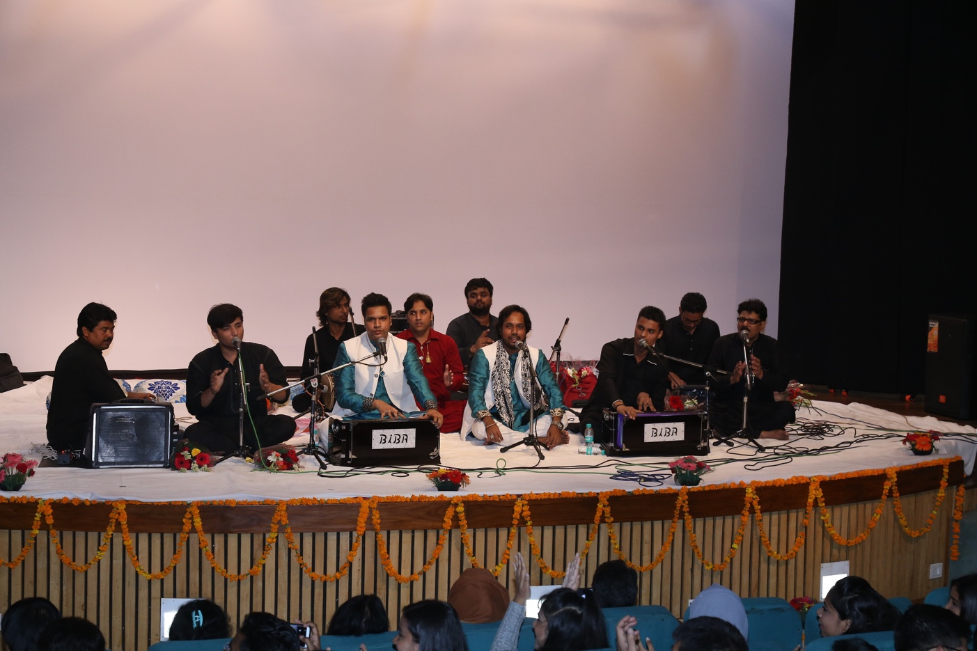
JAMIA HAMDARD
(Deemed to be University)
Hamdard Nagar, New Delhi-110062
7.1.8. Institutional efforts/initiatives in providing an inclusive environment
Latitude: 28.31461
Longitude: 77.15464
CULTURAL EVENING VENUE: ARCHIVES AUDITORIUM

Slide 8
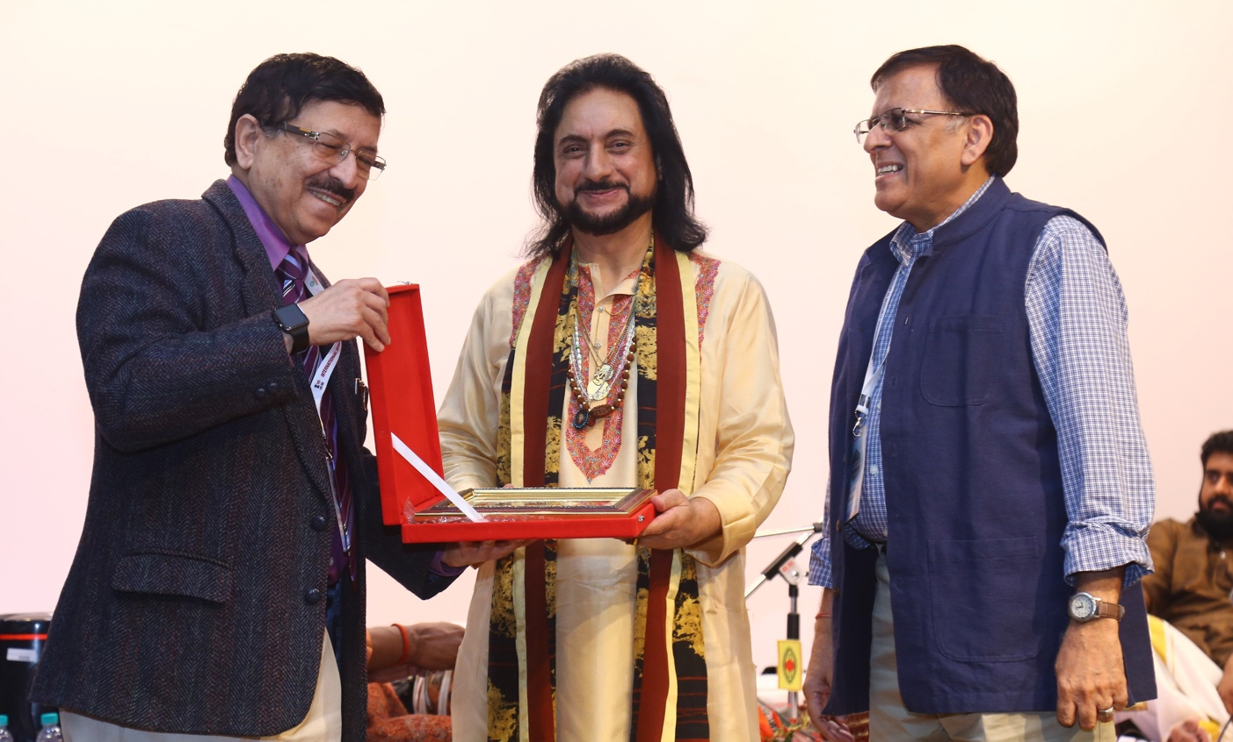
JAMIA HAMDARD
(Deemed to be University)
Hamdard Nagar, New Delhi-110062
7.1.8. Institutional efforts/initiatives in providing an inclusive environment
Latitude: 28.31461
Longitude: 77.15464
NOVEMBER 13, 2018: SANTOOR RECITAL WITH PANDIT BHAJAN SOPORI JI AT ARCHIVES AUDITORIUM

Slide 9
JAMIA HAMDARD
(Deemed to be University)
Hamdard Nagar, New Delhi-110062
7.1.8. Institutional efforts/initiatives in providing an inclusive environment
Latitude: 28.30590
Longitude: 77.15821
NOVEMBER 10, 2021: NATIONAL EDUCATION DAY CELEBRATION

Slide 10
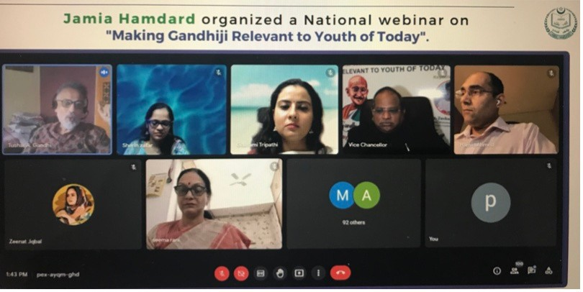
JAMIA HAMDARD
(Deemed to be University)
Hamdard Nagar, New Delhi-110062
7.1.8. Institutional efforts/initiatives in providing an inclusive environment
Latitude: 28.31252
Longitude: 77.15885
OCTOBER 2, 2021: GANDHI JAYANTI CELEBRATION

Slide 11
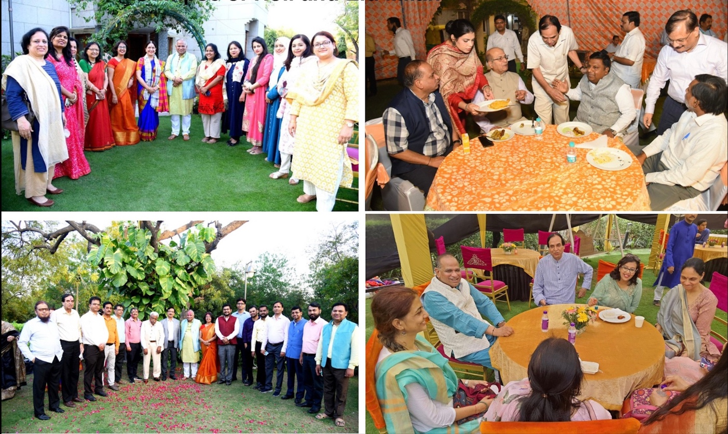
JAMIA HAMDARD
(Deemed to be University)
Hamdard Nagar, New Delhi-110062
7.1.8. Institutional efforts/initiatives in providing an inclusive environment
Latitude: 28.30592
Longitude: 77.15104
EID AND HOLI MILAN

Slide 12
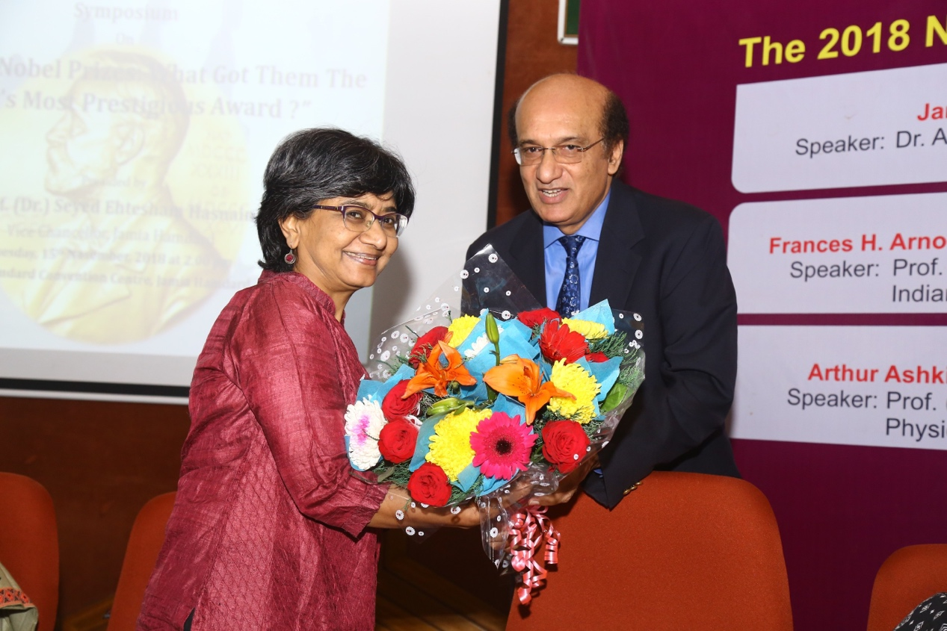
JAMIA HAMDARD
(Deemed to be University)
Hamdard Nagar, New Delhi-110062
7.1.8. Institutional efforts/initiatives in providing an inclusive environment
Latitude: 28.30592
Longitude: 77.15104
NOVEMBER 15, 2018: NOBLE PRIZE SYMPOSIUM

Slide 13
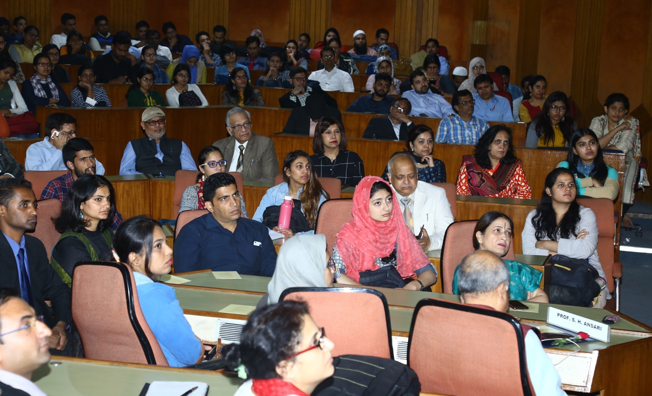
JAMIA HAMDARD
(Deemed to be University)
Hamdard Nagar, New Delhi-110062
7.1.8. Institutional efforts/initiatives in providing an inclusive environment
Latitude: 28.30592
Longitude: 77.15104
NOVEMBER 15, 2018: NOBLE PRIZE SYMPOSIUM

Slide 14
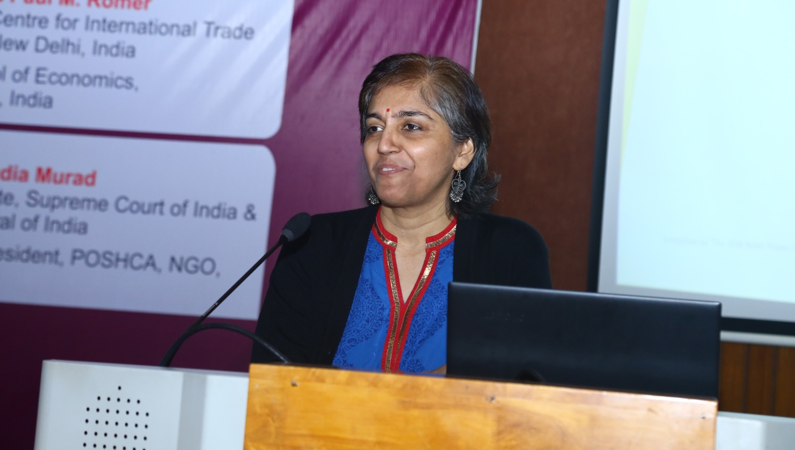
JAMIA HAMDARD
(Deemed to be University)
Hamdard Nagar, New Delhi-110062
7.1.8. Institutional efforts/initiatives in providing an inclusive environment
Latitude: 28.30592
Longitude: 77.15104
NOVEMBER 15, 2018: NOBLE PRIZE SYMPOSIUM

Slide 15
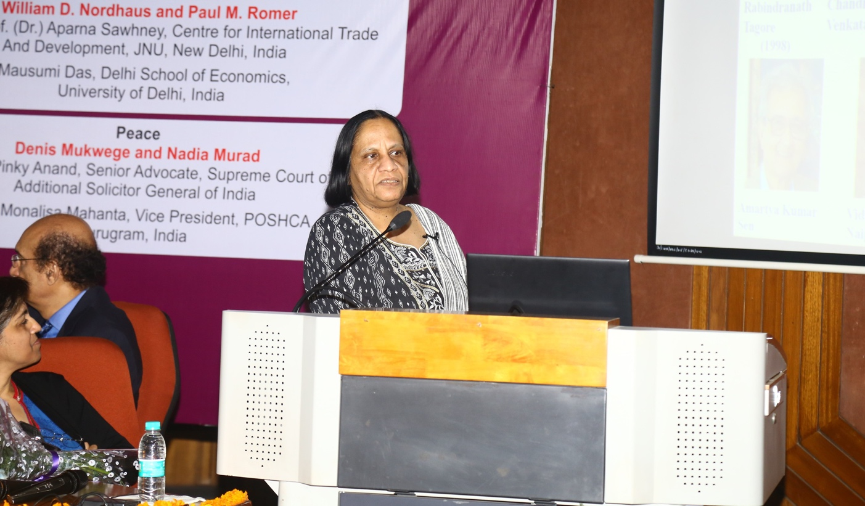
JAMIA HAMDARD
(Deemed to be University)
Hamdard Nagar, New Delhi-110062
7.1.8. Institutional efforts/initiatives in providing an inclusive environment
Latitude: 28.30592
Longitude: 77.15104
NOVEMBER 15, 2018: NOBLE PRIZE SYMPOSIUM

Slide 16
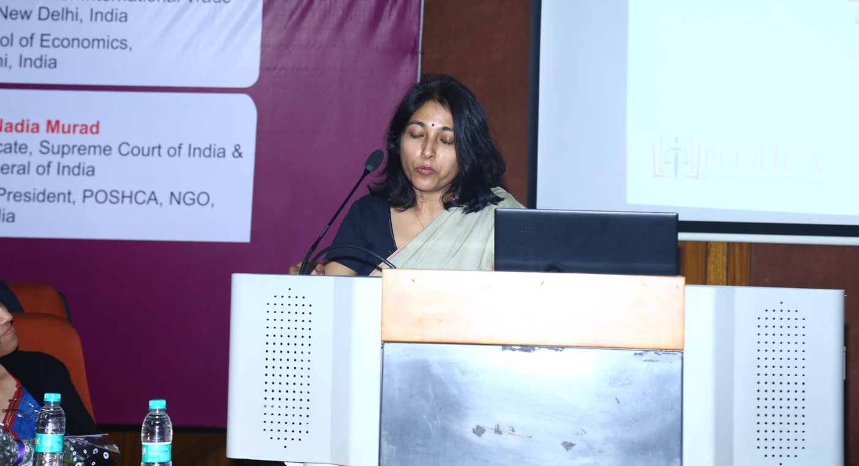
JAMIA HAMDARD
(Deemed to be University)
Hamdard Nagar, New Delhi-110062
7.1.8. Institutional efforts/initiatives in providing an inclusive environment
Latitude: 28.30592
Longitude: 77.15104
NOVEMBER 15, 2018: NOBLE PRIZE SYMPOSIUM

Slide 17
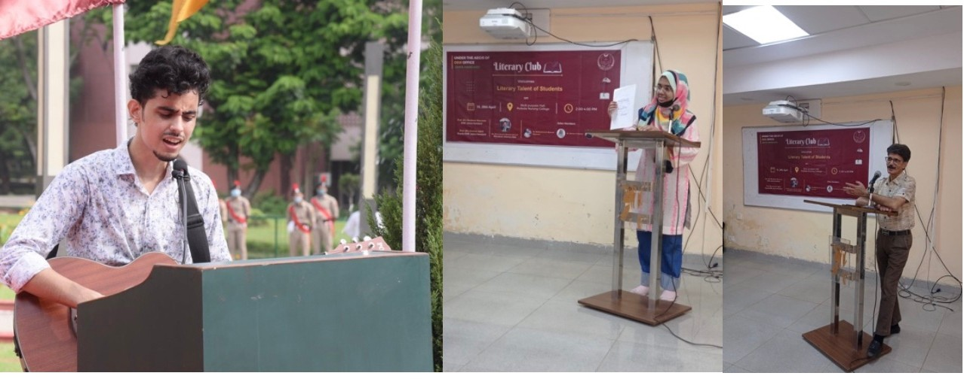
JAMIA HAMDARD
(Deemed to be University)
Hamdard Nagar, New Delhi-110062
7.1.8. Institutional efforts/initiatives in providing an inclusive environment
Latitude: 28.30487
Longitude: 77.15258
LITERARY AND CULTURAL PROGRAMME

