Slide 1
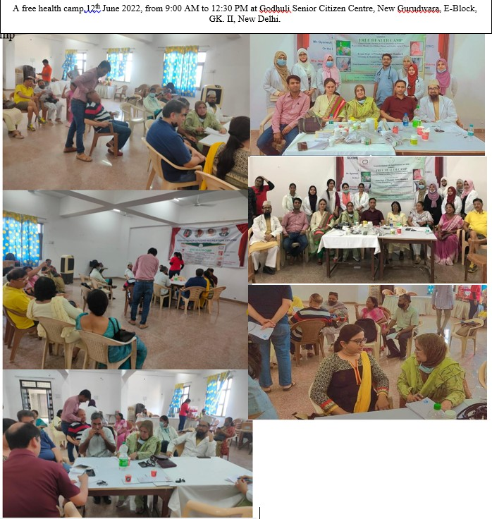
JAMIA HAMDARD
(Deemed to be University)
Hamdard Nagar, New Delhi-110062
7.1 Measures initiated by the Institution for the promotion of gender equity
GeoTag Pictures
Latitude: 28.32308
Longitude: 77.172400

Slide 2
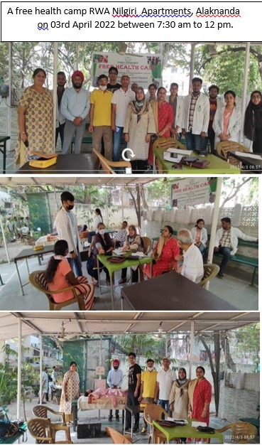
JAMIA HAMDARD
(Deemed to be University)
Hamdard Nagar, New Delhi-110062
7.1 Measures initiated by the Institution for the promotion of gender equity
Latitude: 28.31143
Longitude: 77.15242

Slide 3
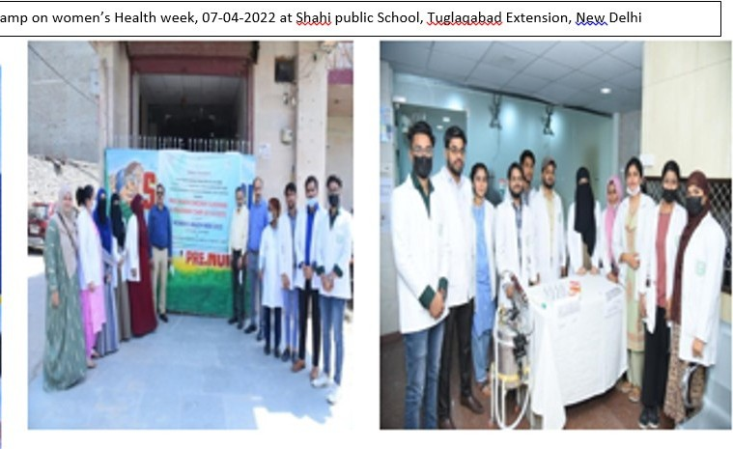
JAMIA HAMDARD
(Deemed to be University)
Hamdard Nagar, New Delhi-110062
7.1 Measures initiated by the Institution for the promotion of gender equity
Latitude: 28.31143
Longitude: 77.15242

Slide 4
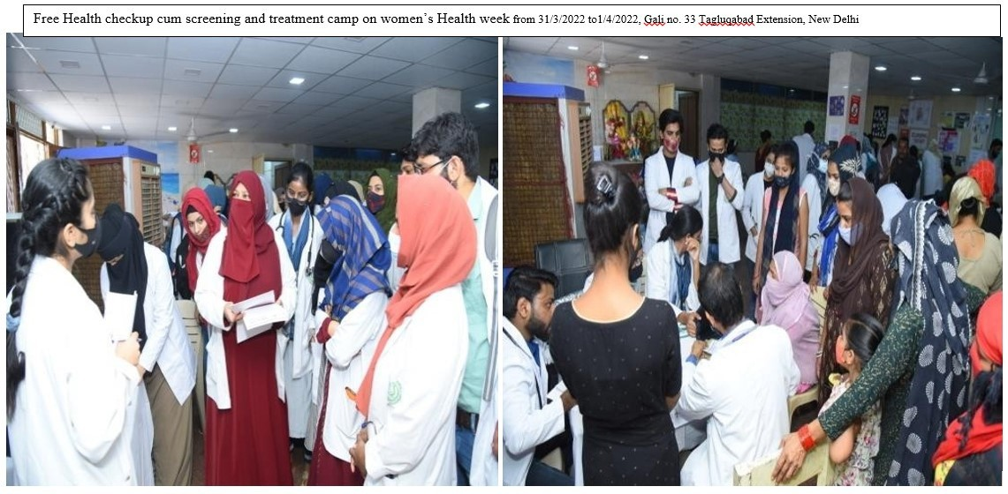
JAMIA HAMDARD
(Deemed to be University)
Hamdard Nagar, New Delhi-110062
7.1 Measures initiated by the Institution for the promotion of gender equity
Latitude: 28.30495
Longitude: 77.15515

Slide 5
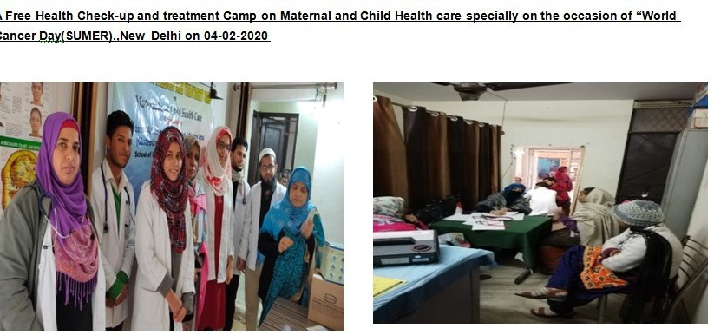
JAMIA HAMDARD
(Deemed to be University)
Hamdard Nagar, New Delhi-110062
7.1 Measures initiated by the Institution for the promotion of gender equity
Latitude: 28.30563
Longitude: 77.15309

Slide 6
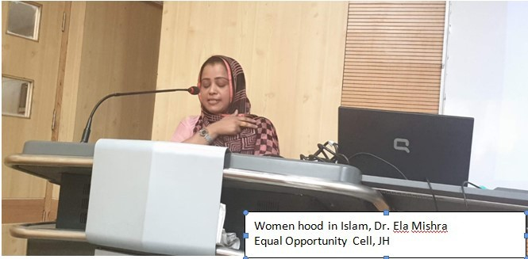
JAMIA HAMDARD
(Deemed to be University)
Hamdard Nagar, New Delhi-110062
7.1 Measures initiated by the Institution for the promotion of gender equity
Latitude: 28.30563
Longitude: 77.15309

Slide 7
JAMIA HAMDARD
(Deemed to be University)
Hamdard Nagar, New Delhi-110062
7.1 Measures initiated by the Institution for the promotion of gender equity
Latitude: 28.30563
Longitude: 77.15309

Slide 8
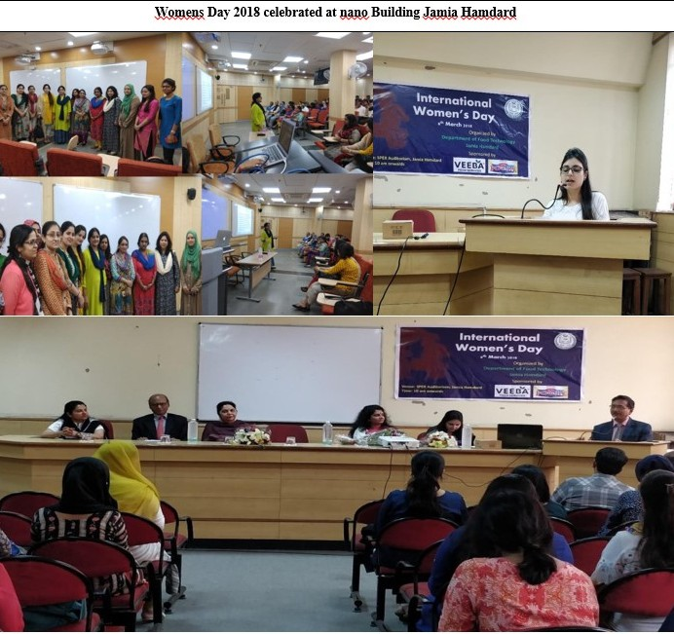
JAMIA HAMDARD
(Deemed to be University)
Hamdard Nagar, New Delhi-110062
7.1 Measures initiated by the Institution for the promotion of gender equity
Latitude: 28.30563
Longitude: 77.15309

Slide 9
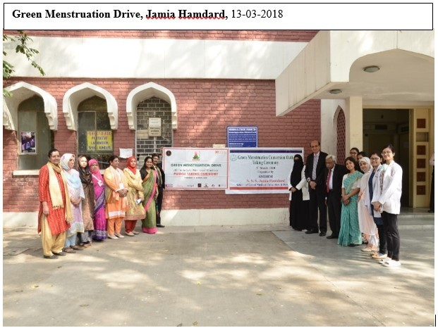
JAMIA HAMDARD
(Deemed to be University)
Hamdard Nagar, New Delhi-110062
7.1 Measures initiated by the Institution for the promotion of gender equity
Latitude: 28.30563
Longitude: 77.15309

Slide 10
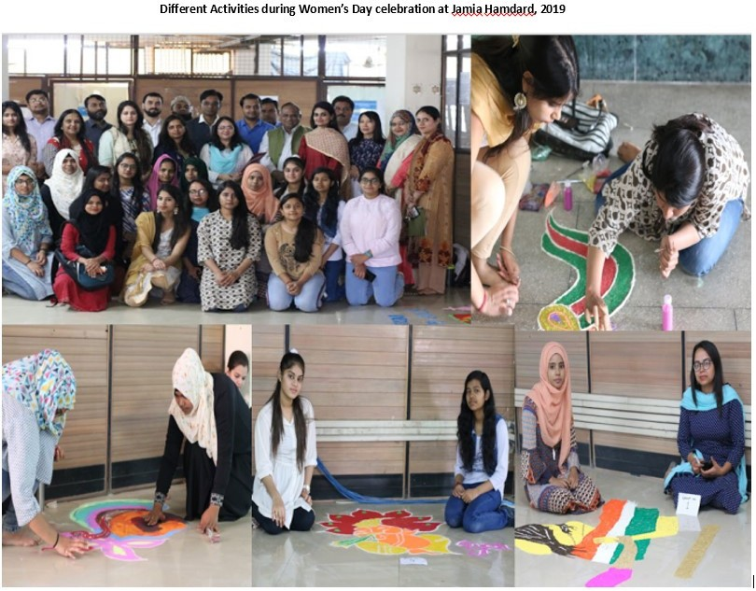
JAMIA HAMDARD
(Deemed to be University)
Hamdard Nagar, New Delhi-110062
7.1 Measures initiated by the Institution for the promotion of gender equity
Latitude: 28.30563
Longitude: 77.15309

Slide 11
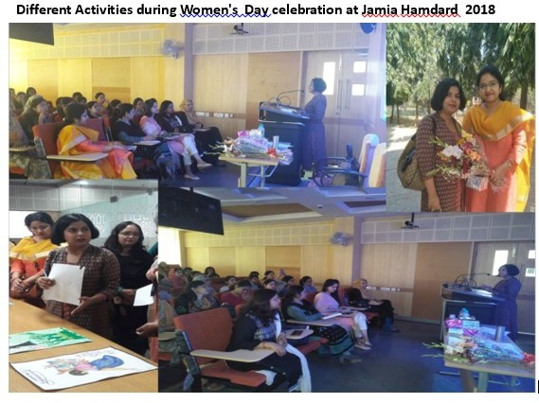
JAMIA HAMDARD
(Deemed to be University)
Hamdard Nagar, New Delhi-110062
7.1 Measures initiated by the Institution for the promotion of gender equity
Latitude: 28.30563
Longitude: 77.15309

Slide 12
JAMIA HAMDARD
(Deemed to be University)
Hamdard Nagar, New Delhi-110062
7.1 Measures initiated by the Institution for the promotion of gender equity
Latitude: 28.30563
Longitude: 77.15309

Slide 13
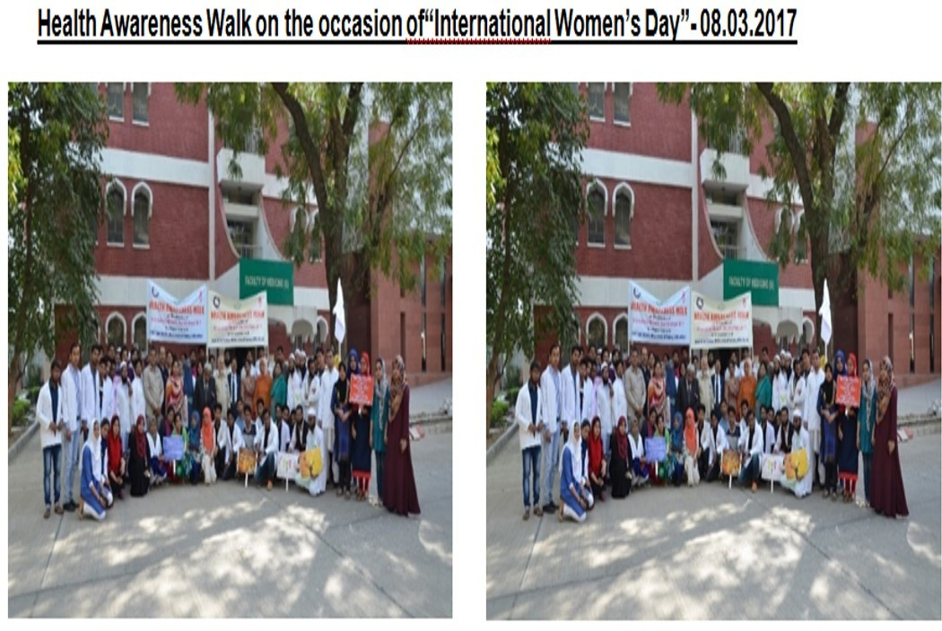
JAMIA HAMDARD
(Deemed to be University)
Hamdard Nagar, New Delhi-110062
7.1 Measures initiated by the Institution for the promotion of gender equity
Latitude: 28.30563
Longitude: 77.15309

Slide 14
JAMIA HAMDARD
(Deemed to be University)
Hamdard Nagar, New Delhi-110062
7.1 Measures initiated by the Institution for the promotion of gender equity
Latitude: 28.30563
Longitude: 77.15309

