Slide 1

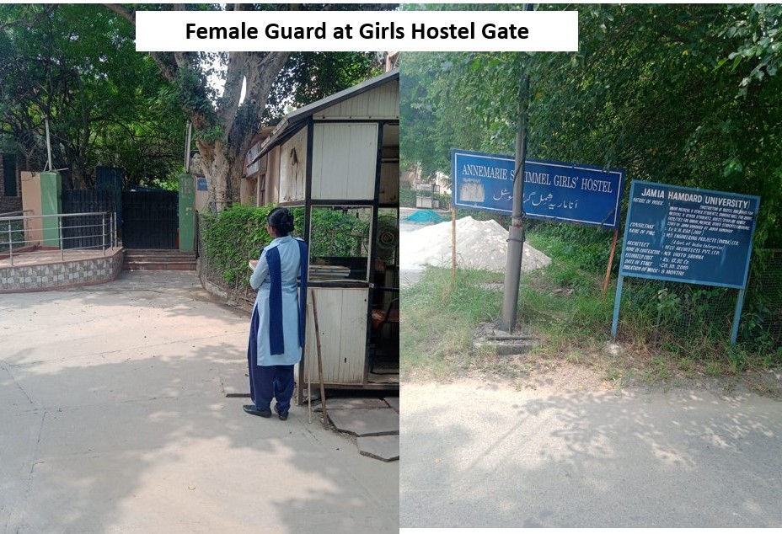
JAMIA HAMDARD
(Deemed to be University)
Hamdard Nagar, New Delhi-110062
GeoTag Pictures
7.1 Campus facilities available for the Safety and Security
Latitude: 28.30569
Longitude: 77.15284

Slide 2
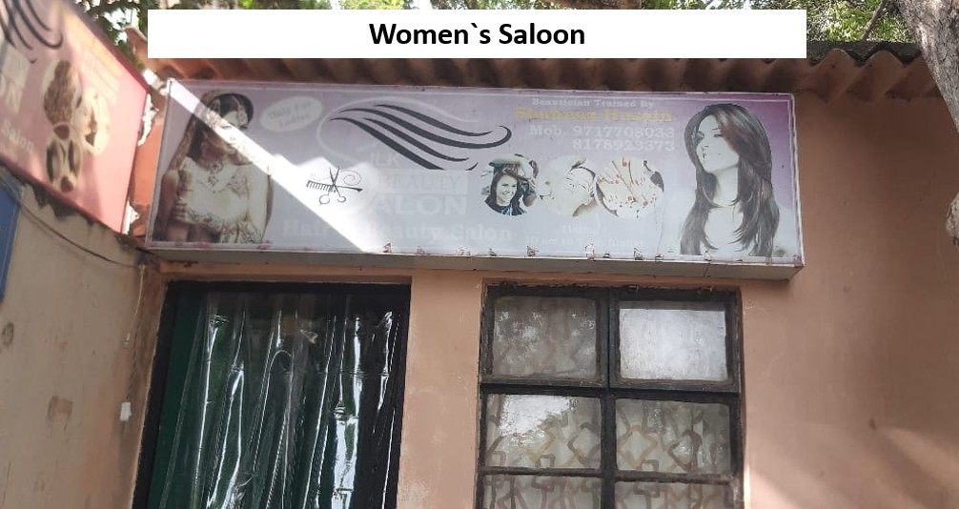
JAMIA HAMDARD
(Deemed to be University)
Hamdard Nagar, New Delhi-110062
7.1 Specific facilities provided for women for the promotion of gender equity
Latitude: 28.30569
Longitude: 77.15284

Slide 3
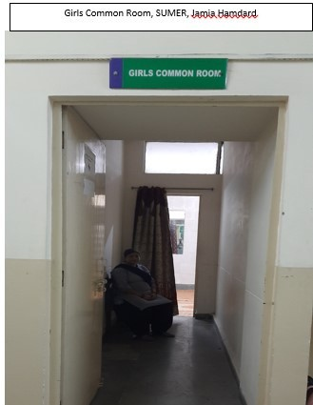
JAMIA HAMDARD
(Deemed to be University)
Hamdard Nagar, New Delhi-110062
7.1 Specific facilities provided for women for the promotion of gender equity
Latitude: 28.30569
Longitude: 77.15284

