Slide 1
JAMIA HAMDARD
(Deemed to be University)
Hamdard Nagar, New Delhi-110062
GeoTag Pictures
7.1.1 Annual gender sensitization action plan
Every year various programs on Gender sensitization and awareness are planned through meetingsworkshops / seminars/ health camps, walks etc. on:
1. Gender Equity / Attitude/ awareness
2. Prevention of Sexual Harassment
3. Women Empowerment
4. Women Health and Hygiene
5. Women’s day and many other relevant topics.
Programmes organized by the Institution for the promotion of gender equity during the last five years. (2017-2022)
Title of the activity | No. of events
Awareness programmes | 20
Women Health Camps | 16
Training Programmes | 7

Slide 2
JAMIA HAMDARD
(Deemed to be University)
Hamdard Nagar, New Delhi-110062
GeoTag Pictures
7.1.1 Programmes organized by the Institution for the promotion of gender equity during the last five years
S. No. | Title of the activity | Date | No of part.
1. | Women Empowerment; Female Hygiene and Sanitation | 13-03-2018 | 70
2. | Training Workshop In collaboration with Delhi Police on Sensitization & Cyber Awareness- Cum-Training Programme And “Familiarization with Himmat Plus App” Chief Guest Shri Vijay Kumar, IPS Deputy Commissioner of Police Other Guests/Trainers /Speakers :Sensitization & Cyber Awareness and Familiarization with Himmat Plus App by Shri Ajit Kumar, Inspector, Delhi Police Key note address by Shri. Parvinder Singh, Addl. Dy Commissioner of Police, SW district, 21st February 2019 | 21st February 2019 | 250
3. | Balance for Better | 27-03-2019 | 34
4. | He for She | 2019 | 58
5. | The Glass Ceiling Breakers: Women Leaders in Science. The Felicitation Ceremony | 8th August 2019 | 200
6. | Challenges and Opportunities in Higher Education in the digital world: Ensuring, Excellence, Equity and Inclusivity | 12th December 2019 | 140
7. | Women in Science-Whatcan be done ? Prof.(Dr.) Sandeep Verma, Secretary, SERB, GoI. On the Occasion of National Science Day Popular Lecture | 28th February 2020
8. | SEHAT – Women Health Camp | 18thOctober 2020 | 230
9. | Self Defence Program in collaboration with Delhi Police | 2020 | 280
10. | COVID-19 Pandemic: Impact of Lockdown on Personal and Professional Life of Women | 04-06-2020 | 430
11. | Women who Inspire | 11-10-2021 | 22
12. | Workshop for bystander intervention program against street harassment.
13. | Girl-Up Hamdard, School of Law, HILSR
14. | Legal Aid Clinic, School of Law, HILSR
15. | InternationalWomen’sDayCelebration, Food Tech | March 8, 2017- 19
16. | Green Menstruation Drive: Workshop Awareness walks: Guest Lecture and Hands on training and live demonstration and pledge taking ceremony have been organised in University. Guest Speaker: Dr Neha Gupta HIMSR | 2018-2020 | 200

Slide 3
JAMIA HAMDARD
(Deemed to be University)
Hamdard Nagar, New Delhi-110062
7.1.1 Programmes organized by the Institution for the promotion of gender equity during the last five years
 | During the programme an oath was taken by both staff and students of JamiaHamdard: Inaugurated by Pro Vice Chancellor: Aprox: more than 200 Students and staff of SUMER, Nursing School, MUH and HAHCH were the participants
17. | Screening of cancer and Breast self examination Drive in JH female employee: On the occasion of World Cancer Day the following events were organised Guest speakers Dr Majid Talikoti Oncologist (Batra Hospital),Dr Aruna Nigam and Dr Neha Gupta and Dr Abhinav Jain (HAHCH) were invited and Hands on training on “Breast self examination” were organised along with the Awareness walk . Free screening Prevention and management camp were also executed. The group of some faculty members were visited to each school and live demonstration and screening method through BSE was explained and demonstrated with the help of AV aid Simulator and live | 2016-2020 | 200-300
18. | Student Mentorship | 2017-2021
19. | Discipline &Anti-Ragging Committee | 2017-20
20. | Free Health Camps for Women (7 camps) | 2017-2021 | `
21. | She Inspires Me | 10-03-2022 | 40
22. | The department of amraz e niswan wa qabalat organized women’s health week-2022 | from 31/3/2022 to 1/4/2022.
23. | Free Health Checkup, screening and treatment camp for Women | 07-04-2022
24. | Quiz Competition on “Gender Equality and Development “on the occasion of International Women’s Day | 08-03-2022 | 130
25. | lecture program of Women development cell on “Musculoskeletal Health among Women during the Digital Era’’ | 17-02-2022
26. | Logo designing competition by WDC | 3rd June 2022
27. | A free health camp for women was organized by Women Development Cell Jamia Hamdard, at Godhuli Senior Citizen Centre, New Gurudwara, E-Block, GK. II, New Delhi. | on 12th June 2022
28. | Women Development Cell, Jamia Hamdard, organizes a Workshop on Skill Development via Hands-on Training, on Bakery Technology | 28th March 2022
29. | Equal opportunity Cell, Jamia Hamdard organized an online lecture on disability sensitization on the topic entitled " | 10th May 2022

Slide 4
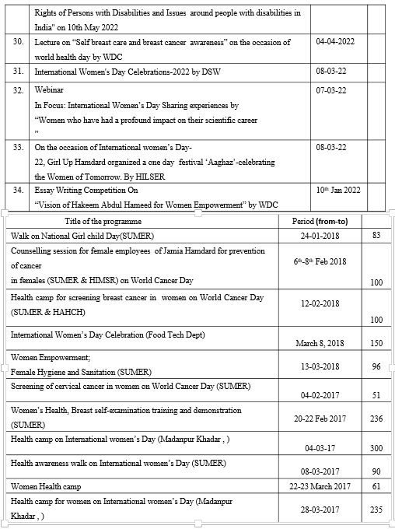
JAMIA HAMDARD
(Deemed to be University)
Hamdard Nagar, New Delhi-110062
7.1.1 Programmes organized by the Institution for the promotion of gender equity during the last five years

Slide 5
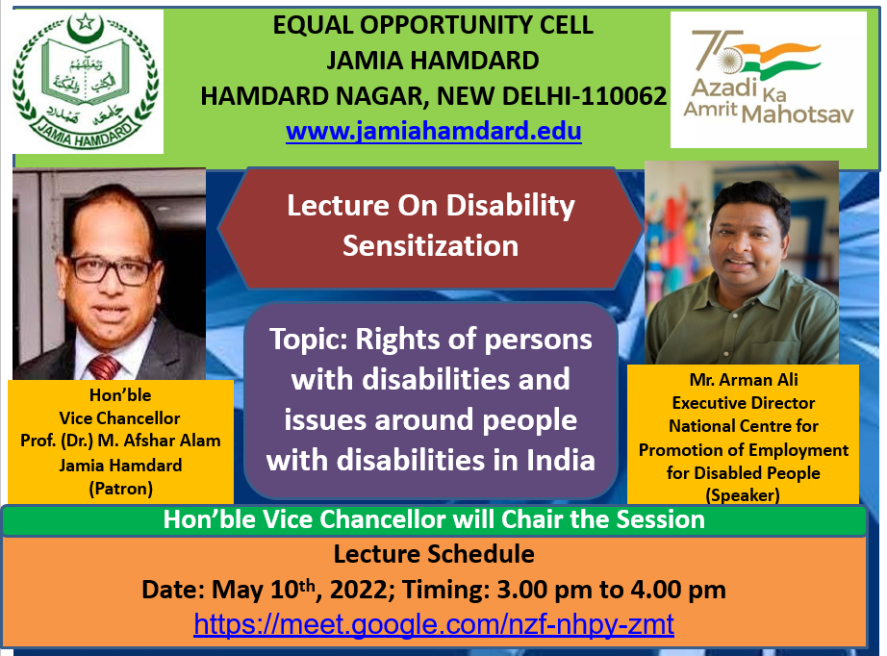
JAMIA HAMDARD
(Deemed to be University)
Hamdard Nagar, New Delhi-110062
7.1.1 Programmes organized by the Institution for the promotion of gender equity during the last five years

Slide 6
JAMIA HAMDARD
(Deemed to be University)
Hamdard Nagar, New Delhi-110062
7.1.1 Programmes organized by the Institution for the promotion of gender equity during the last five years

Slide 7
JAMIA HAMDARD
(Deemed to be University)
Hamdard Nagar, New Delhi-110062
7.1.1 Programmes organized by the Institution for the promotion of gender equity during the last five years

Slide 8
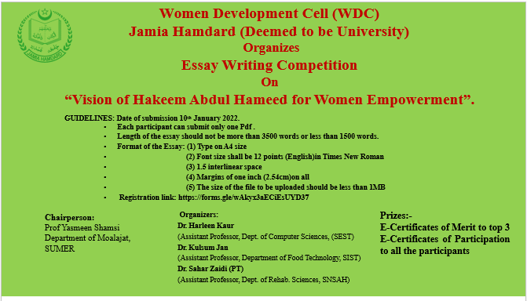
JAMIA HAMDARD
(Deemed to be University)
Hamdard Nagar, New Delhi-110062
7.1.1 Programmes organized by the Institution for the promotion of gender equity during the last five years

Slide 9
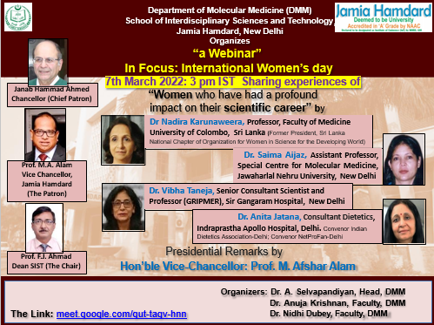
JAMIA HAMDARD
(Deemed to be University)
Hamdard Nagar, New Delhi-110062
7.1.1 Programmes organized by the Institution for the promotion of gender equity during the last five years

Slide 10
JAMIA HAMDARD
(Deemed to be University)
Hamdard Nagar, New Delhi-110062
7.1.1 Programmes organized by the Institution for the promotion of gender equity during the last five years

Slide 11
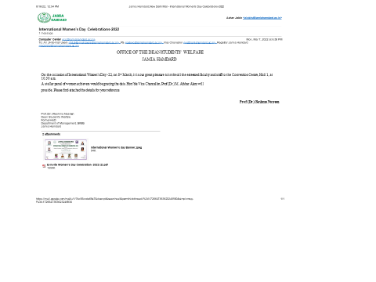
JAMIA HAMDARD
(Deemed to be University)
Hamdard Nagar, New Delhi-110062
7.1.1 Programmes organized by the Institution for the promotion of gender equity during the last five years

Slide 12
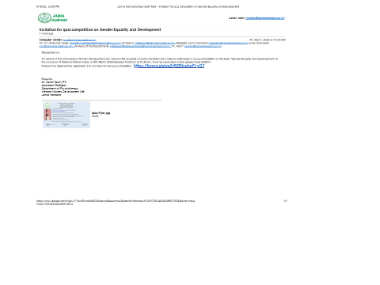
JAMIA HAMDARD
(Deemed to be University)
Hamdard Nagar, New Delhi-110062
7.1.1 Programmes organized by the Institution for the promotion of gender equity during the last five years

Slide 13
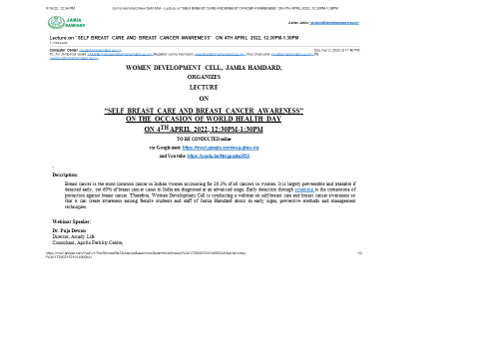
JAMIA HAMDARD
(Deemed to be University)
Hamdard Nagar, New Delhi-110062
7.1.1 Programmes organized by the Institution for the promotion of gender equity during the last five years

Slide 14
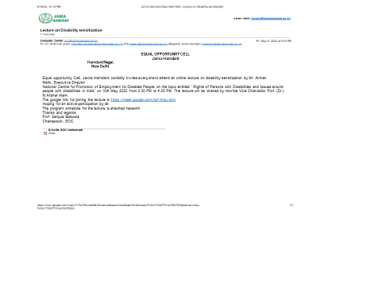
JAMIA HAMDARD
(Deemed to be University)
Hamdard Nagar, New Delhi-110062
7.1.1 Programmes organized by the Institution for the promotion of gender equity during the last five years

Slide 15
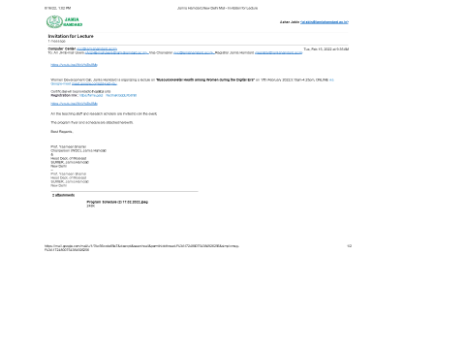
JAMIA HAMDARD
(Deemed to be University)
Hamdard Nagar, New Delhi-110062
7.1.1 Programmes organized by the Institution for the promotion of gender equity during the last five years

Slide 16
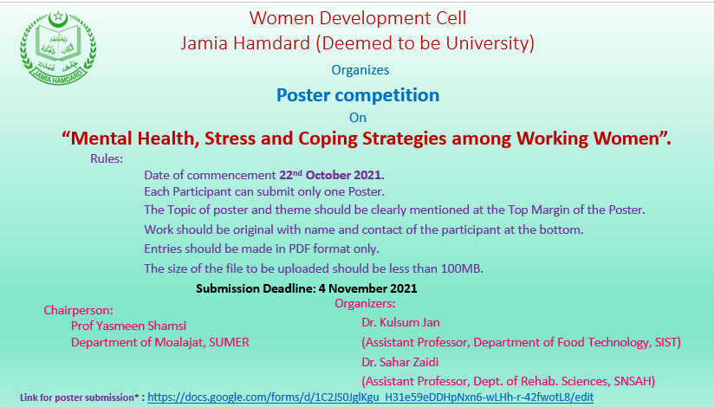
JAMIA HAMDARD
(Deemed to be University)
Hamdard Nagar, New Delhi-110062
7.1.1 Programmes organized by the Institution for the promotion of gender equity during the last five years

Slide 17
JAMIA HAMDARD
(Deemed to be University)
Hamdard Nagar, New Delhi-110062
7.1.1 Programmes organized by the Institution for the promotion of gender equity during the last five years

Slide 18
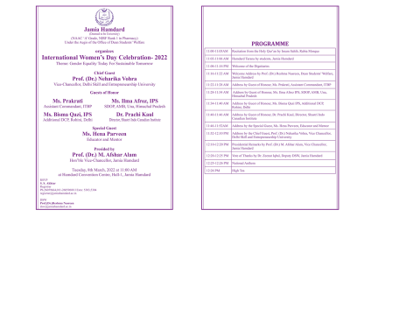
JAMIA HAMDARD
(Deemed to be University)
Hamdard Nagar, New Delhi-110062
7.1.1 Programmes organized by the Institution for the promotion of gender equity during the last five years

Slide 19
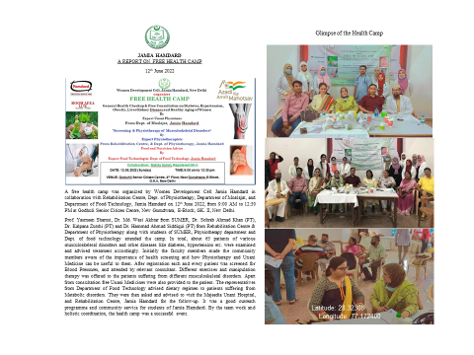
JAMIA HAMDARD
(Deemed to be University)
Hamdard Nagar, New Delhi-110062
7.1.1 Programmes organized by the Institution for the promotion of gender equity during the last five years

Slide 20
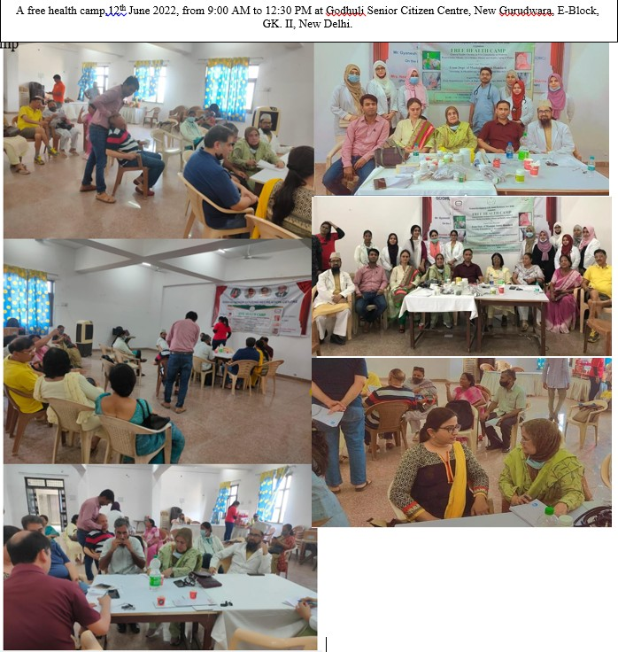
JAMIA HAMDARD
(Deemed to be University)
Hamdard Nagar, New Delhi-110062
7.1.1 Measures initiated by the Institution for the promotion of gender equity
Latitude: 28.32308
Longitude: 77.172400

Slide 21
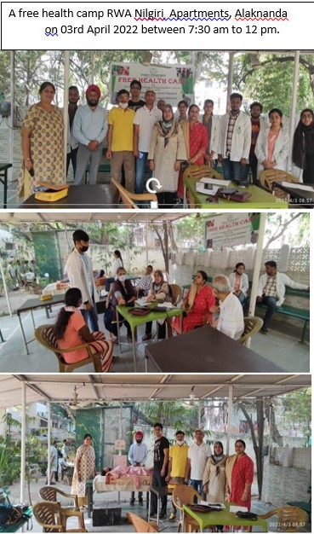
JAMIA HAMDARD
(Deemed to be University)
Hamdard Nagar, New Delhi-110062
7.1.1 Measures initiated by the Institution for the promotion of gender equity
Latitude: 28.31143
Longitude: 77.15242

Slide 22
JAMIA HAMDARD
(Deemed to be University)
Hamdard Nagar, New Delhi-110062
7.1.1 Programmes organized by the Institution for the promotion of gender equity during the last five years

Slide 23
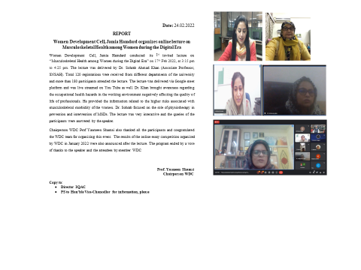
JAMIA HAMDARD
(Deemed to be University)
Hamdard Nagar, New Delhi-110062
7.1.1 Programmes organized by the Institution for the promotion of gender equity during the last five years

Slide 24
JAMIA HAMDARD
(Deemed to be University)
Hamdard Nagar, New Delhi-110062
7.1.1 Programmes organized by the Institution for the promotion of gender equity during the last five years

Slide 25
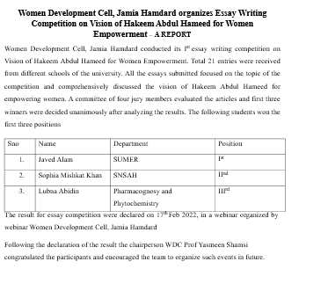
JAMIA HAMDARD
(Deemed to be University)
Hamdard Nagar, New Delhi-110062
7.1.1 Programmes organized by the Institution for the promotion of gender equity during the last five years

Slide 26
JAMIA HAMDARD
(Deemed to be University)
Hamdard Nagar, New Delhi-110062
7.1.1 Programmes organized by the Institution for the promotion of gender equity during the last five years

Slide 27
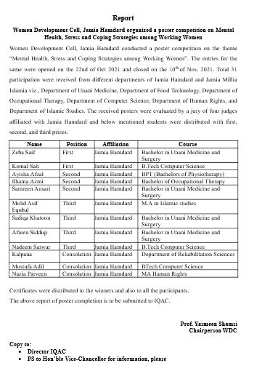
JAMIA HAMDARD
(Deemed to be University)
Hamdard Nagar, New Delhi-110062
7.1.1 Programmes organized by the Institution for the promotion of gender equity during the last five years

Slide 28
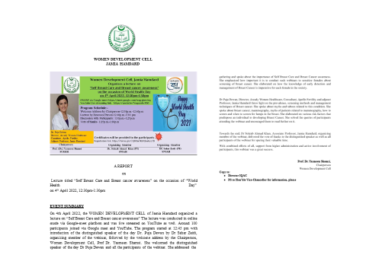
JAMIA HAMDARD
(Deemed to be University)
Hamdard Nagar, New Delhi-110062
7.1.1 Programmes organized by the Institution for the promotion of gender equity during the last five years

Slide 29
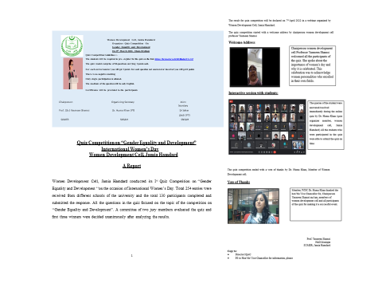
JAMIA HAMDARD
(Deemed to be University)
Hamdard Nagar, New Delhi-110062
7.1.1 Programmes organized by the Institution for the promotion of gender equity during the last five years

Slide 30
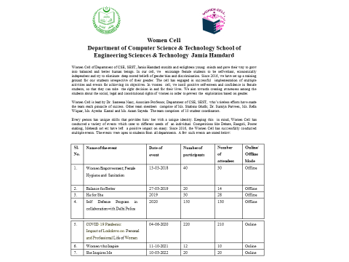
JAMIA HAMDARD
(Deemed to be University)
Hamdard Nagar, New Delhi-110062
7.1.1 Programmes organized by the Institution for the promotion of gender equity during the last five years

Slide 31
JAMIA HAMDARD
(Deemed to be University)
Hamdard Nagar, New Delhi-110062
7.1.1 Programmes organized by the Institution for the promotion of gender equity during the last five years
THE DEPARTMENT OF AMRAZ E NISWAN WA QABALAT ORGANIZED WOMEN’S HEALTH WEEK-2022 FROM 31/3/2022 TO 1/4/2022.
(07.04.2022)
Jamia Hamdard Deemed University (Accredited by NAAC in ‘A’ Category) taking forward initiatives to commemorate the different Events on world cancer day like Women’s Day, Human Rights Day children’s Day and used to organize some events like Conference essay writing competitions, Poster drafting competitions ,Guest
lecturers along with free health checkup and treatment camps. Now on the occasion
of “ International Health Week (1-7 September) Department of Gynaecology, Obstetrics and Pediatrics, Faculty of Medicine ,Jamia Hamdard joined hands with “Bharitiya Socialist Republican Trust “and organizing Free Health Checkup and Treatment Camps every month on Sundays in slum areas of Delhi, recently on 5thFebruary 2022 on the occasion of Cancer Survival Day & World Cancer Day .
Following persons from Jamia Hamdard have rendered their services in the camp and made the camp successful in every aspect and distributed the Unani Medicines free of cost to the people coming to the camp for treatment.
Organizing Chairperson Prof Dr Suhail Fatima HOD, Gynae & OBG SUMER, Jamia Hamdard Organizing secretaries
Dr Muhammd Maaz, Associate professor D/o Mahiyatul Amraz Dr Roohi Azam Assistant professor D/o Mahiyatul Amraz
Dr Saman Anees Assistant professor D/o Amraze Niswan Wa Qabalat
Venue-Gali No 33,Tughlaqabad Extension ,New Delh
Time- 9:00am to 1:00 pm
No. of People-800(BUMS Students, Interns, M.D.Students, Faculty members & hospital staff)

Slide 32
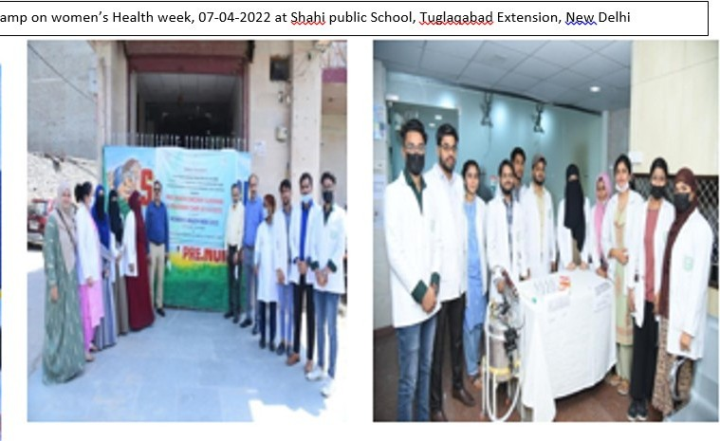
JAMIA HAMDARD
(Deemed to be University)
Hamdard Nagar, New Delhi-110062
7.1.1 Measures initiated by the Institution for the promotion of gender equity
Latitude: 28.31143
Longitude: 77.15242

Slide 33
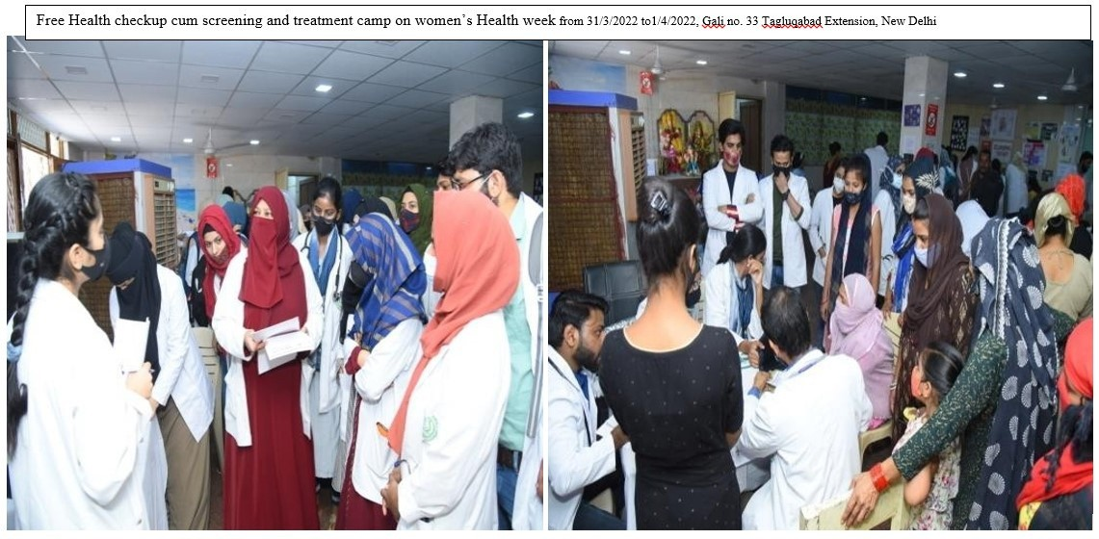
JAMIA HAMDARD
(Deemed to be University)
Hamdard Nagar, New Delhi-110062
7.1.1 Measures initiated by the Institution for the promotion of gender equity
Latitude: 28.30495
Longitude: 77.15515

Slide 34
JAMIA HAMDARD
(Deemed to be University)
Hamdard Nagar, New Delhi-110062
7.1.1 Programmes organized by the Institution for the promotion of gender equity during the last five years

Slide 35
JAMIA HAMDARD
(Deemed to be University)
Hamdard Nagar, New Delhi-110062
7.1.1 Programmes organized by the Institution for the promotion of gender equity during the last five years

Slide 36
JAMIA HAMDARD
(Deemed to be University)
Hamdard Nagar, New Delhi-110062
7.1.1 Programmes organized by the Institution for the promotion of gender equity during the last five years

Slide 37
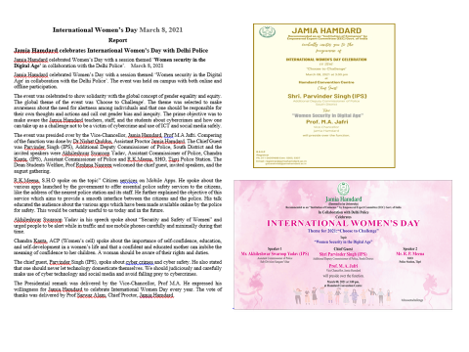
JAMIA HAMDARD
(Deemed to be University)
Hamdard Nagar, New Delhi-110062
7.1.1 Programmes organized by the Institution for the promotion of gender equity during the last five years

Slide 38
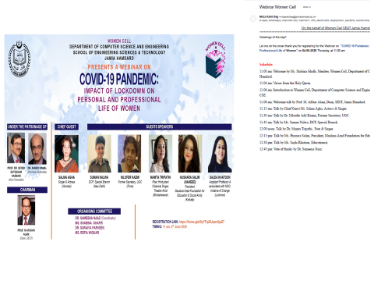
JAMIA HAMDARD
(Deemed to be University)
Hamdard Nagar, New Delhi-110062
7.1.1 Programmes organized by the Institution for the promotion of gender equity during the last five years

Slide 39
JAMIA HAMDARD
(Deemed to be University)
Hamdard Nagar, New Delhi-110062
7.1.1 Programmes organized by the Institution for the promotion of gender equity during the last five years
Title of the Practice: Screening of cancer and Breast self examination Drive in JH female employee: On the occasion of World Cancer Day the following events were organised
Guest speakers Dr Majid Talikoti Oncologist (Batra Hospital),Dr Aruna Nigam and Dr Neha Gupta and Dr Abhinav Jain (HAHCH) were invited and
Hands on training on “Breast self examination” were organised along with the
Awareness walk .
Free screening Prevention and management camp were also executed.
The group of some faculty members were visited to each school and live demonstration and screening method through BSE was explained and demonstrated with the help of AV aid Simulator and live
8. Coordinator/in-charge who has been assigned for the above best practice (optional)
a) Name: Prof. Suhail Fatima
b) Designation: organizer
c) Period/tenure involved in coordination of the best practice: 201-2020

Slide 40
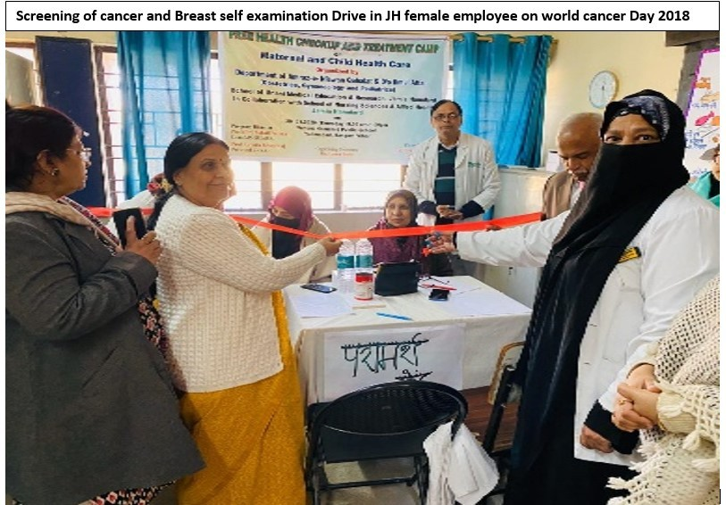
JAMIA HAMDARD
(Deemed to be University)
Hamdard Nagar, New Delhi-110062
7.1.1 Measures initiated by the Institution for the promotion of gender equity
Latitude: 28.30563
Longitude: 77.15309

Slide 41
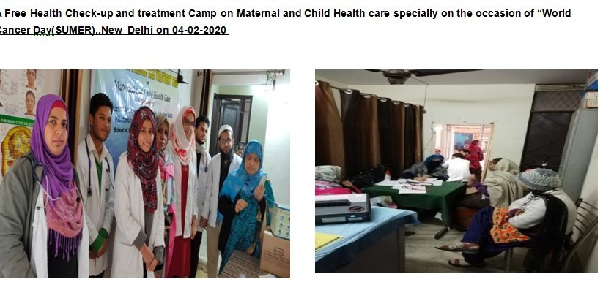
JAMIA HAMDARD
(Deemed to be University)
Hamdard Nagar, New Delhi-110062
7.1.1 Measures initiated by the Institution for the promotion of gender equity
Latitude: 28.30563
Longitude: 77.15309

Slide 42
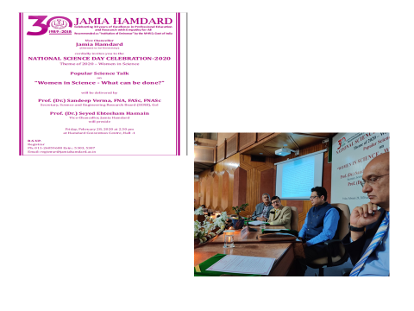
JAMIA HAMDARD
(Deemed to be University)
Hamdard Nagar, New Delhi-110062
7.1.1 Programmes organized by the Institution for the promotion of gender equity during the last five years

Slide 43
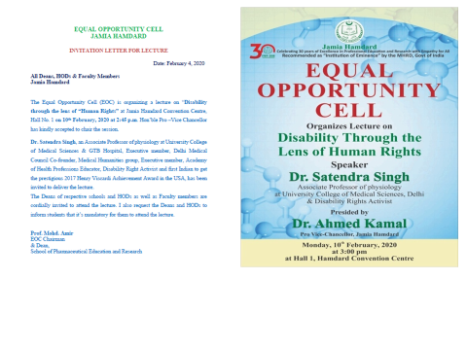
JAMIA HAMDARD
(Deemed to be University)
Hamdard Nagar, New Delhi-110062
7.1.1 Programmes organized by the Institution for the promotion of gender equity during the last five years

Slide 44
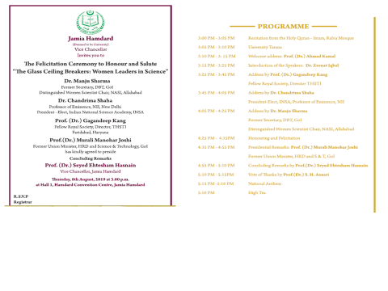
JAMIA HAMDARD
(Deemed to be University)
Hamdard Nagar, New Delhi-110062
7.1.1 Programmes organized by the Institution for the promotion of gender equity during the last five years

Slide 45
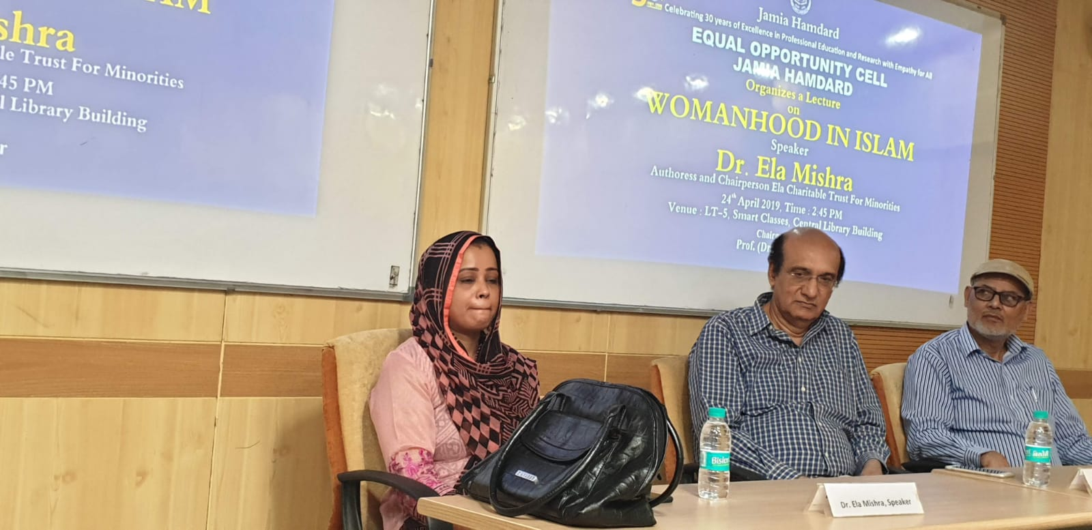
JAMIA HAMDARD
(Deemed to be University)
Hamdard Nagar, New Delhi-110062
7.1.1 Programmes organized by the Institution for the promotion of gender equity during the last five years
Latitude: 28.30563
Longitude: 77.15309

Slide 46
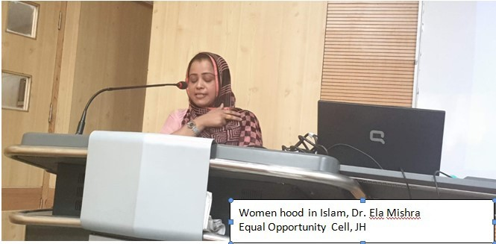
JAMIA HAMDARD
(Deemed to be University)
Hamdard Nagar, New Delhi-110062
7.1.1 Measures initiated by the Institution for the promotion of gender equity
Latitude: 28.30563
Longitude: 77.15309

Slide 47
JAMIA HAMDARD
(Deemed to be University)
Hamdard Nagar, New Delhi-110062
7.1.1 Programmes organized by the Institution for the promotion of gender equity during the last five years

Slide 48
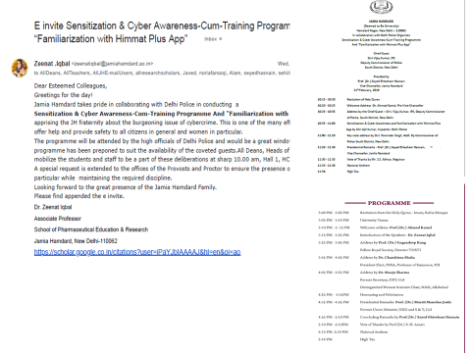
JAMIA HAMDARD
(Deemed to be University)
Hamdard Nagar, New Delhi-110062
7.1.1 Programmes organized by the Institution for the promotion of gender equity during the last five years

Slide 49
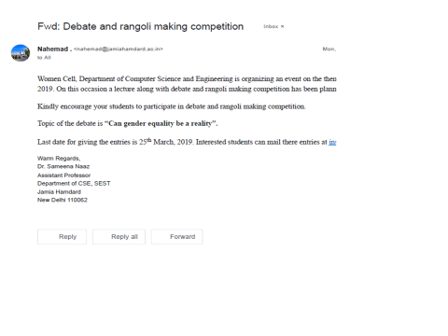
JAMIA HAMDARD
(Deemed to be University)
Hamdard Nagar, New Delhi-110062
7.1.1 Programmes organized by the Institution for the promotion of gender equity during the last five years

Slide 50
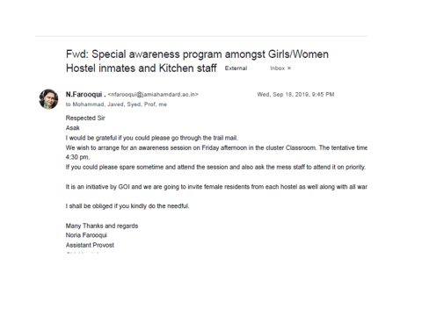
JAMIA HAMDARD
(Deemed to be University)
Hamdard Nagar, New Delhi-110062
7.1.1 Programmes organized by the Institution for the promotion of gender equity during the last five years

Slide 51
JAMIA HAMDARD
(Deemed to be University)
Hamdard Nagar, New Delhi-110062
7.1.1 Programmes organized by the Institution for the promotion of gender equity during the last five years
Title of the Practice : (Green Menstruation Drive): Dealing with new disposal methods of sanitary pads and use of new type of sanitary pads which lessen the burden on earth by non degradable pads
Objectives of the Practices : To generate awareness among students and other employees of Jamia Hamdard in particular the females of managing and disposing off methods of Menstruation sanitary pads as a part of Green Menstruation Drive and Pledge taking ceremony have been organised
The Practice has been arranged in the following manner:
Awareness walks:
Guest Lecture and Hands on training and live demonstration and pledge taking ceremony have been organised in University.
Title of Workshop: Green Menstruation Drive
Guest Speaker: Dr Neha Gupta HIMSR
During the programme an oath was taken by both staff and students of Jamia Hamdard: Inaugurated by Pro Vice Chancellor: Aprox: more than 200 Students and staff of SUMER, Nursing School, MUH and HAHCH were the participants
8. Coordinator/in-charge who has been assigned for the above best practice (optional)
a) Name: Prof. Suhail Fatima
b) Designation: organizer
c) Period/tenure involved in coordination of the best practice: 2018-2020

Slide 52
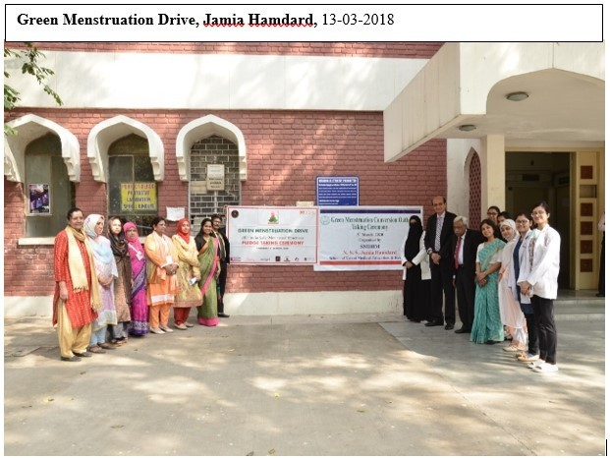
JAMIA HAMDARD
(Deemed to be University)
Hamdard Nagar, New Delhi-110062
7.1.1 Measures initiated by the Institution for the promotion of gender equity
Latitude: 28.30563
Longitude: 77.15309

Slide 53
JAMIA HAMDARD
(Deemed to be University)
Hamdard Nagar, New Delhi-110062
7.1.1 Programmes organized by the Institution for the promotion of gender equity during the last five years

Slide 54
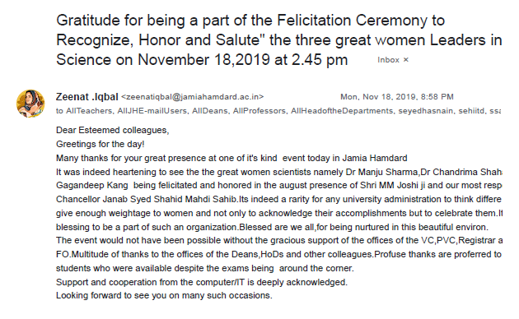
JAMIA HAMDARD
(Deemed to be University)
Hamdard Nagar, New Delhi-110062
7.1.1 Programmes organized by the Institution for the promotion of gender equity during the last five years

Slide 55
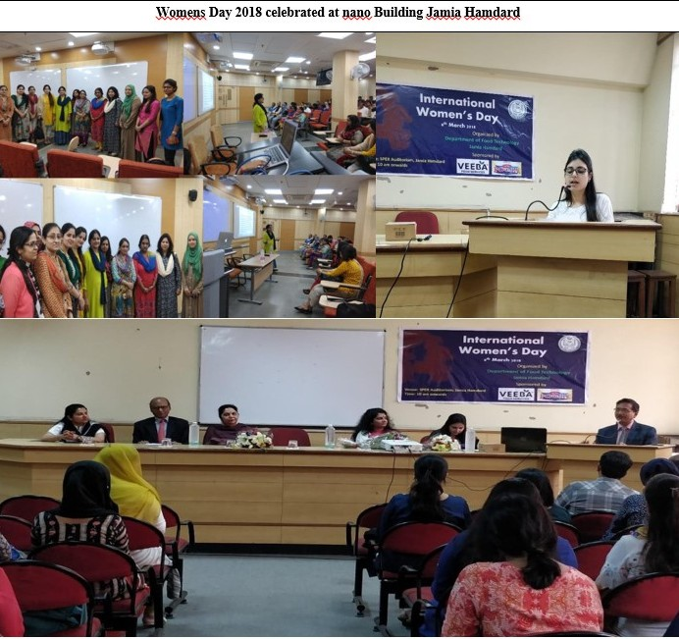
JAMIA HAMDARD
(Deemed to be University)
Hamdard Nagar, New Delhi-110062
7.1.1 Measures initiated by the Institution for the promotion of gender equity
Latitude: 28.30563
Longitude: 77.15309

Slide 56
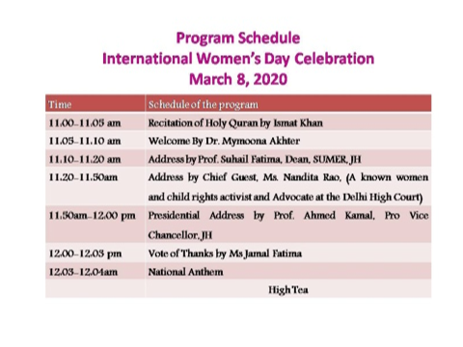
JAMIA HAMDARD
(Deemed to be University)
Hamdard Nagar, New Delhi-110062
7.1.1 Programmes organized by the Institution for the promotion of gender equity during the last five years

Slide 57
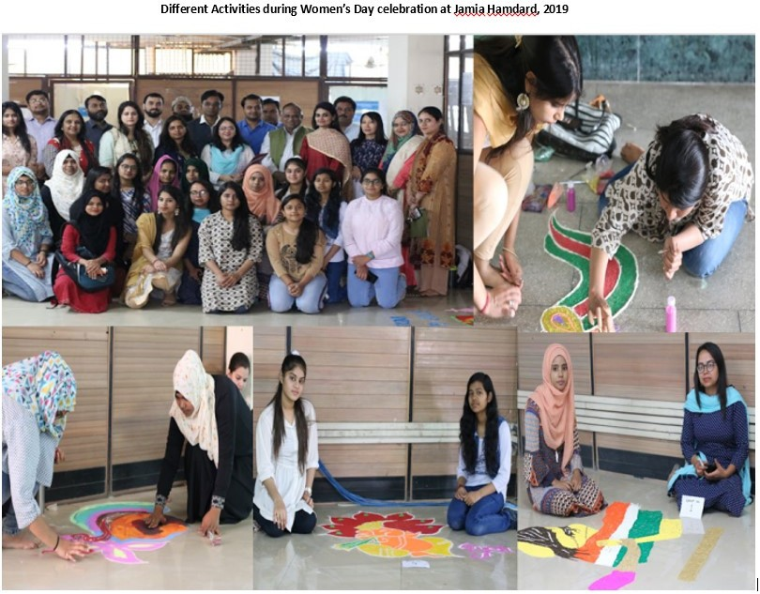
JAMIA HAMDARD
(Deemed to be University)
Hamdard Nagar, New Delhi-110062
7.1.1 Measures initiated by the Institution for the promotion of gender equity
Latitude: 28.30563
Longitude: 77.15309

Slide 58
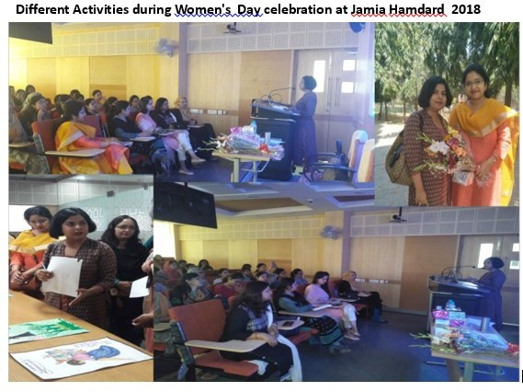
JAMIA HAMDARD
(Deemed to be University)
Hamdard Nagar, New Delhi-110062
7.1.1 Measures initiated by the Institution for the promotion of gender equity
Latitude: 28.30563
Longitude: 77.15309

Slide 59
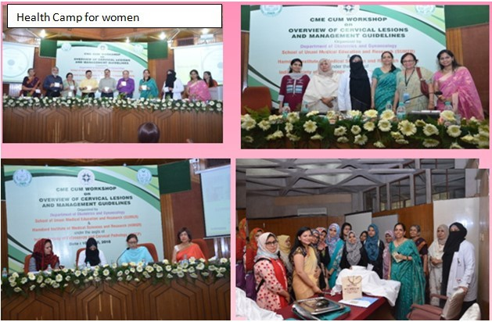
JAMIA HAMDARD
(Deemed to be University)
Hamdard Nagar, New Delhi-110062
7.1.1 Measures initiated by the Institution for the promotion of gender equity
Latitude: 28.30563
Longitude: 77.15309

Slide 60
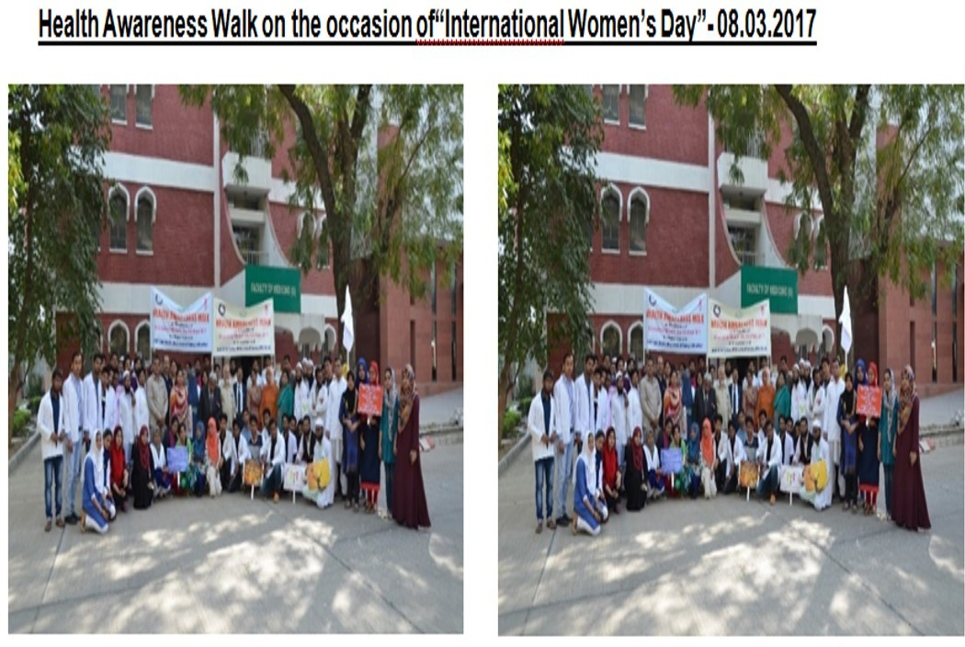
JAMIA HAMDARD
(Deemed to be University)
Hamdard Nagar, New Delhi-110062
7.1.1 Measures initiated by the Institution for the promotion of gender equity
Latitude: 28.30563
Longitude: 77.15309

Slide 61
JAMIA HAMDARD
(Deemed to be University)
Hamdard Nagar, New Delhi-110062
7.1.1 Measures initiated by the Institution for the promotion of gender equity
Latitude: 28.30563
Longitude: 77.15309

