Slide 1

JAMIA HAMDARD
(Deemed to be University)
Hamdard Nagar, New Delhi-110062
3.1.5
Click Here for the Geotagged Photos of Facilities

Slide 2
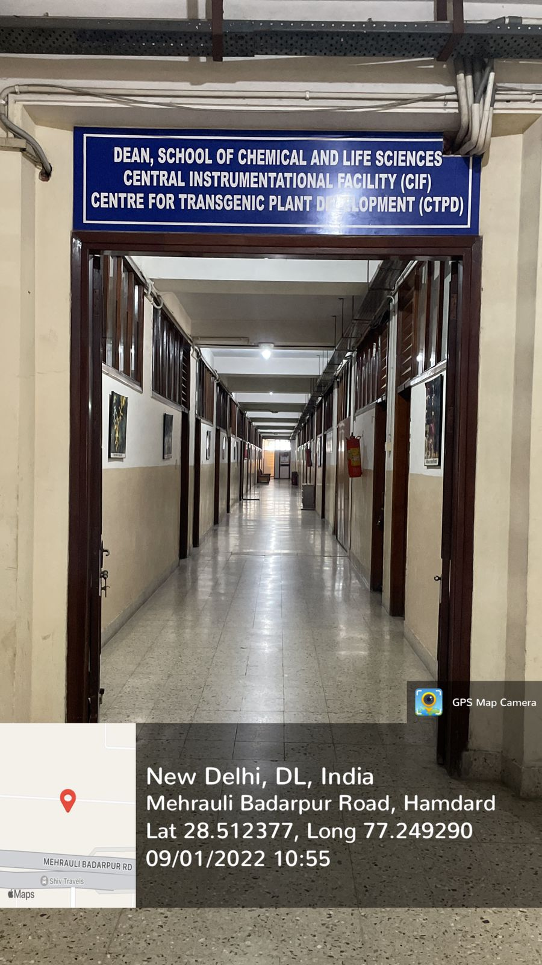
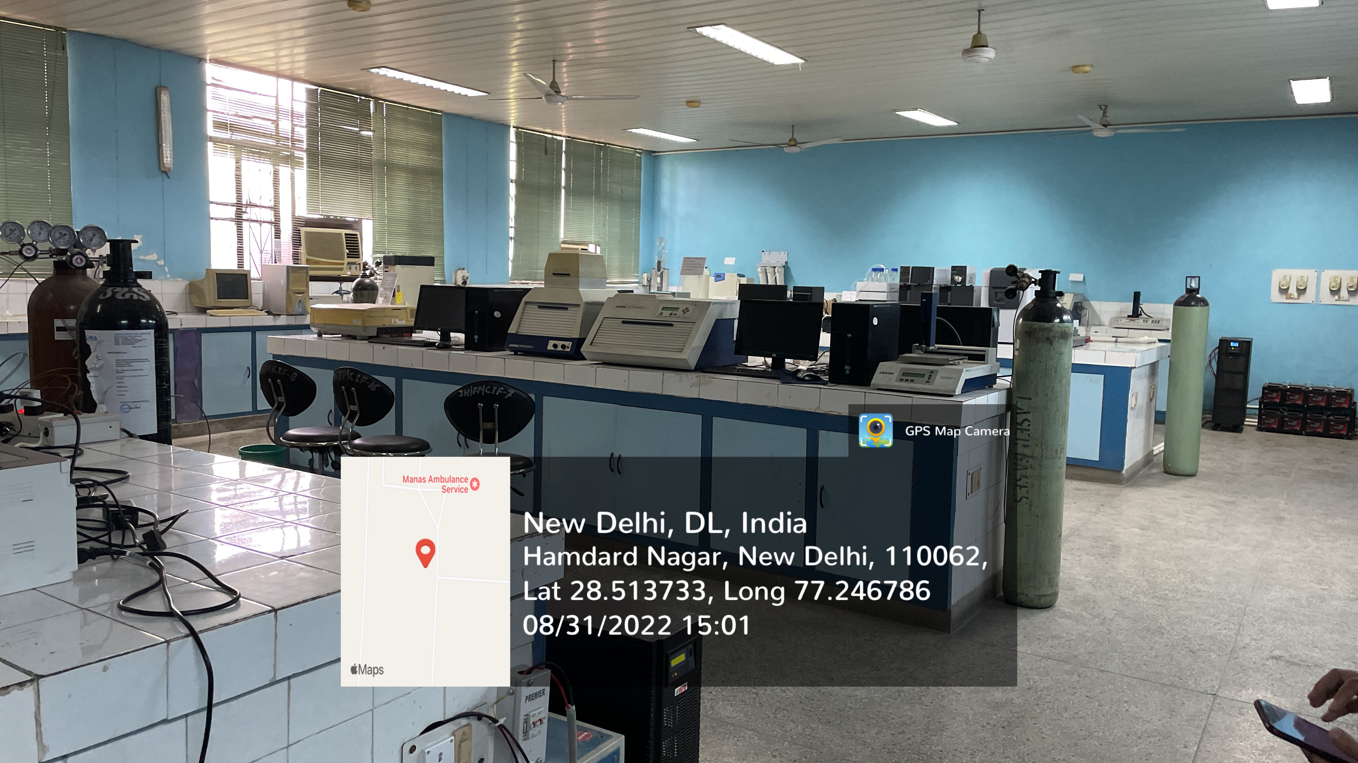
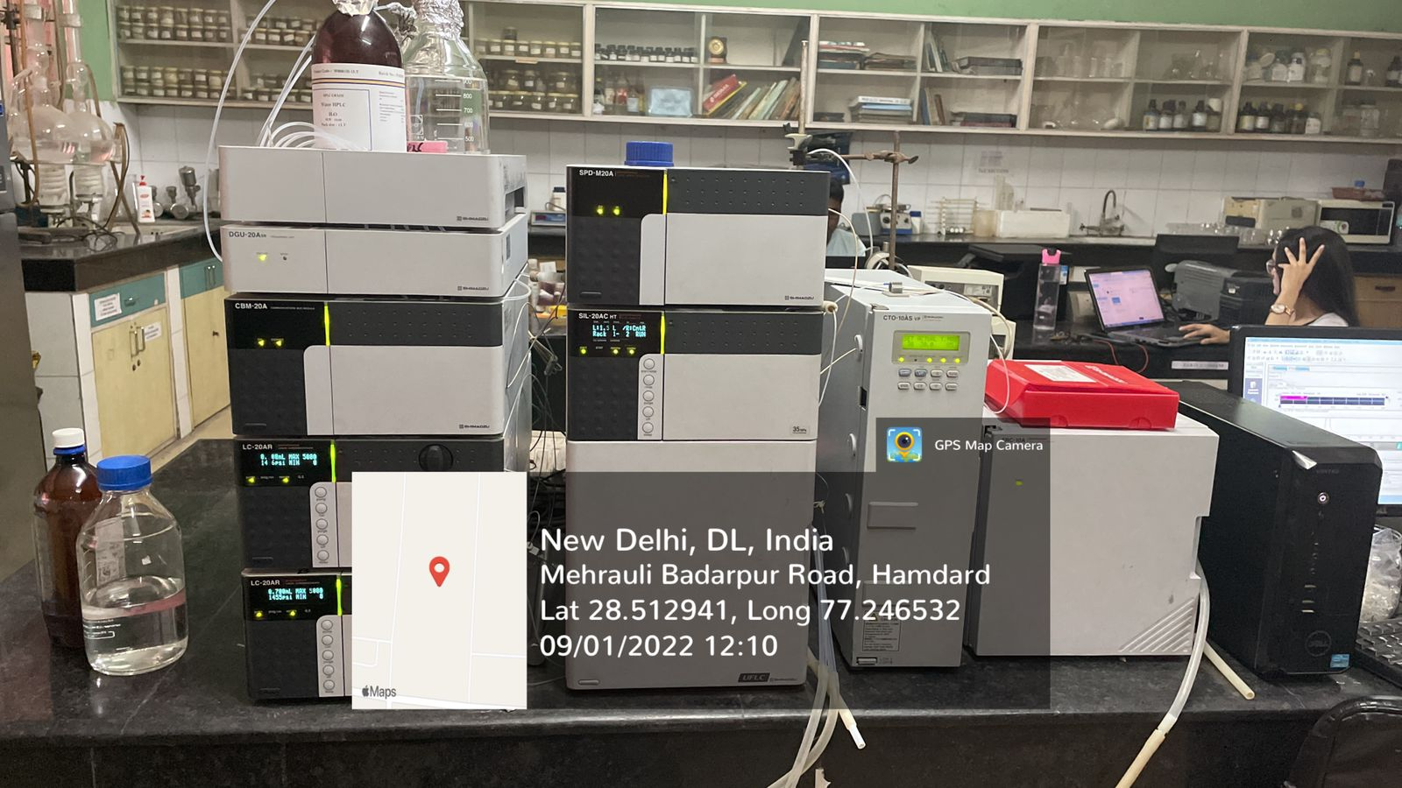
JAMIA HAMDARD
(Deemed to be University)
Hamdard Nagar, New Delhi-110062
CENTRAL INSTRUMENTATION FACILITY
https://www.youtube.com/watch?v=uIKbYh157Qc

Slide 3
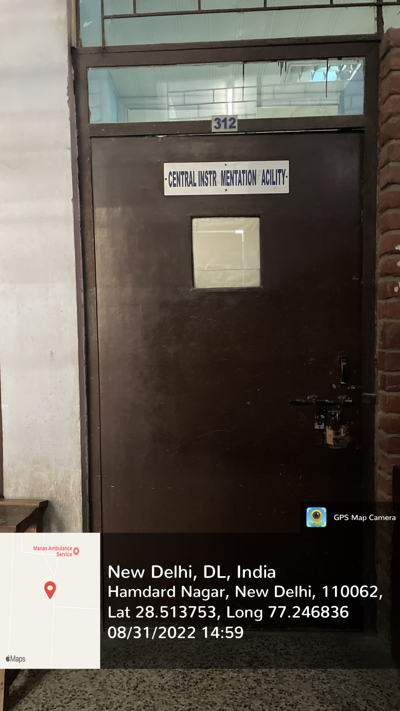
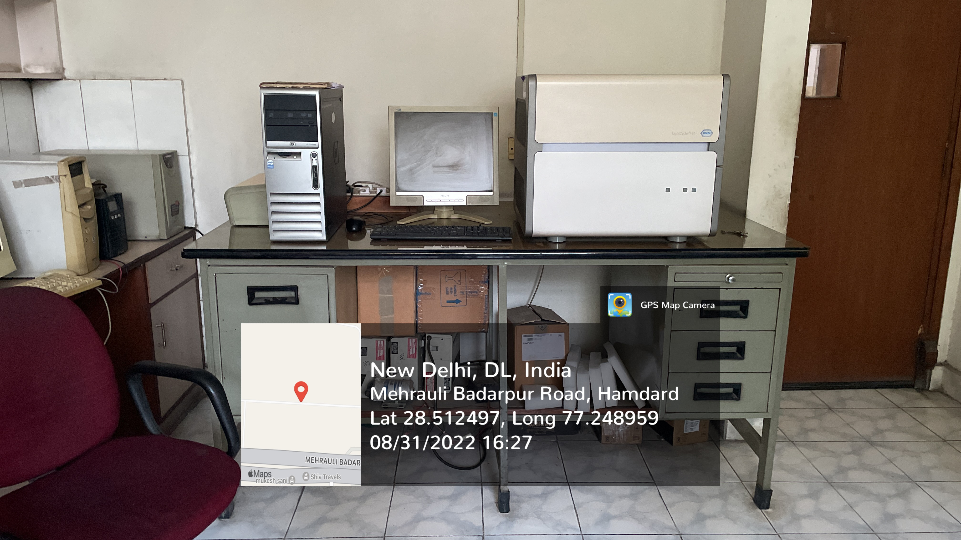
JAMIA HAMDARD
(Deemed to be University)
Hamdard Nagar, New Delhi-110062
CENTRAL INSTRUMENTATION FACILITY
https://www.youtube.com/watch?v=uIKbYh157Qc

Slide 4
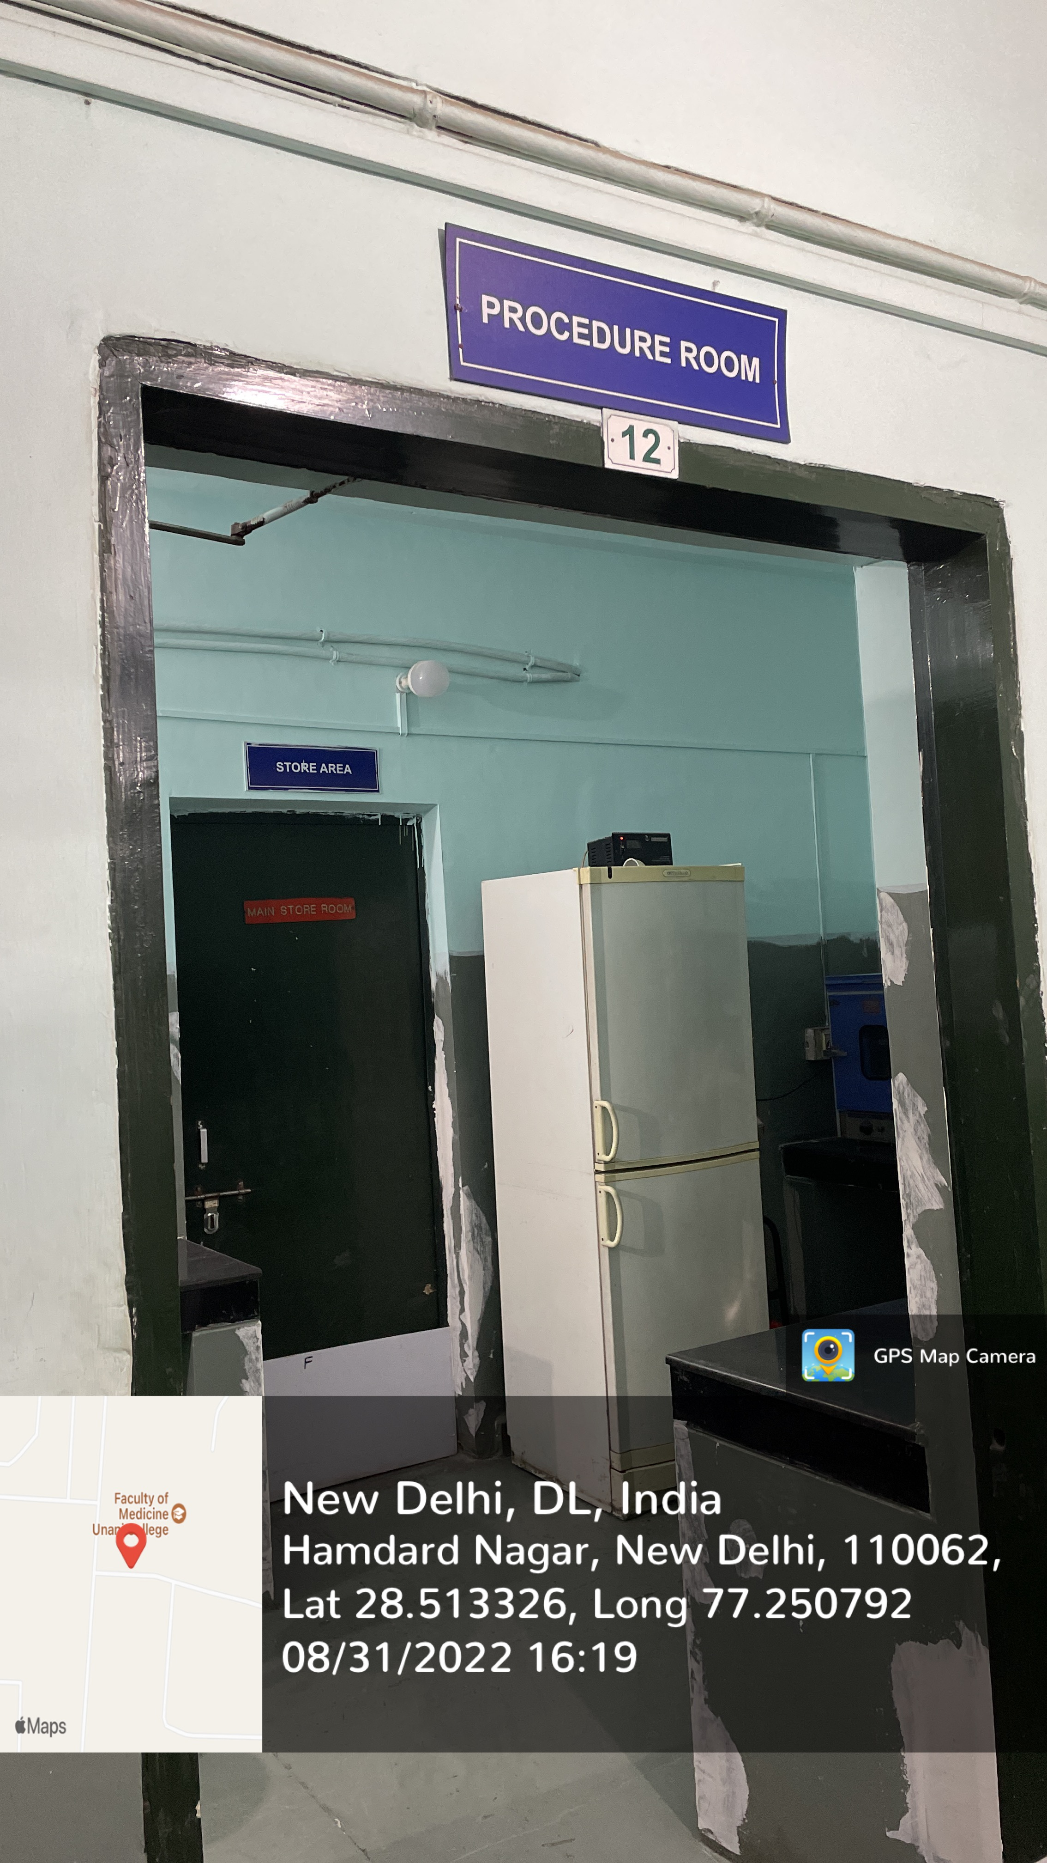
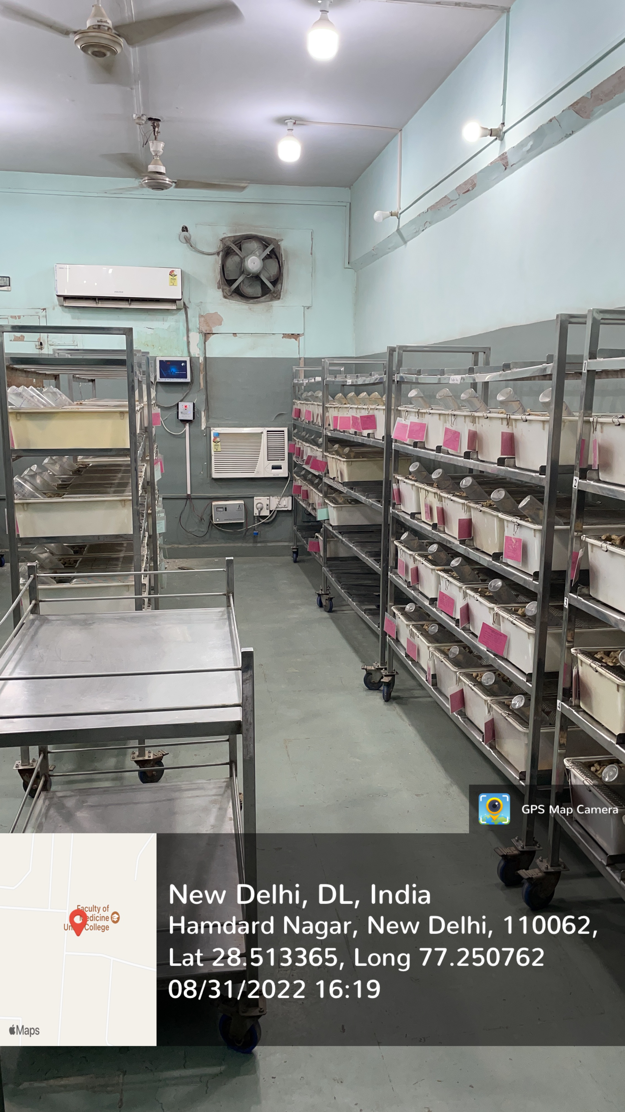
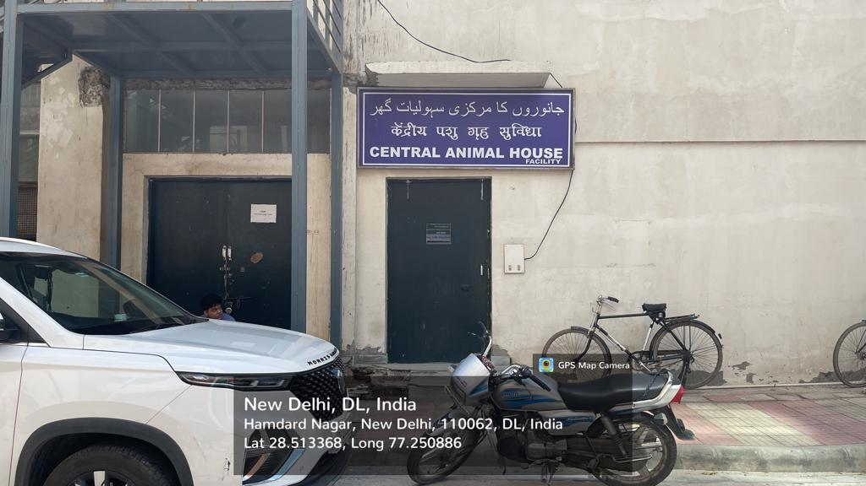
JAMIA HAMDARD
(Deemed to be University)
Hamdard Nagar, New Delhi-110062
ANIMAL HOUSE
https://www.youtube.com/watch?v=WMJwRXch4A8

Slide 5
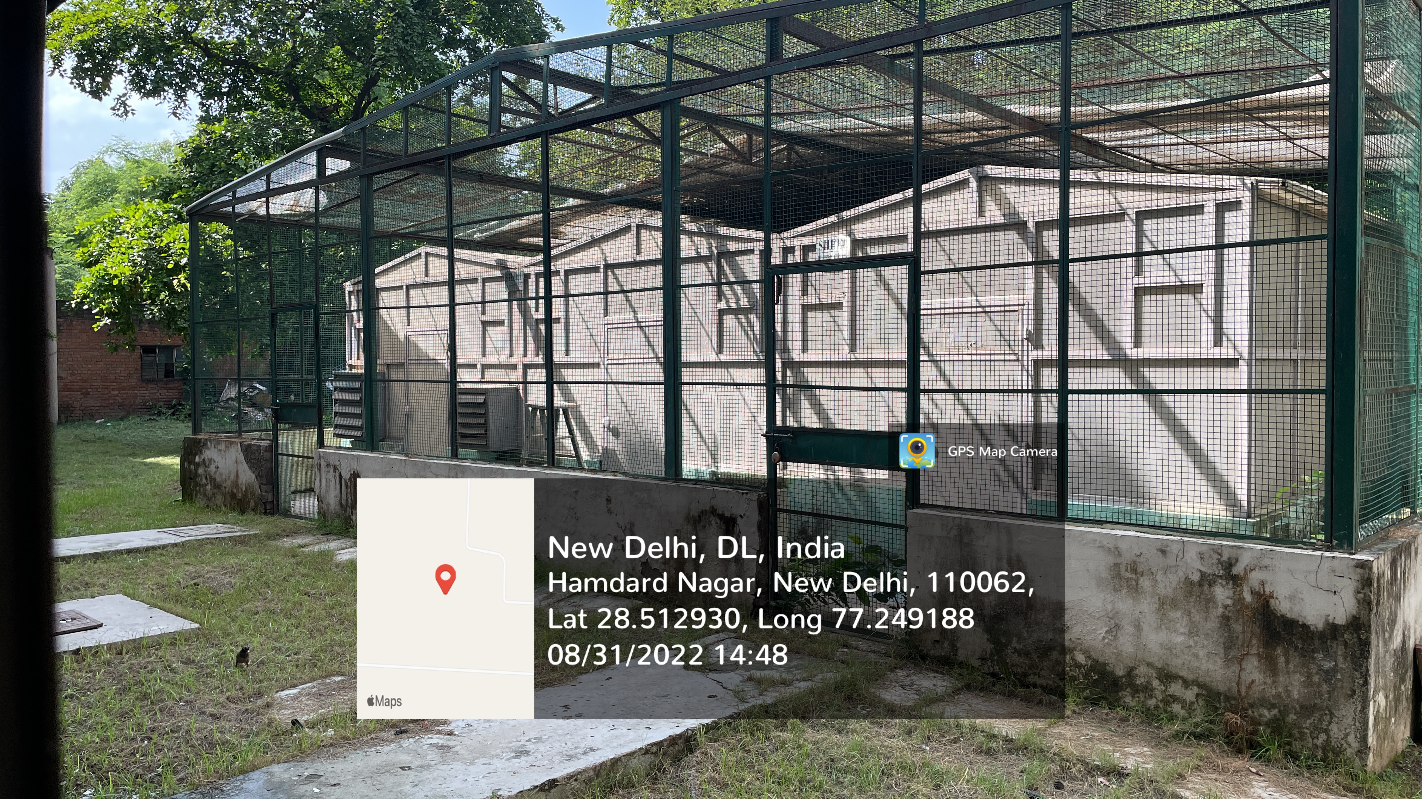
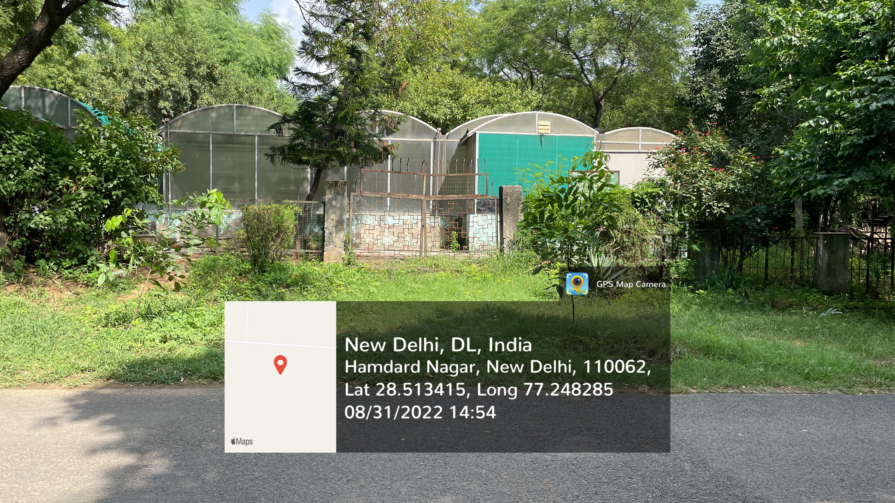
JAMIA HAMDARD
(Deemed to be University)
Hamdard Nagar, New Delhi-110062
GREEN HOUSE
https://www.youtube.com/watch?v=2q1cImGNUAU

Slide 6
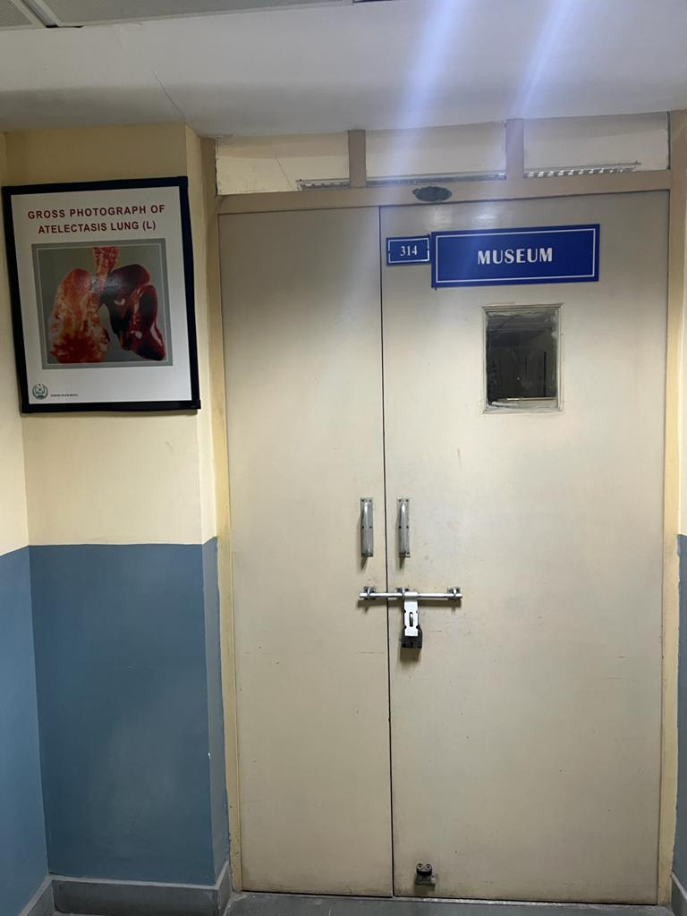
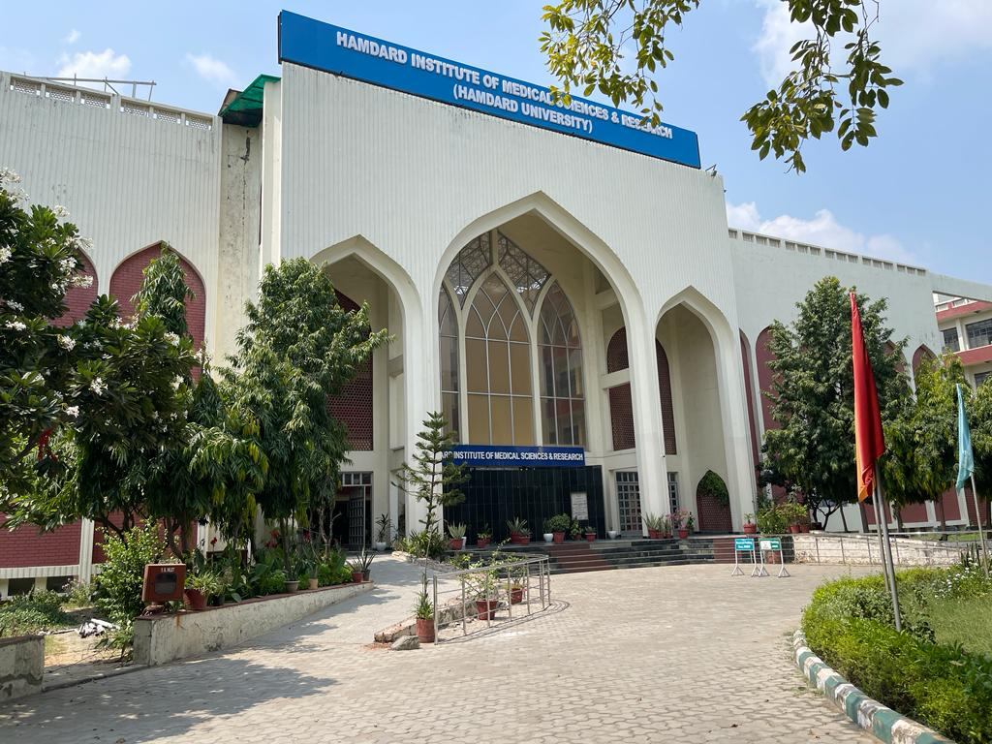
JAMIA HAMDARD
(Deemed to be University)
Hamdard Nagar, New Delhi-110062
MUSEUM
https://www.youtube.com/watch?v=ZgkPsR2S0hM&t=36s

Slide 7
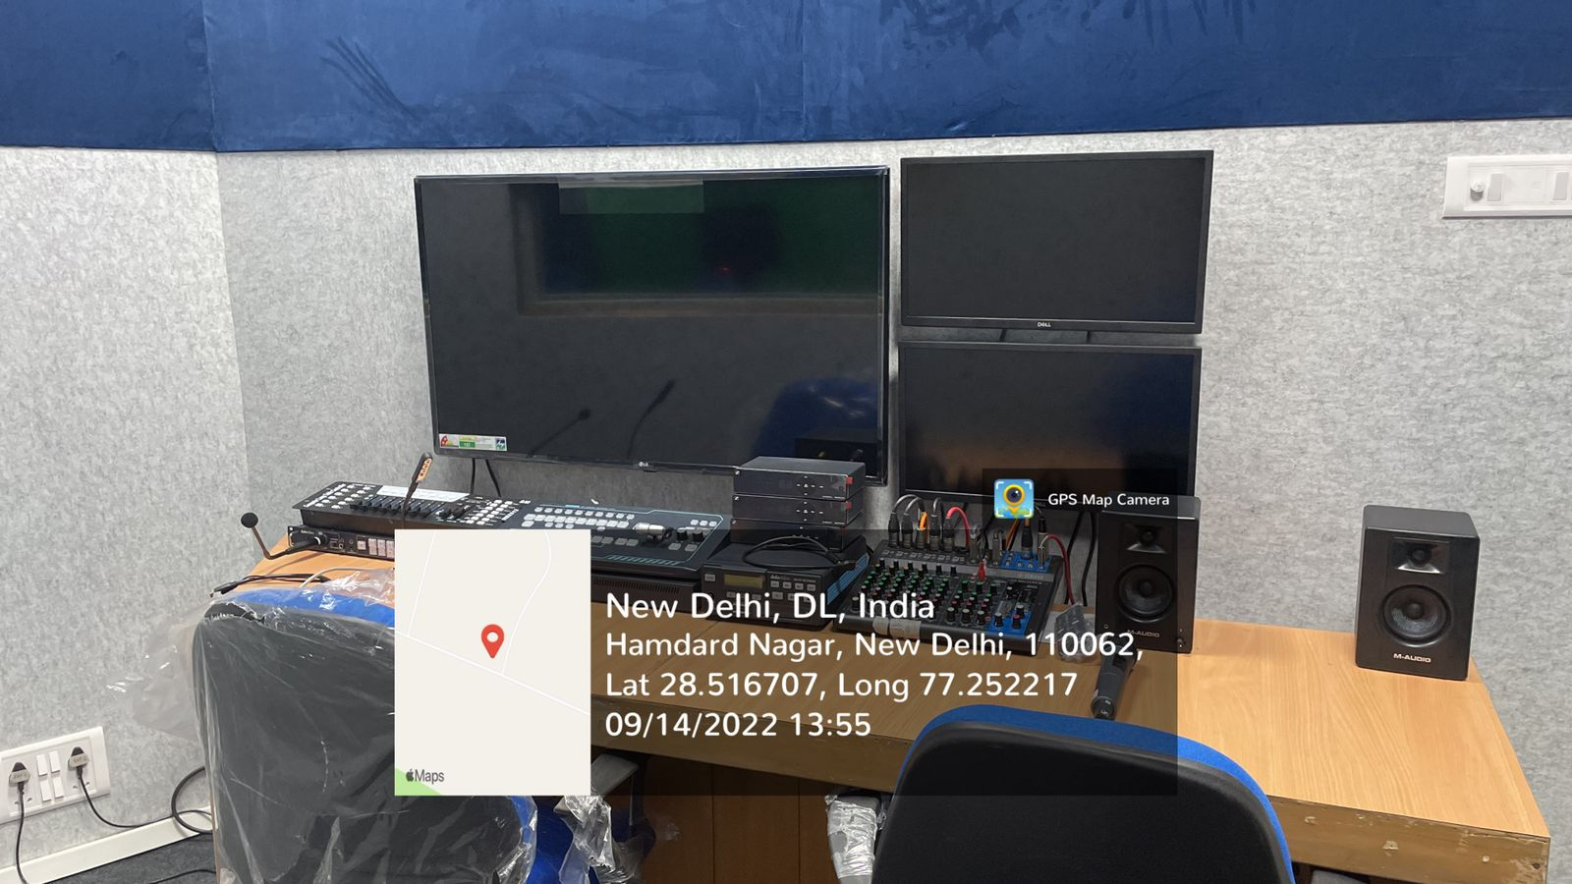
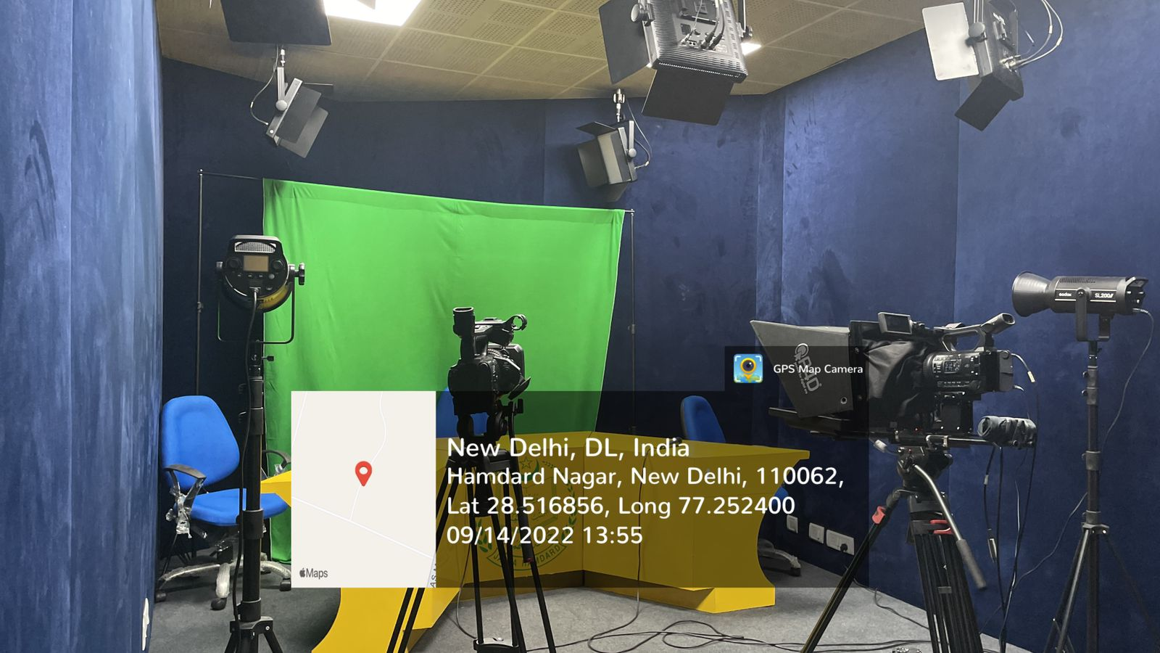
JAMIA HAMDARD
(Deemed to be University)
Hamdard Nagar, New Delhi-110062
MEDIA LABORATORY/STUDIOS
https://www.youtube.com/watch?v=MzulwIYXmkQ

Slide 8
JAMIA HAMDARD
(Deemed to be University)
Hamdard Nagar, New Delhi-110062
RESEARCH/ STATISTICAL DATABASES

Slide 9
JAMIA HAMDARD
(Deemed to be University)
Hamdard Nagar, New Delhi-110062
RESEARCH/ STATISTICAL DATABASES

Slide 10
JAMIA HAMDARD
(Deemed to be University)
Hamdard Nagar, New Delhi-110062
RESEARCH/ STATISTICAL DATABASES

Slide 11
JAMIA HAMDARD
(Deemed to be University)
Hamdard Nagar, New Delhi-110062
RESEARCH/ STATISTICAL DATABASES

Slide 12
JAMIA HAMDARD
(Deemed to be University)
Hamdard Nagar, New Delhi-110062
RESEARCH/ STATISTICAL DATABASES

Slide 13
JAMIA HAMDARD
(Deemed to be University)
Hamdard Nagar, New Delhi-110062
RESEARCH/ STATISTICAL DATABASES

Slide 14
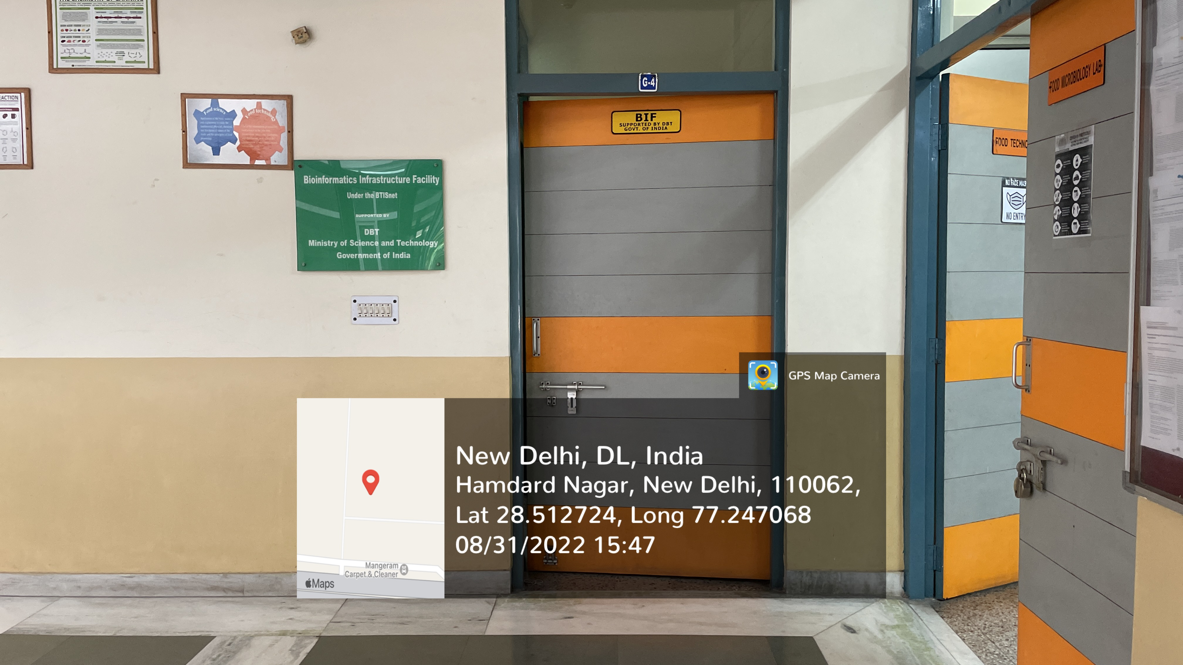
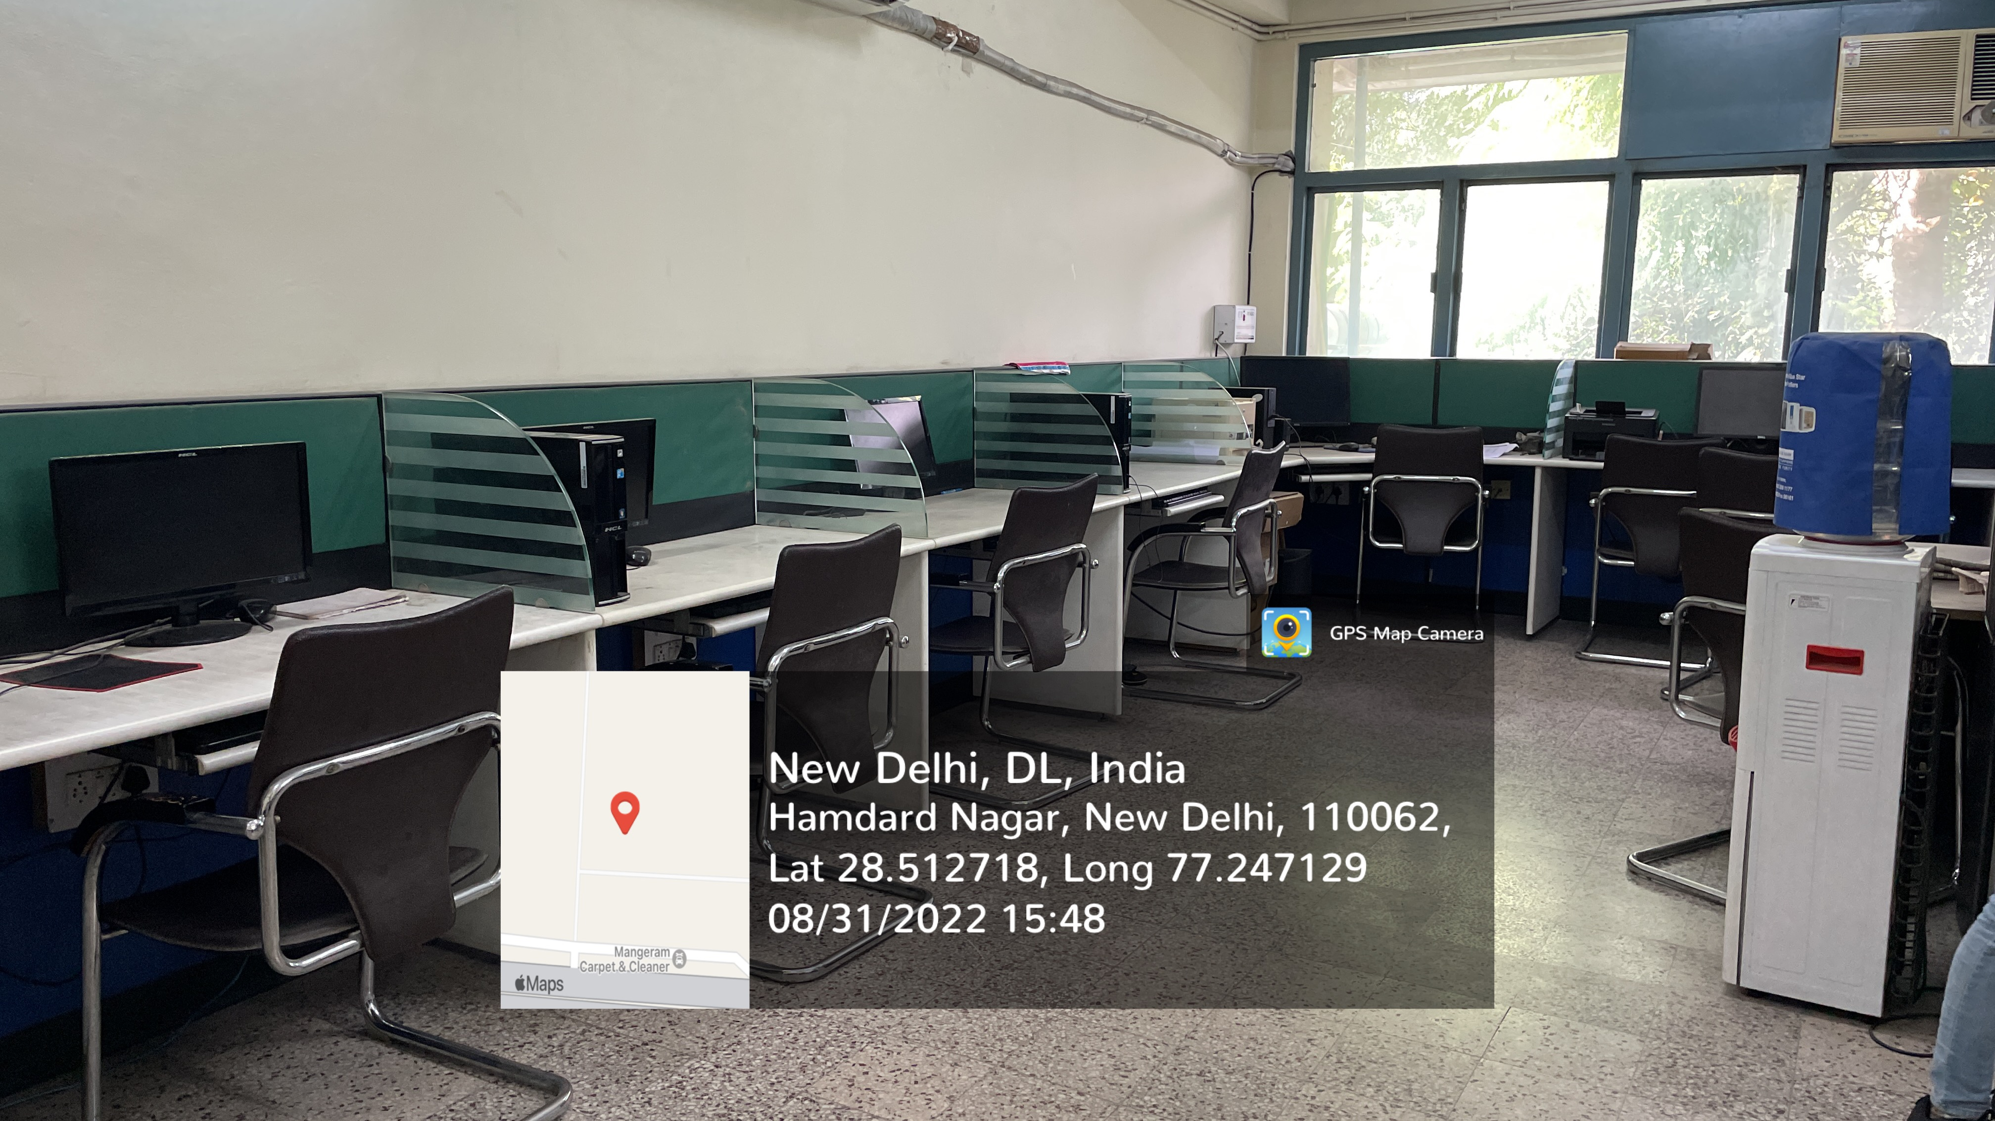
JAMIA HAMDARD
(Deemed to be University)
Hamdard Nagar, New Delhi-110062
BIF CENTER
RESEARCH/ STATISTICAL DATABASES
https://www.youtube.com/watch?v=y1Tb5frGQ5g

Slide 15
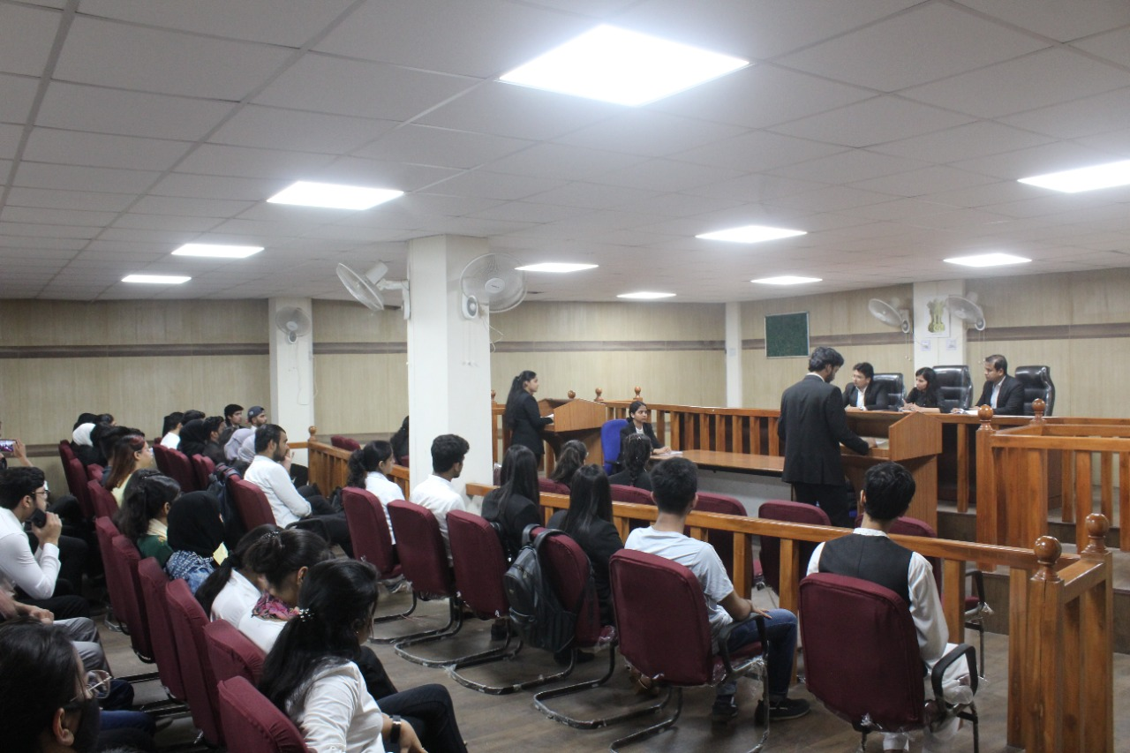
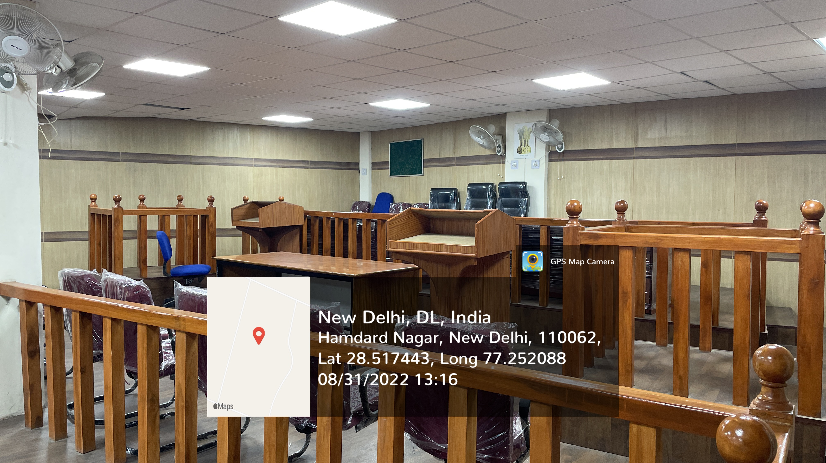
JAMIA HAMDARD
(Deemed to be University)
Hamdard Nagar, New Delhi-110062
MOOT COURT
https://www.youtube.com/watch?v=EZMpCb-F6V8

Slide 16
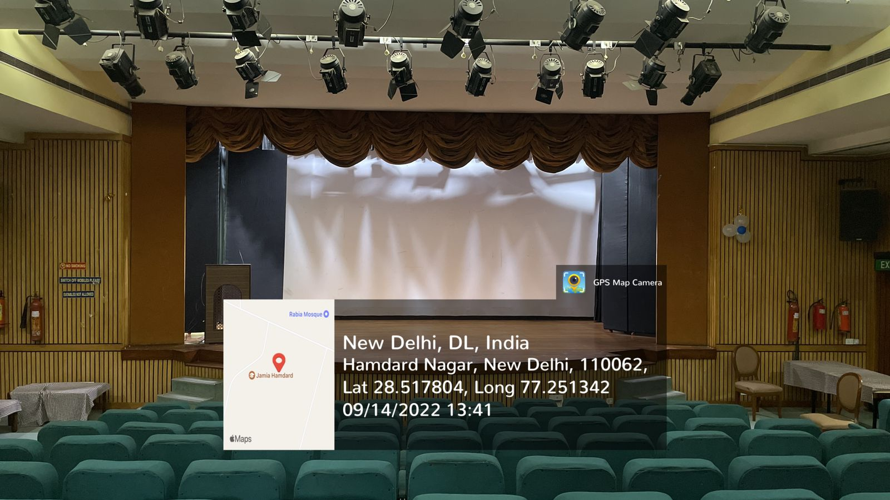
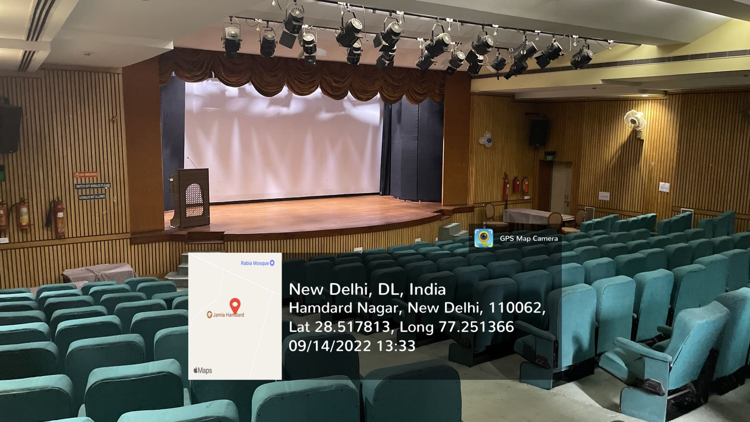
JAMIA HAMDARD
(Deemed to be University)
Hamdard Nagar, New Delhi-110062
THEATRE
https://www.youtube.com/watch?v=M5SIl3jZcQ0

Slide 17
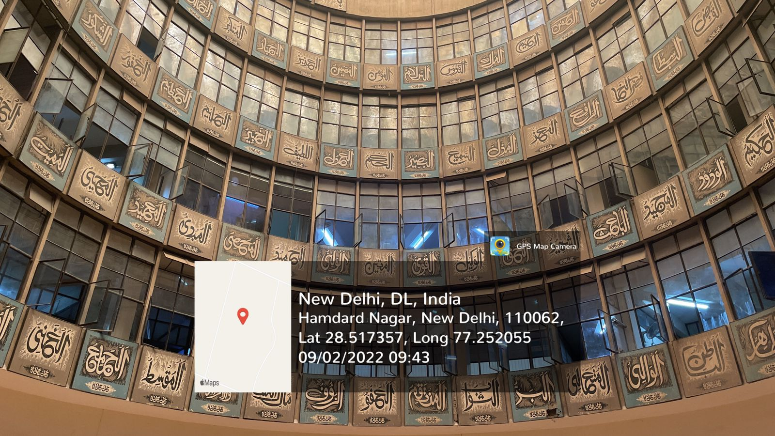
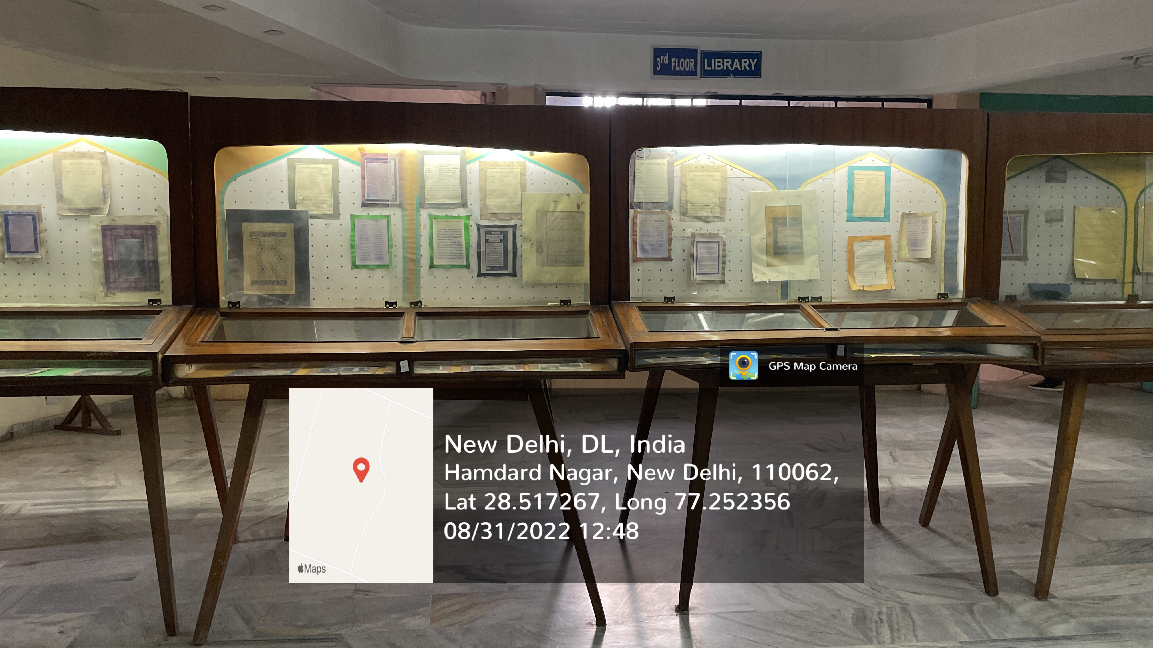
JAMIA HAMDARD
(Deemed to be University)
Hamdard Nagar, New Delhi-110062
ART GALLERY
https://www.youtube.com/watch?v=_eM9H_3hAJA

Slide 18
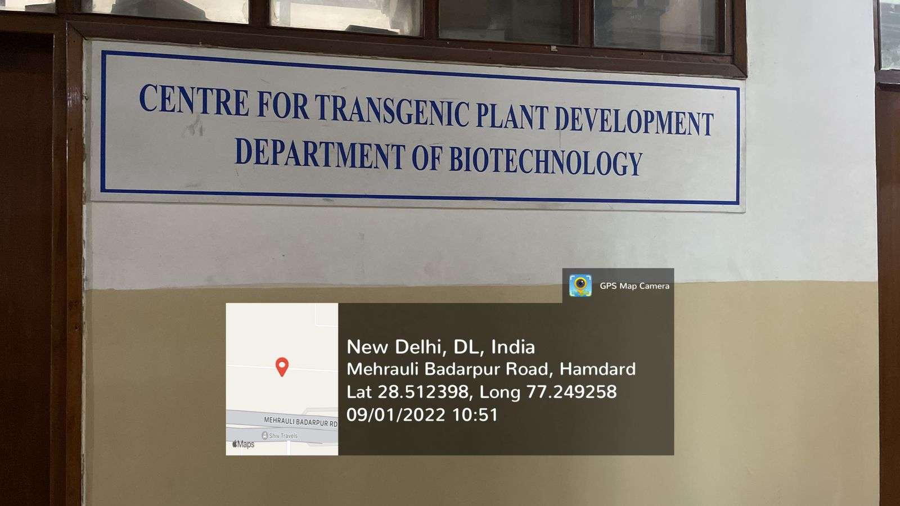
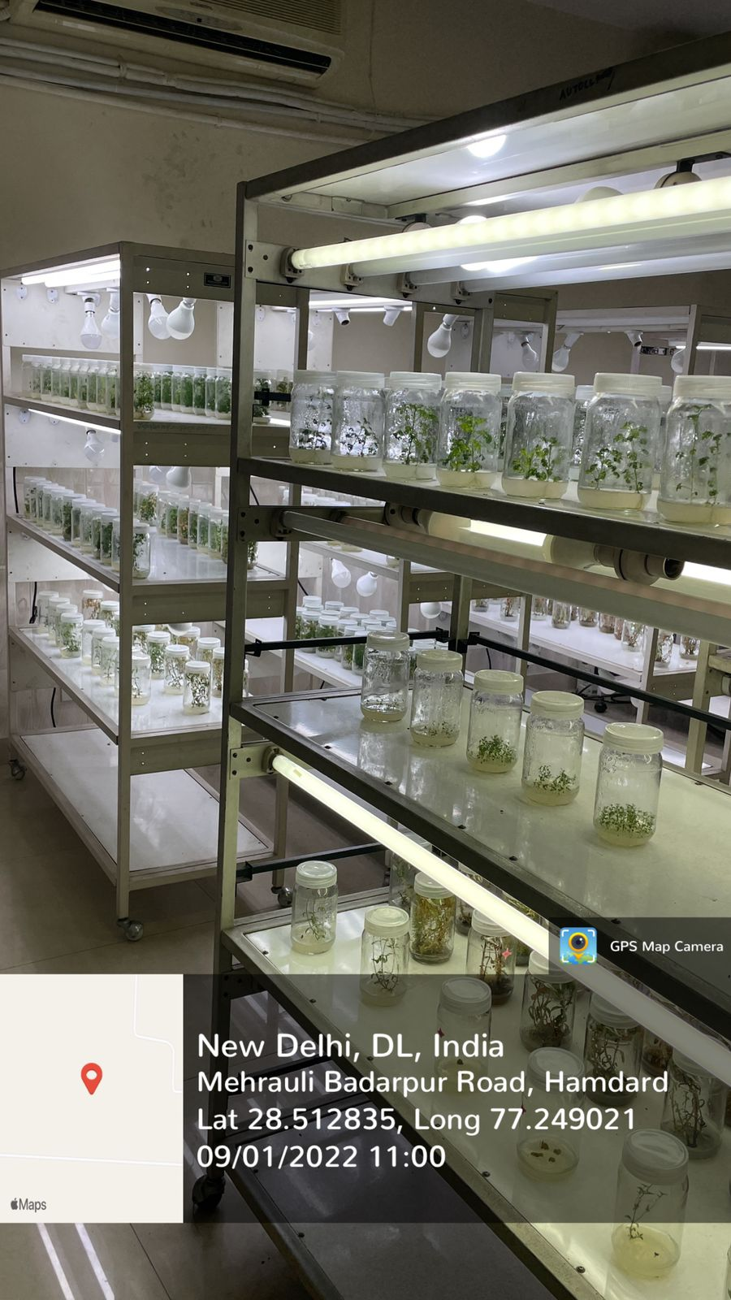
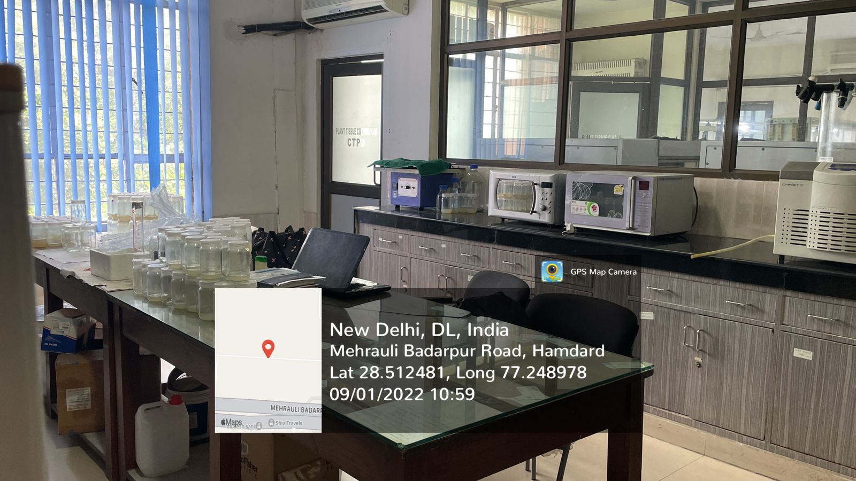
JAMIA HAMDARD
(Deemed to be University)
Hamdard Nagar, New Delhi-110062
CENTER FOR TRANSGENIC PLANT DEVELOPMENT
https://www.youtube.com/watch?v=AtissrJaKSI

Slide 19
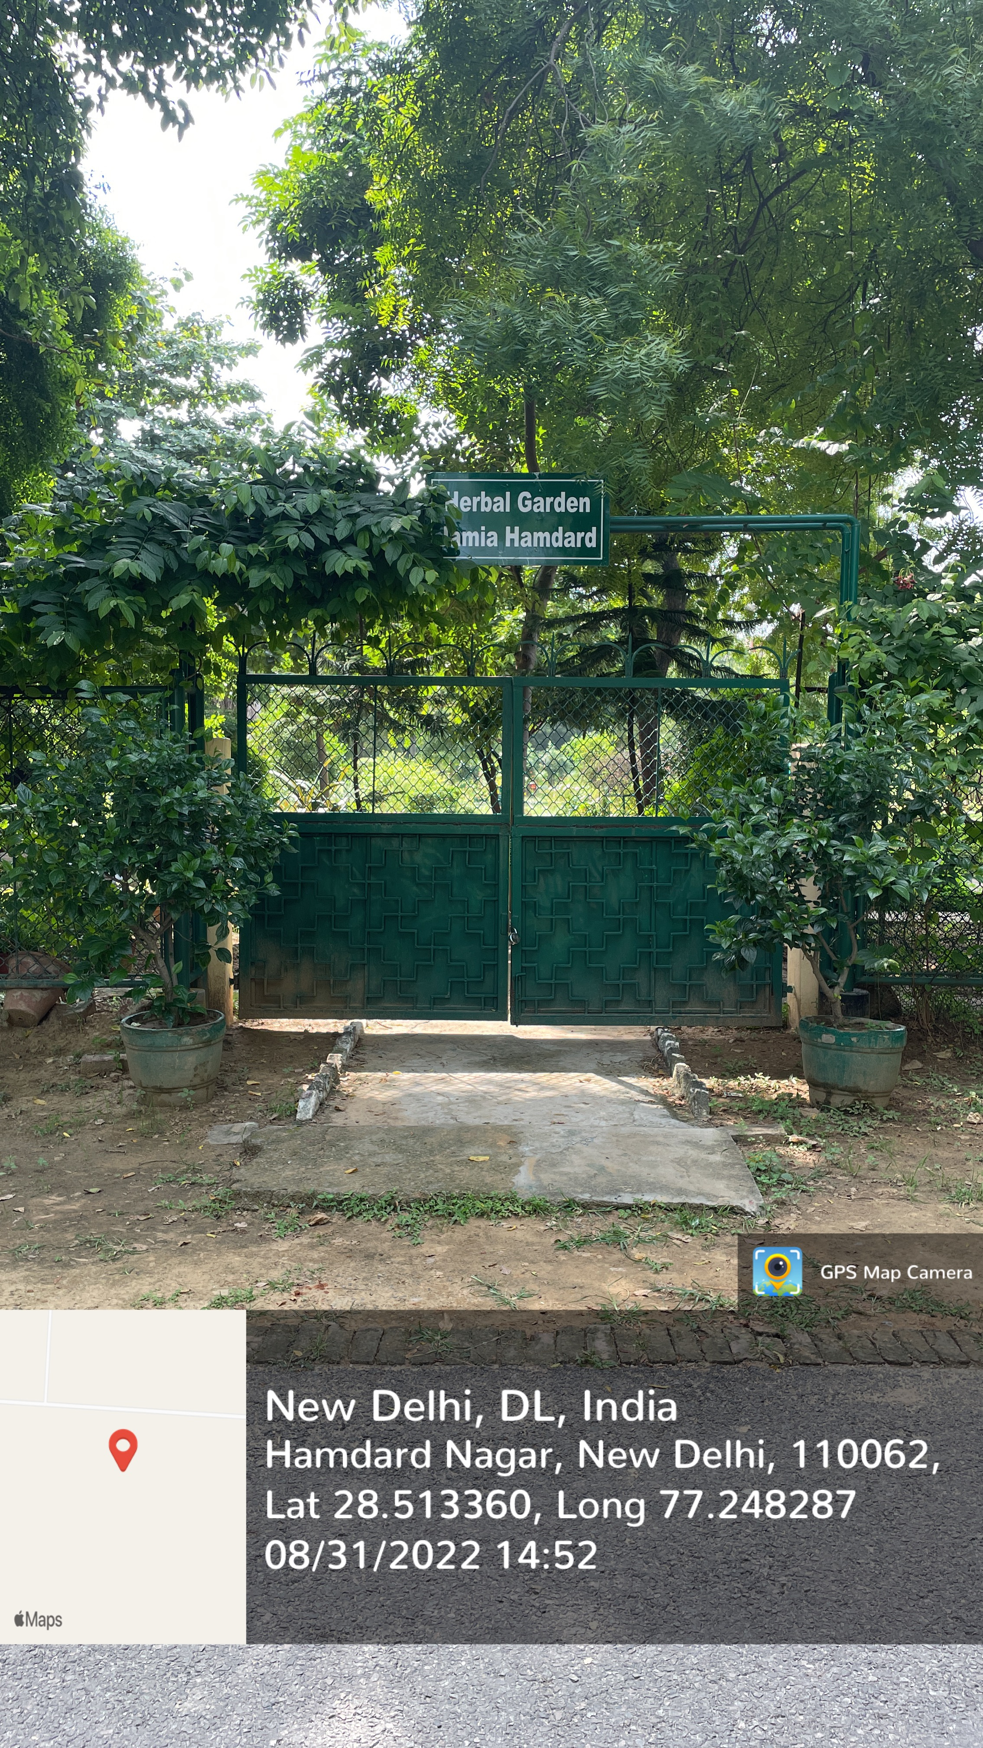
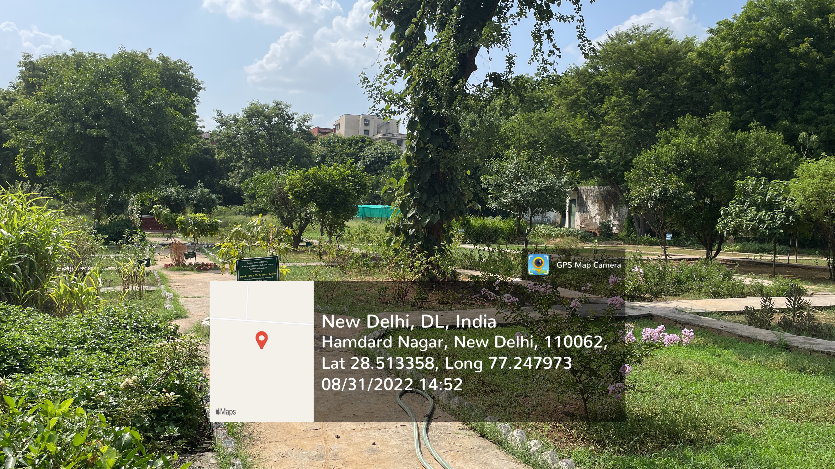
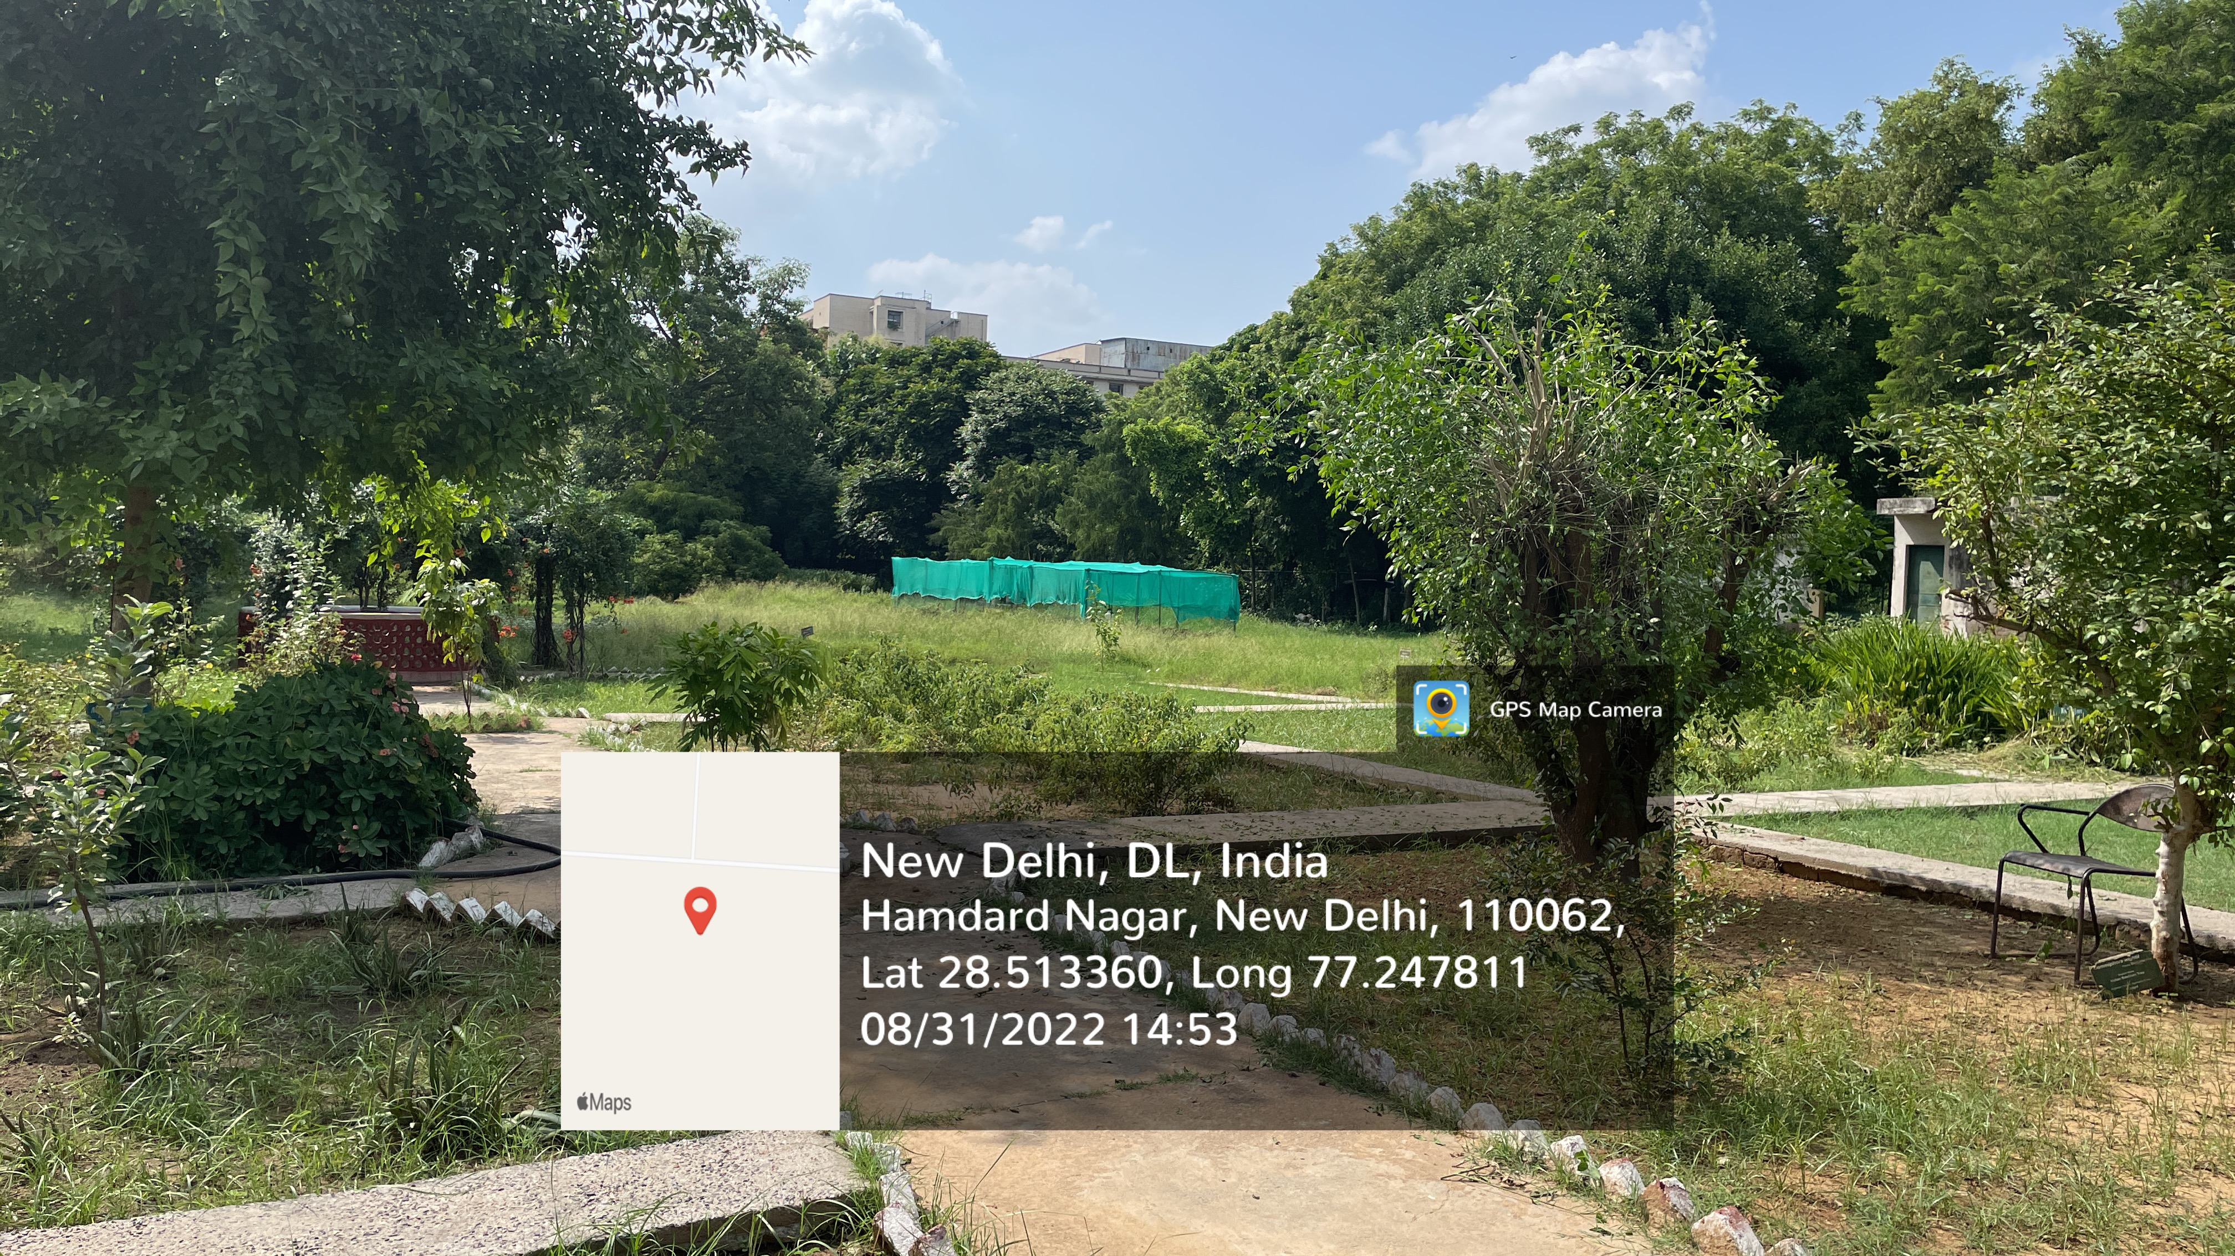
JAMIA HAMDARD
(Deemed to be University)
Hamdard Nagar, New Delhi-110062
HERBAL GARDEN
https://www.youtube.com/watch?v=4NoDmxDErSw

Slide 20
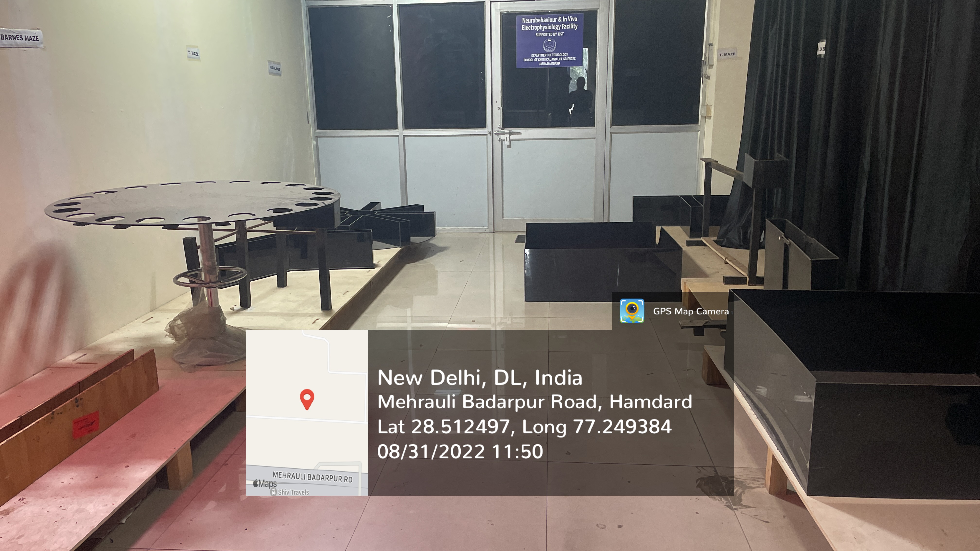
JAMIA HAMDARD
(Deemed to be University)
Hamdard Nagar, New Delhi-110062
NEUROBEHAVIORAL FACILITY
https://www.youtube.com/watch?v=-KJs8Vl0E7g

Slide 21
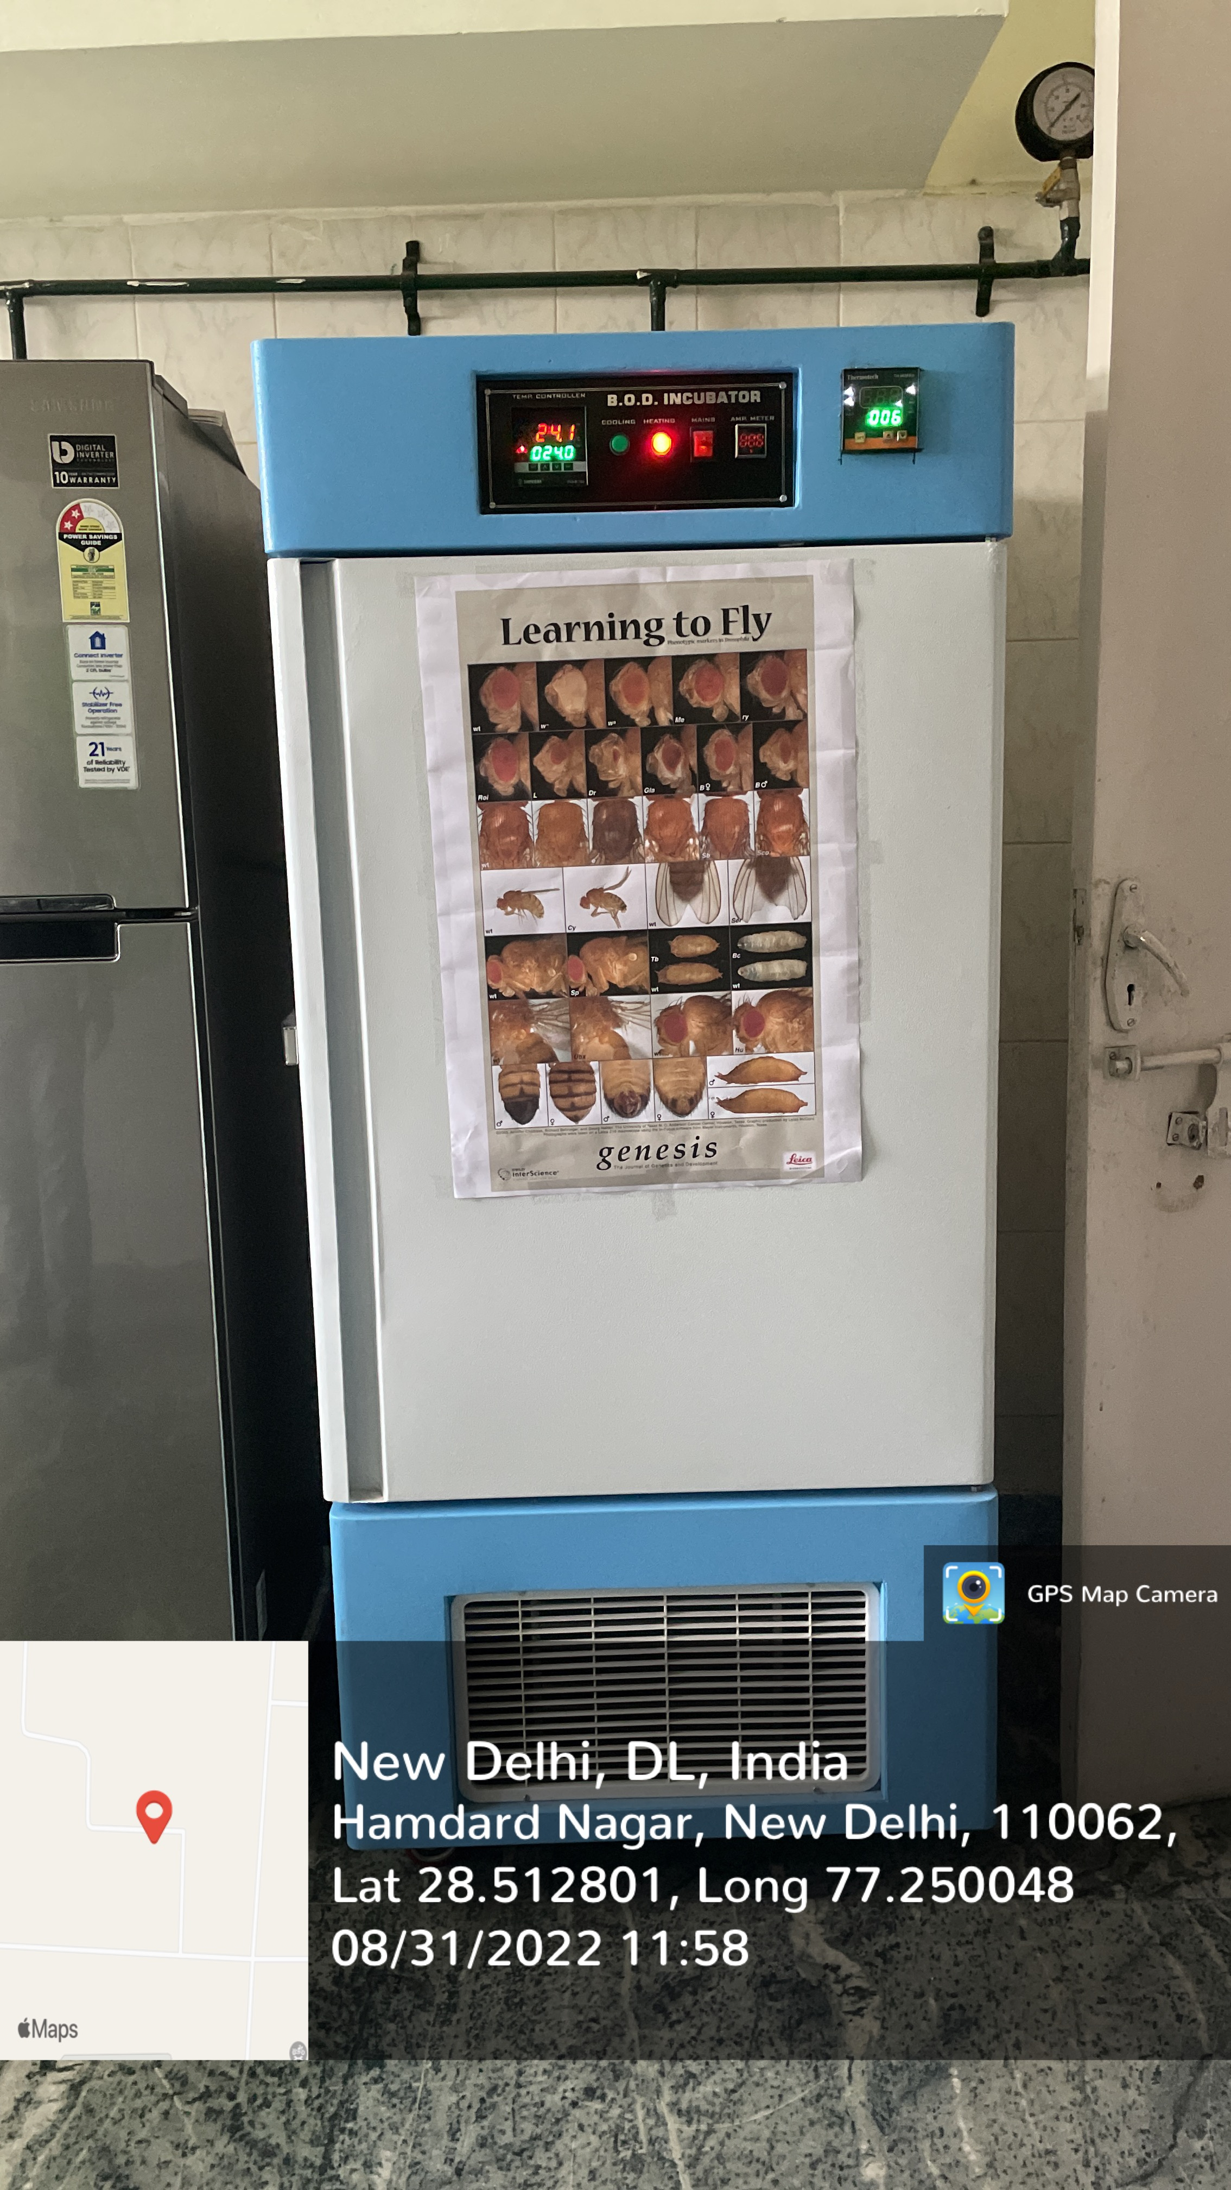
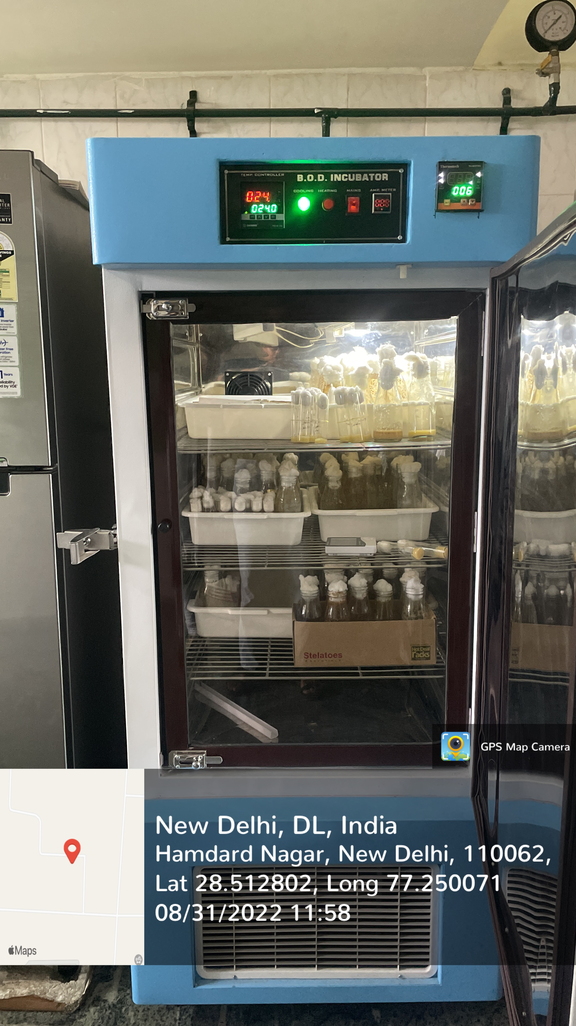
JAMIA HAMDARD
(Deemed to be University)
Hamdard Nagar, New Delhi-110062
FLY FACILITY
https://www.youtube.com/watch?v=304o7ZBuDVI

Slide 22
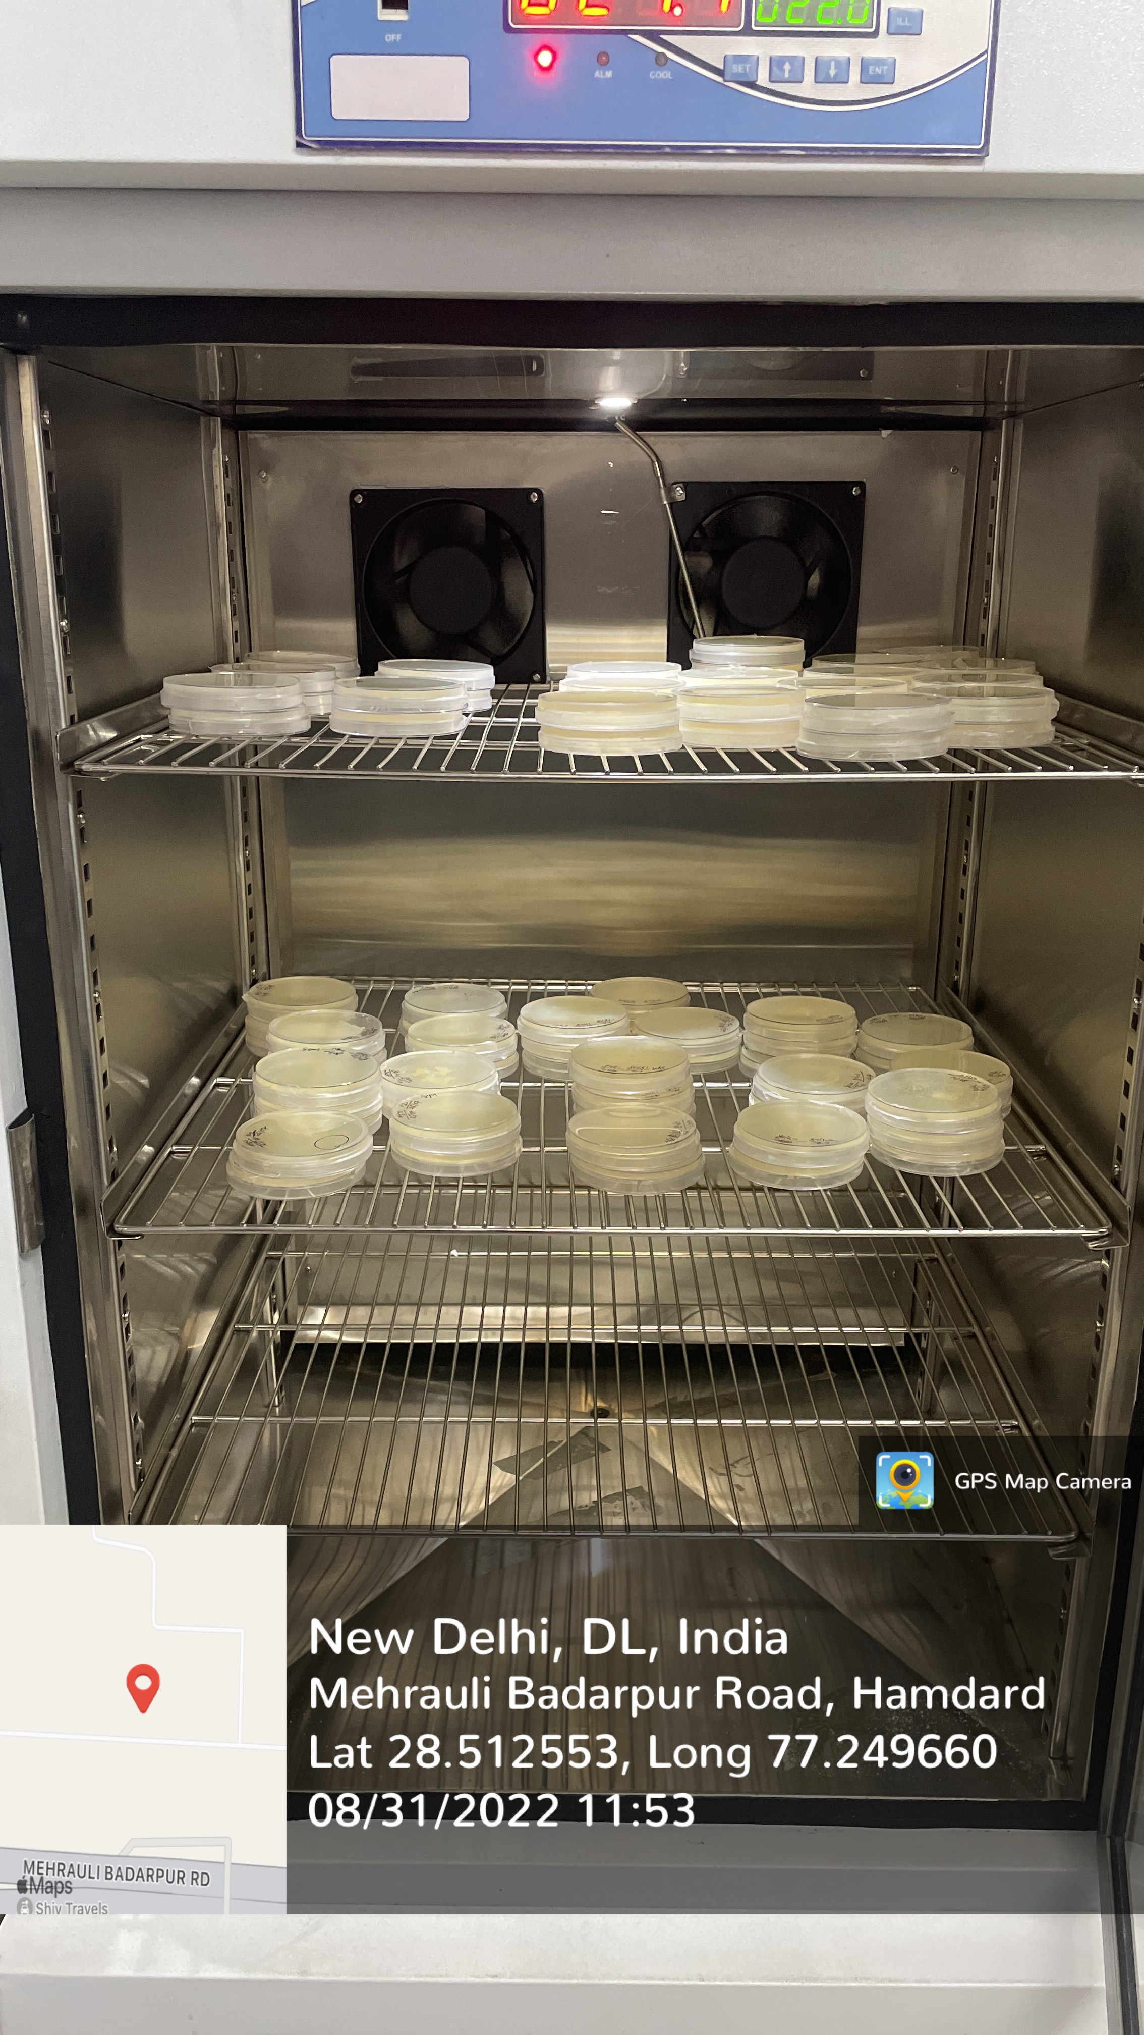
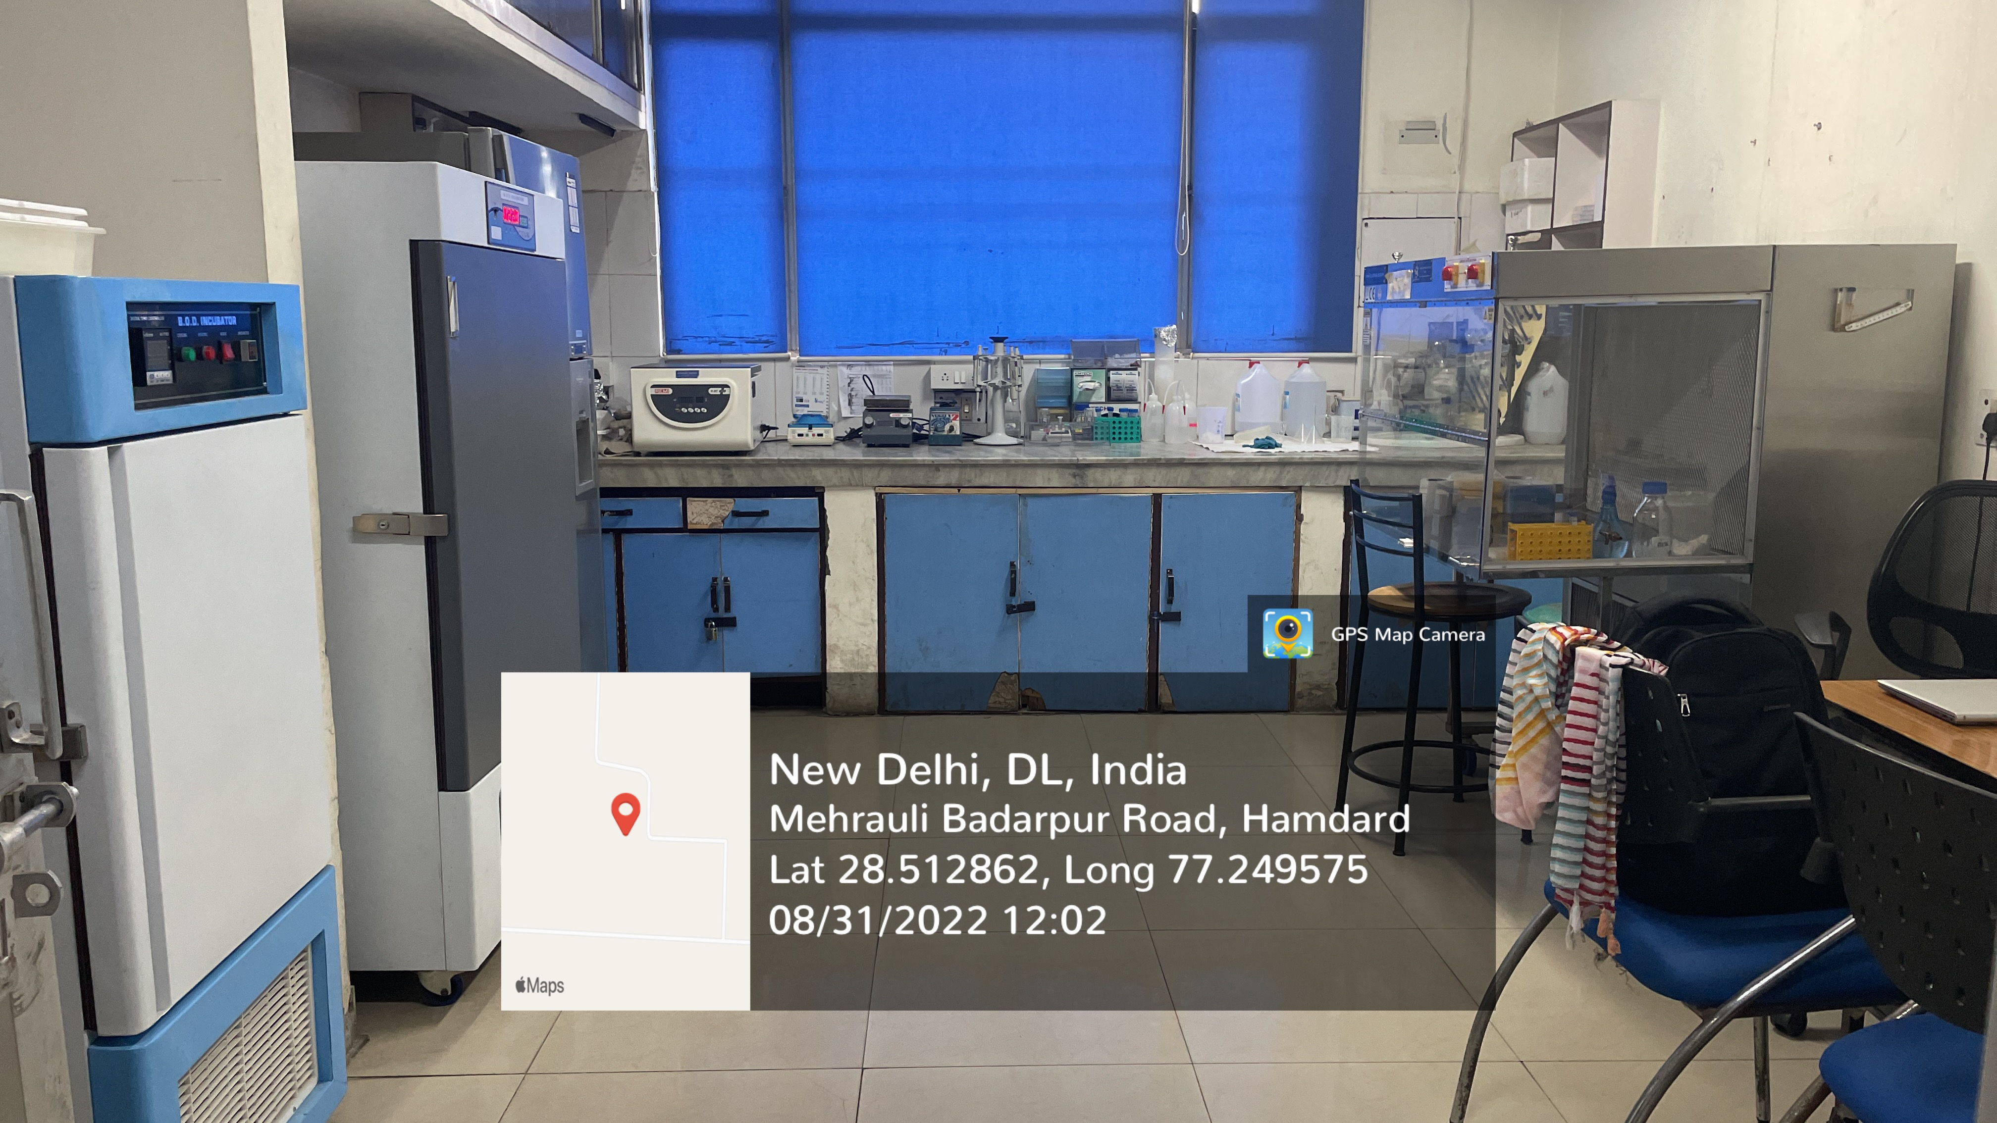
JAMIA HAMDARD
(Deemed to be University)
Hamdard Nagar, New Delhi-110062
C. elegans LABORATORY
https://www.youtube.com/watch?v=F4bJ5e9RTXk

Slide 23
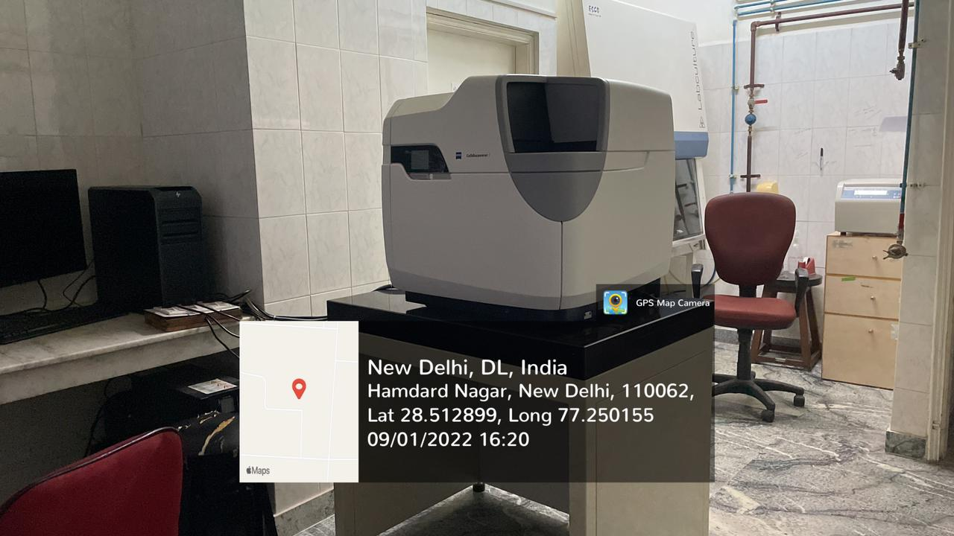
JAMIA HAMDARD
(Deemed to be University)
Hamdard Nagar, New Delhi-110062
LIVE CELL IMAGING
https://www.youtube.com/watch?v=nsNDwHNkg7Q

Slide 24
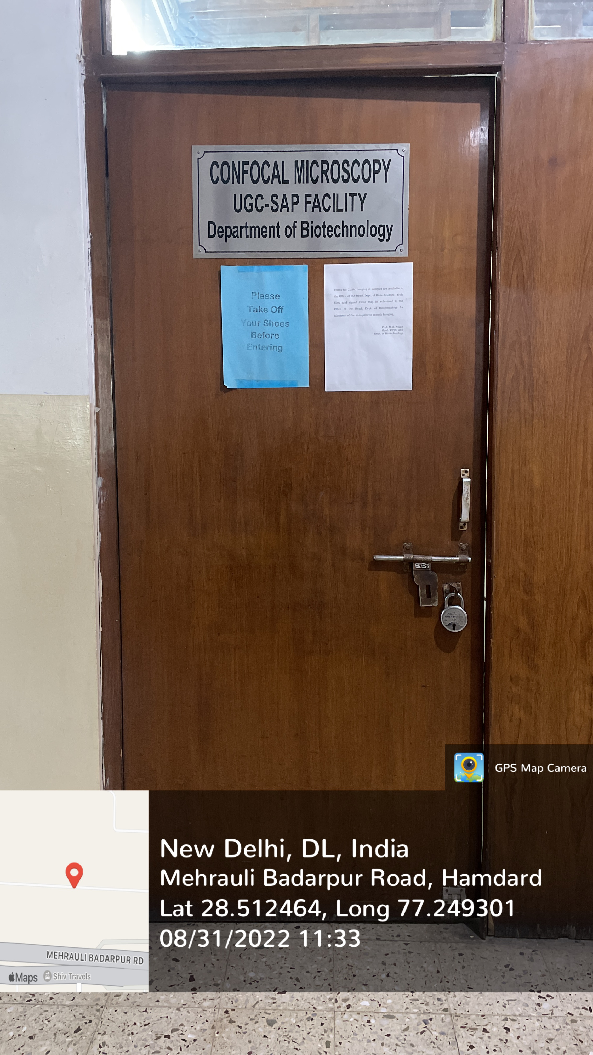
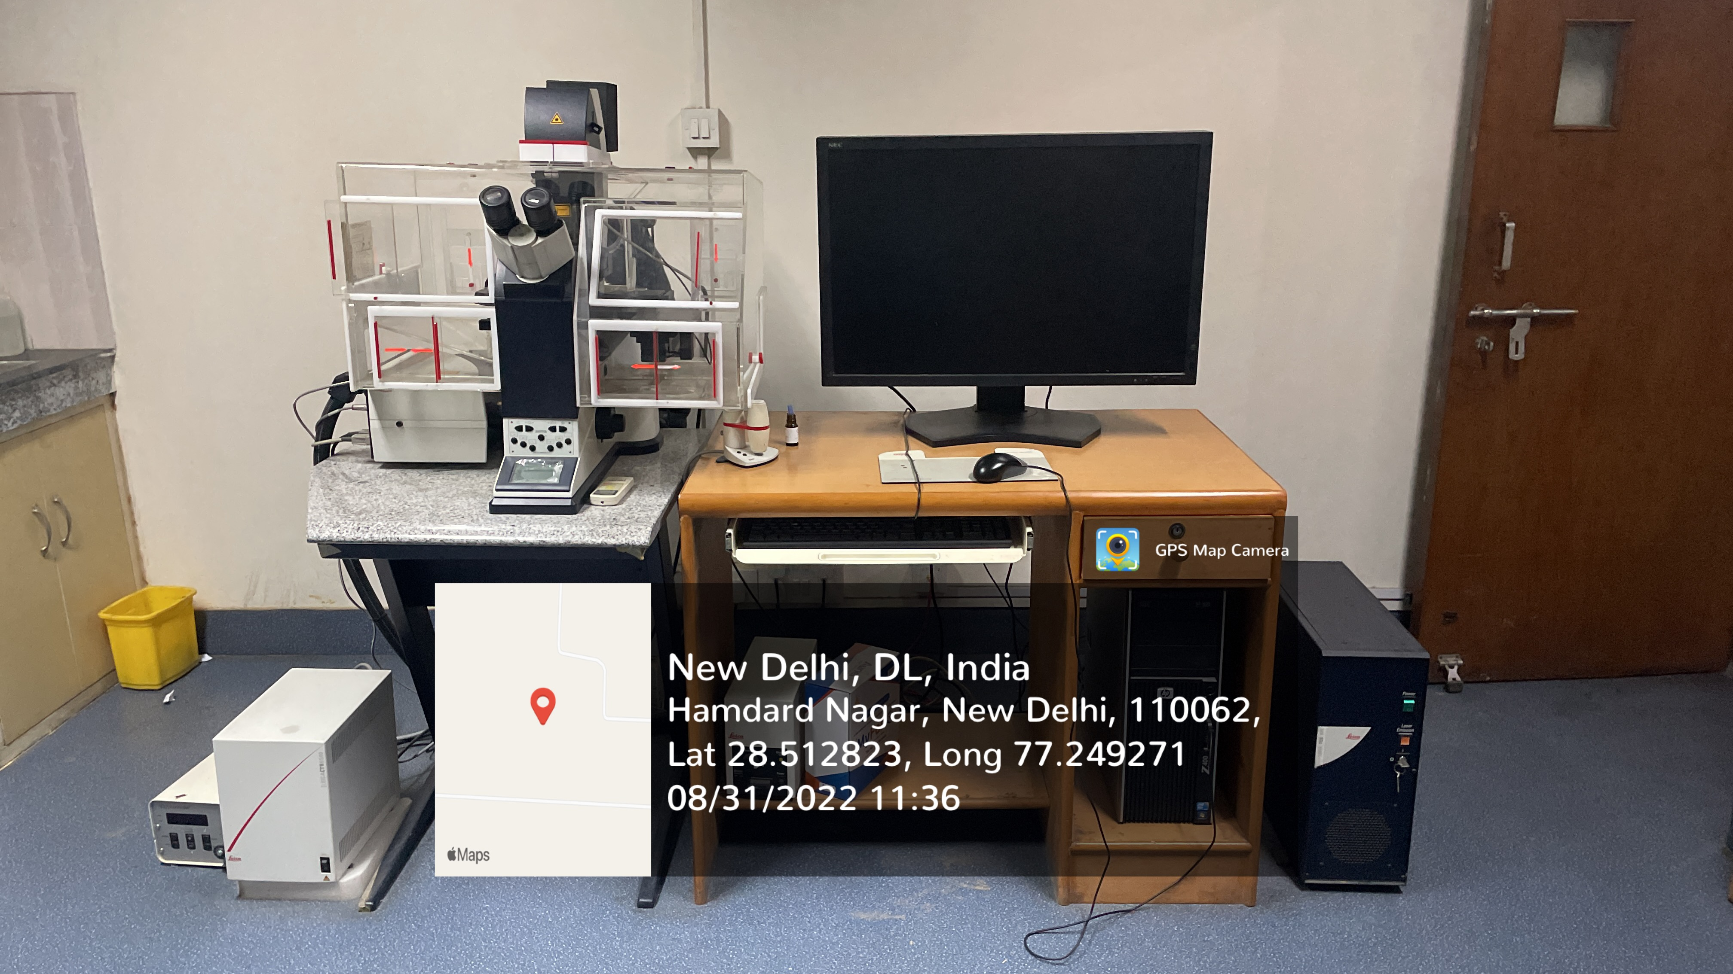
JAMIA HAMDARD
(Deemed to be University)
Hamdard Nagar, New Delhi-110062
CONFOCAL LASER SCANNING MICROSCOPE
https://www.youtube.com/watch?v=qRwN5qYQOjU

Slide 25
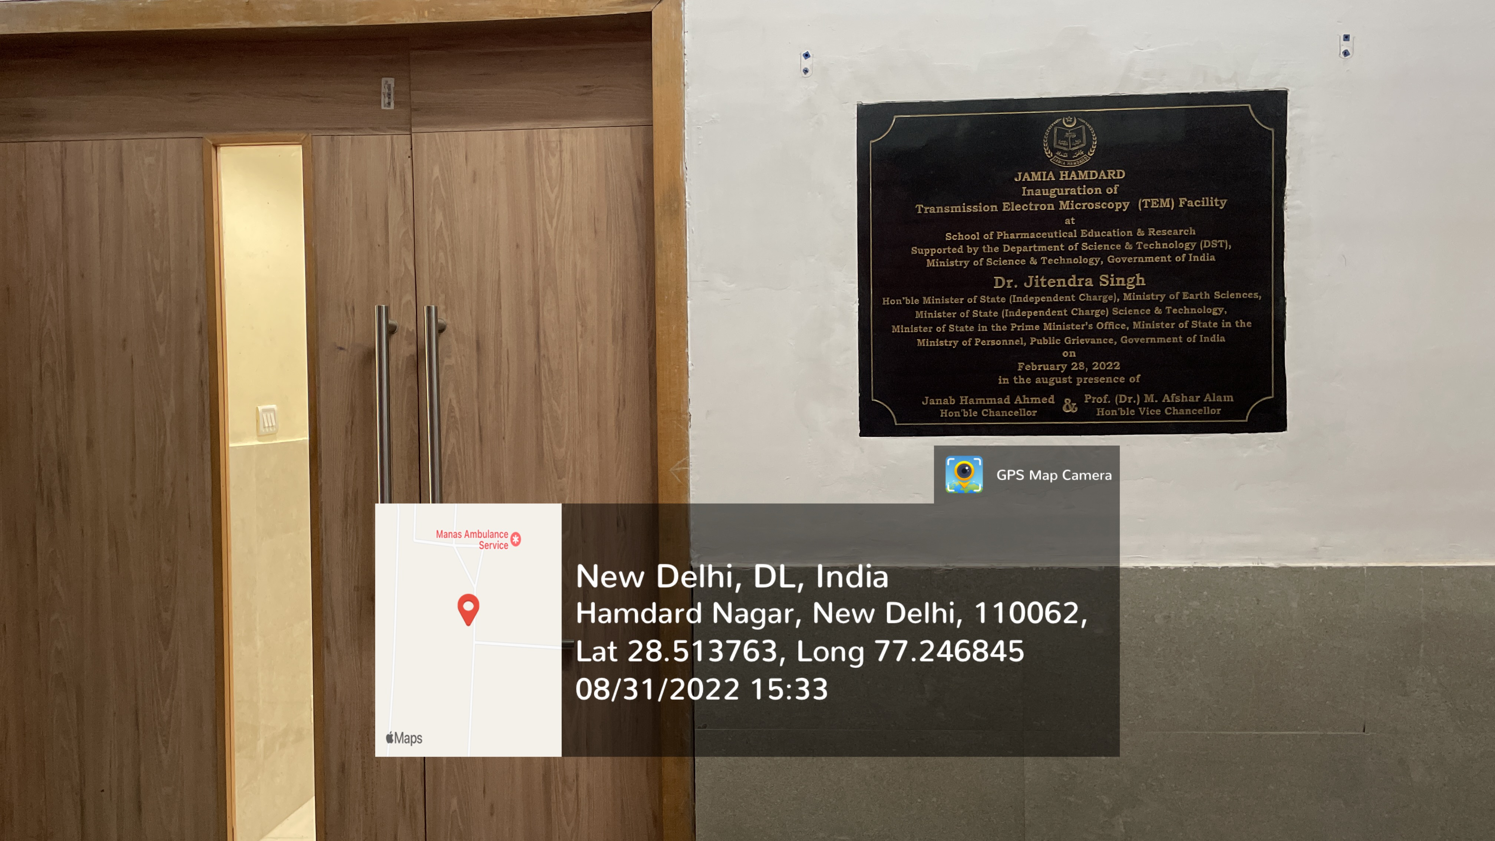
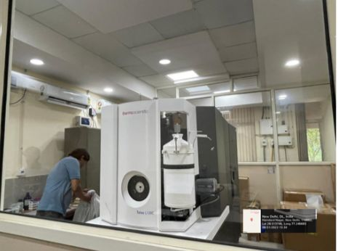
JAMIA HAMDARD
(Deemed to be University)
Hamdard Nagar, New Delhi-110062
TRANSMISSION ELECTRON MICROSCOPY (TEM)
https://www.youtube.com/watch?v=UYZGa_D4i6I

Slide 26
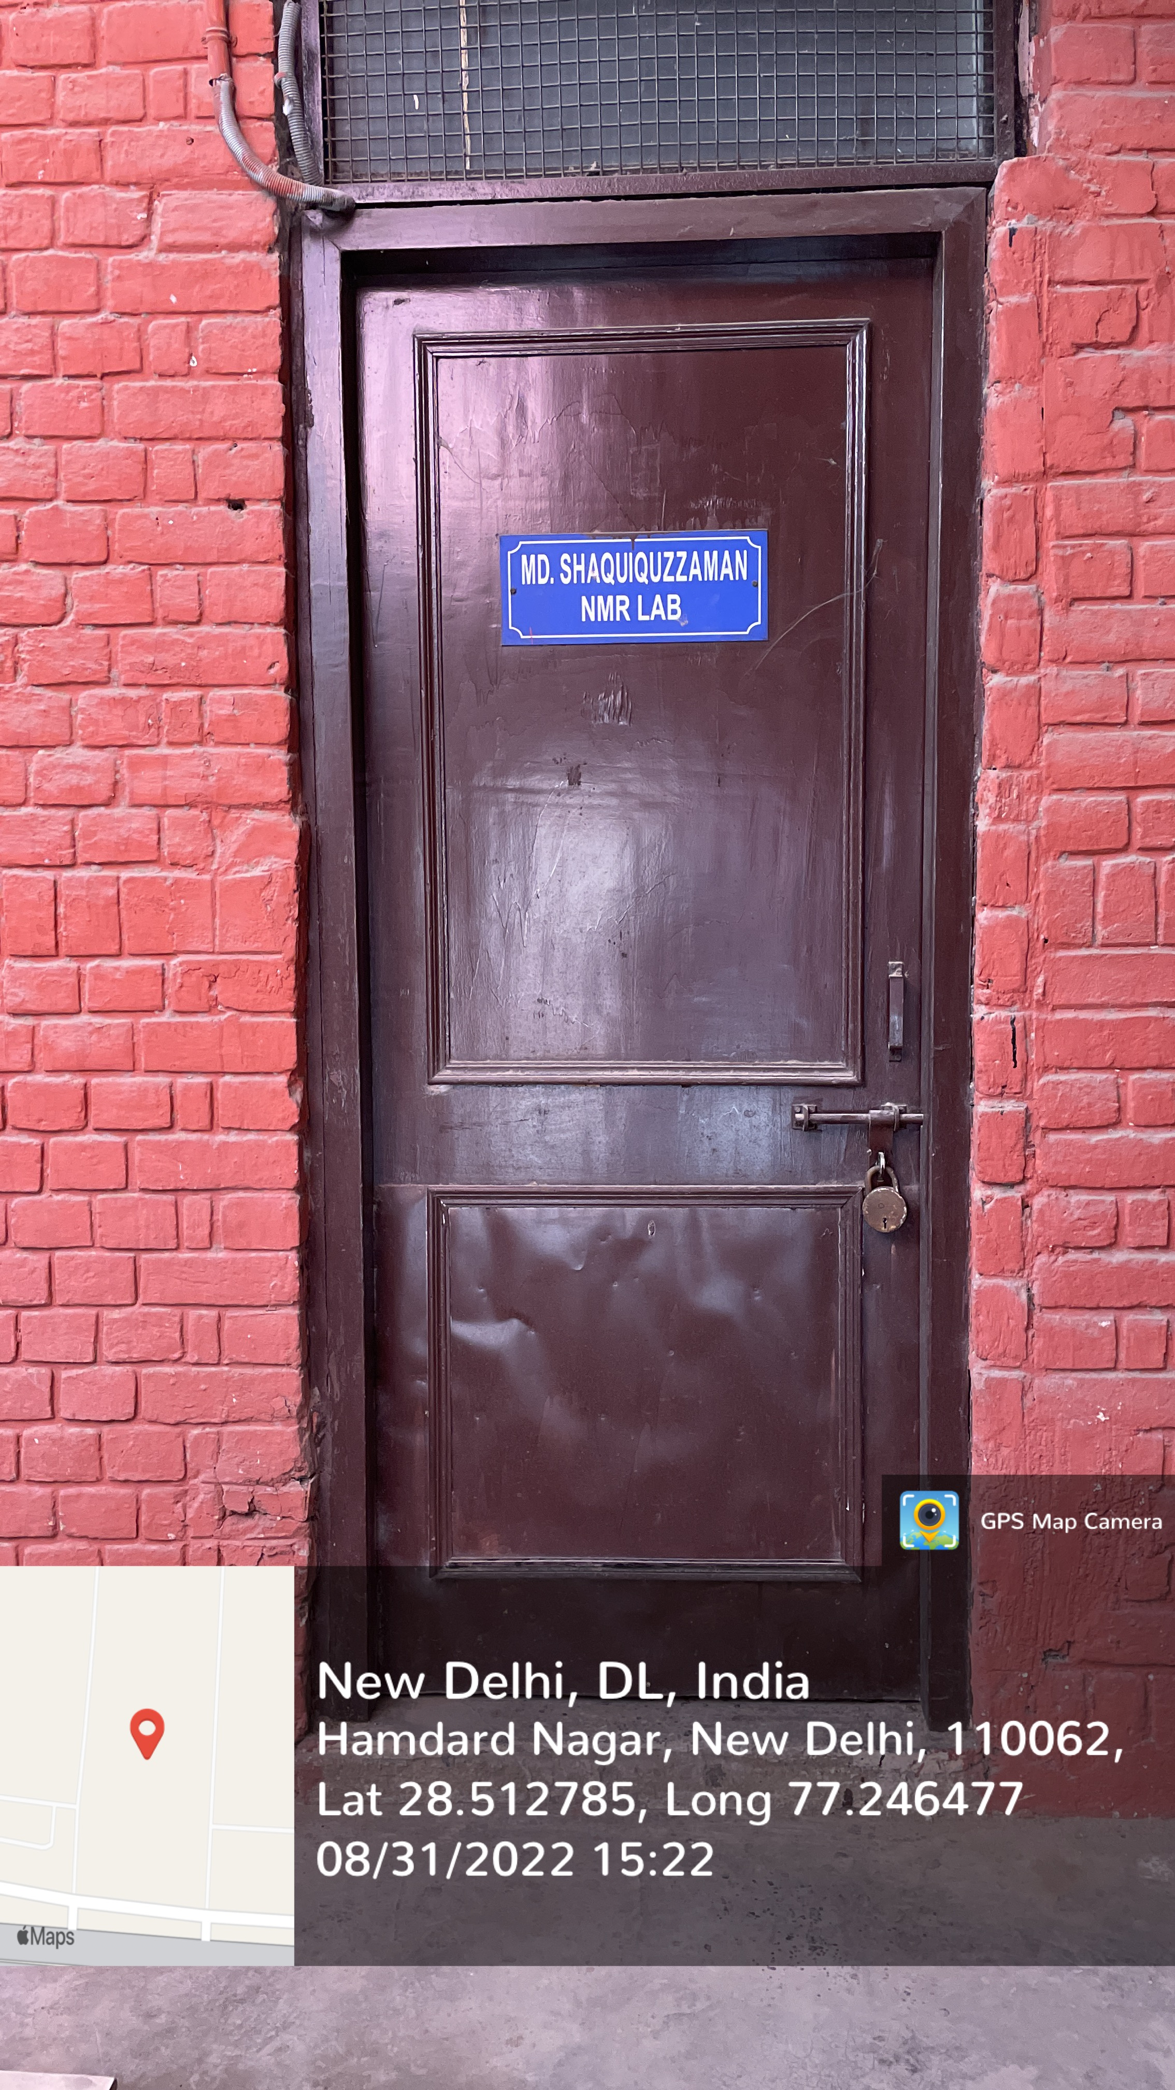
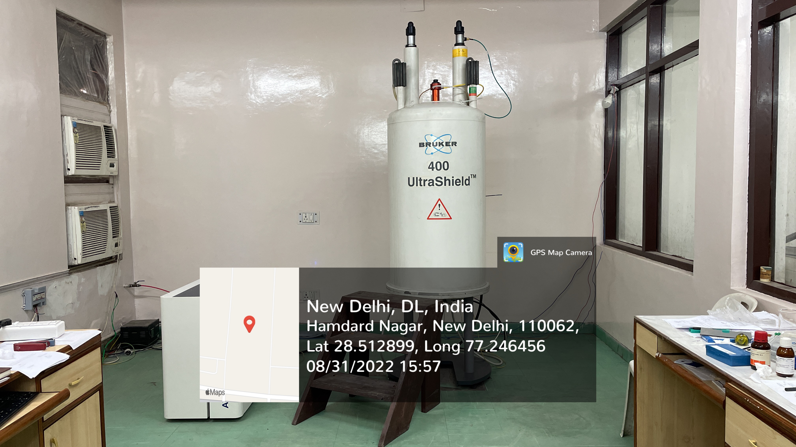
JAMIA HAMDARD
(Deemed to be University)
Hamdard Nagar, New Delhi-110062
NUCLEAR MAGNETIC RESONANCE (NMR)
https://www.youtube.com/watch?v=q4GEFFrY-8A

